Slide 1
Welcome to the
Oak Class
Y4/5
Art Exhibition
(Part one)
Castle Acre Primary Academy
July 2021

Slide 2
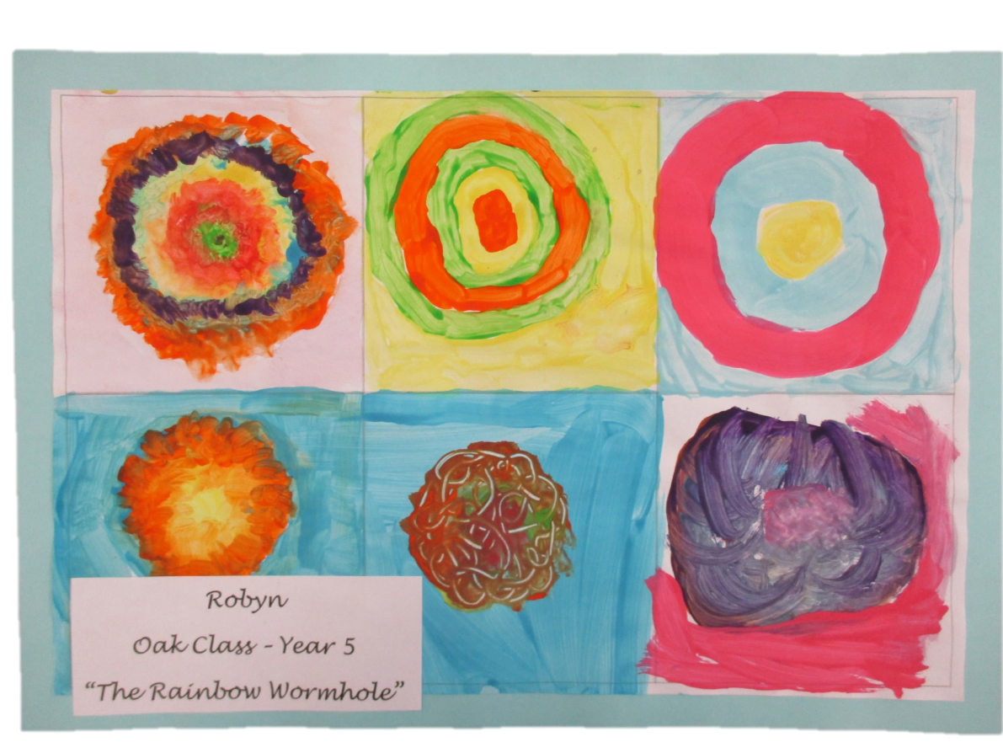

Slide 3
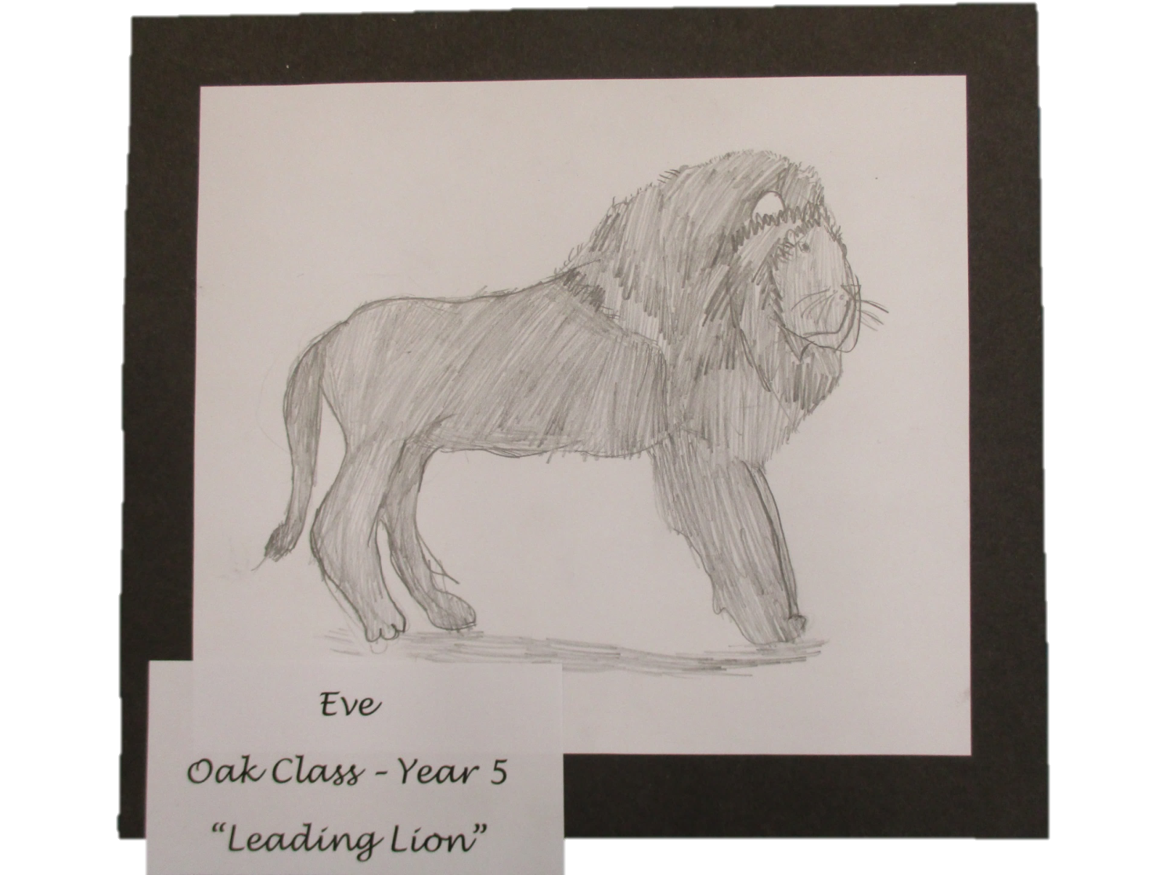

Slide 4
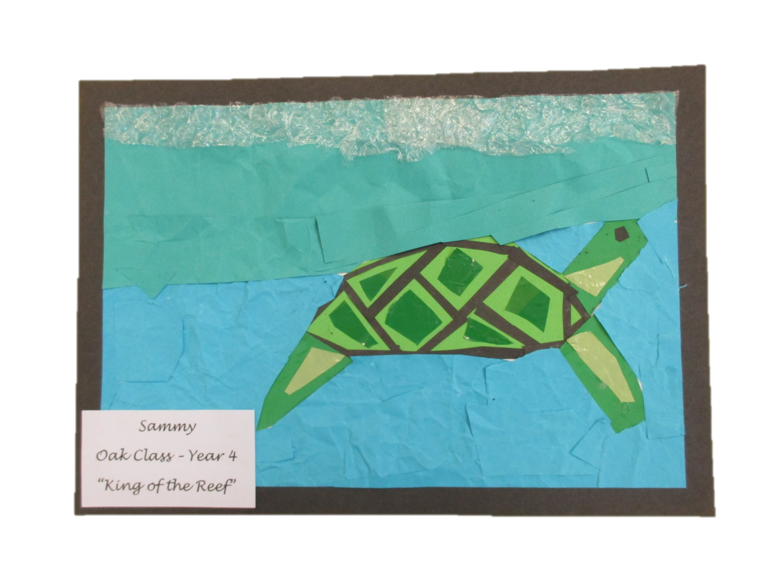

Slide 5
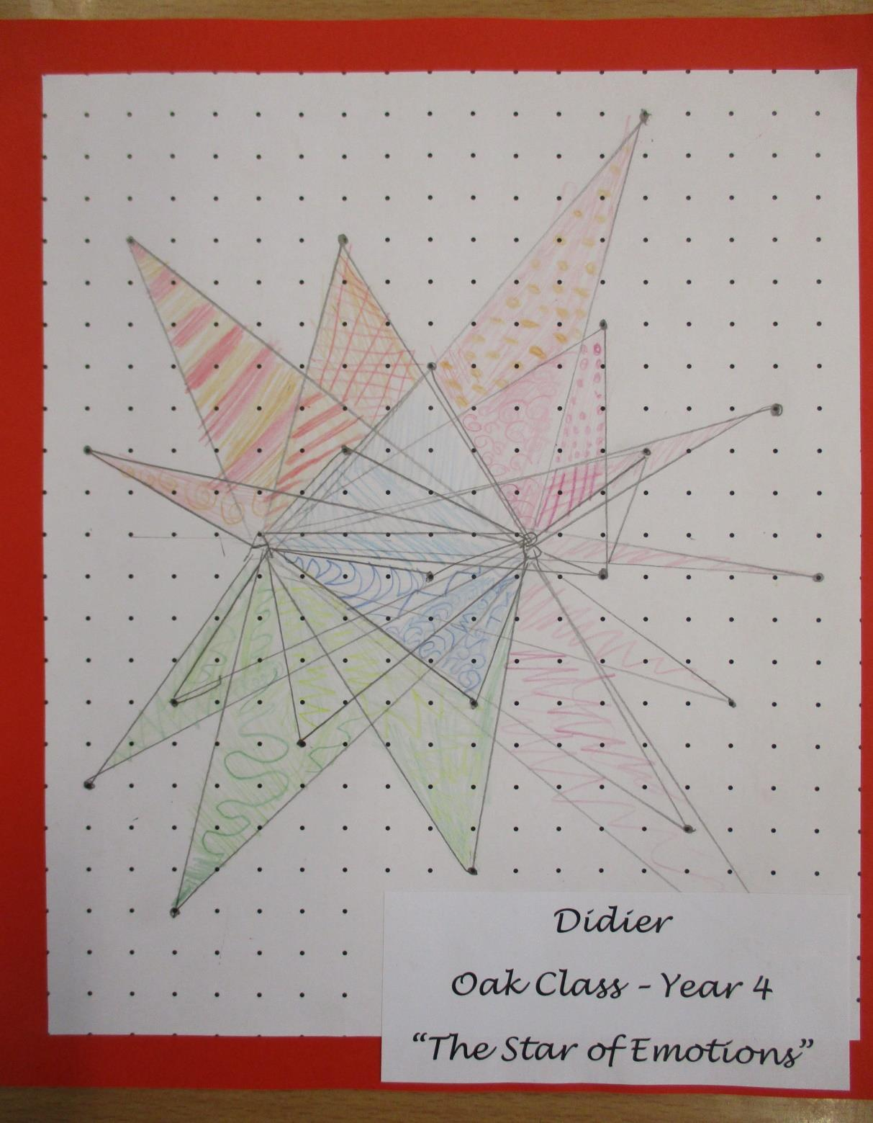

Slide 6
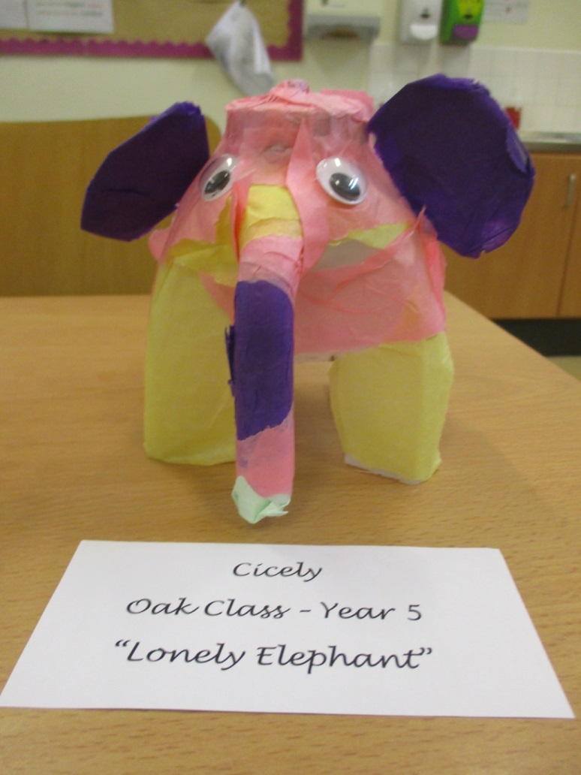

Slide 7
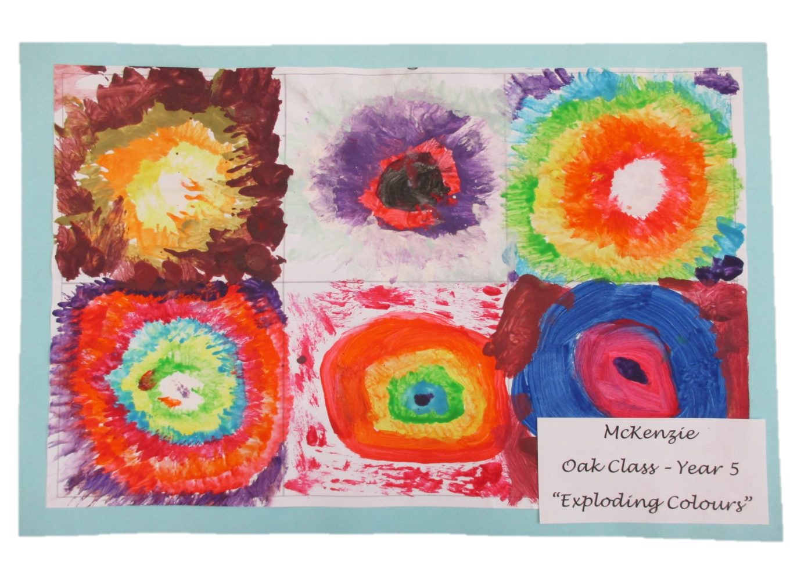

Slide 8
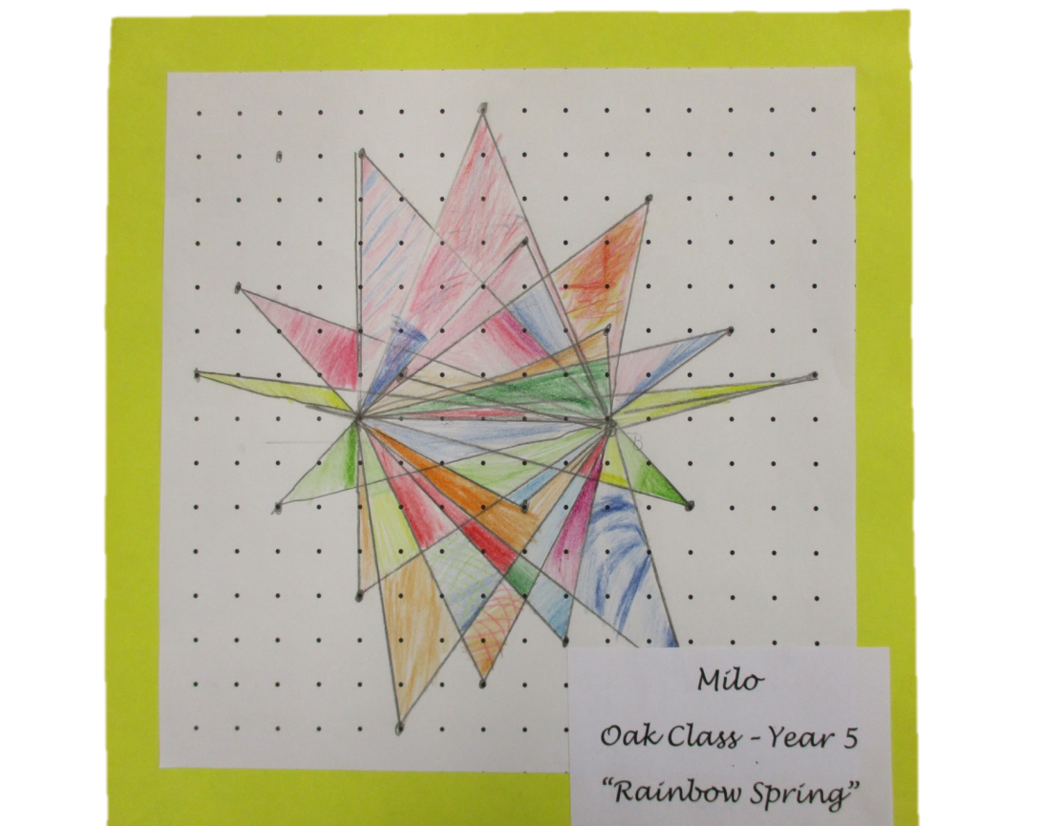

Slide 9
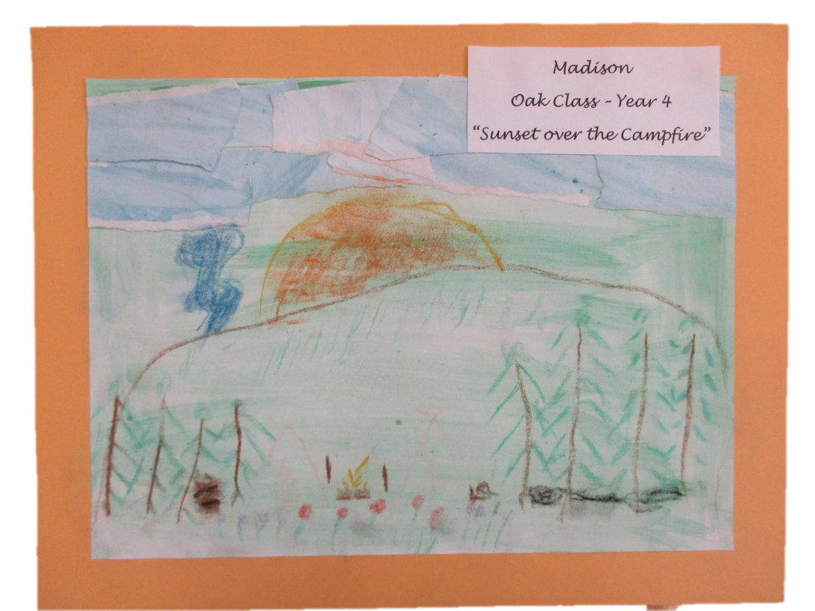

Slide 10
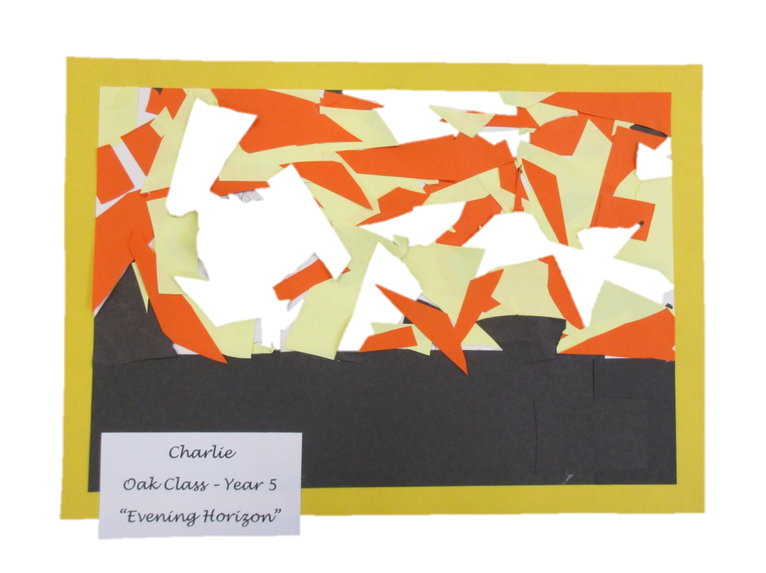

Slide 11
Please watch part two to see more of our work.

