Slide 1
Welcome to the Woodpeckers’ art
Enjoy some of the fabulous art we have created this year. We used mod roc to have a go at creating our own sea animal sculptures, designed willow pattern plates and drew lighthouse scenes.

Slide 2
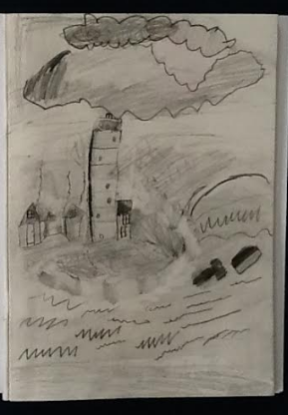
Kai- Robert year 2 – a lighthouse scene

Slide 3
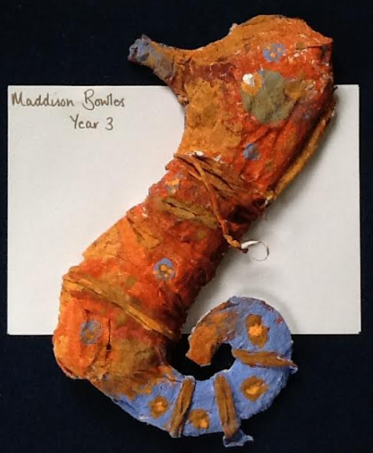
Maddison year 3- a sea animal sculpture

Slide 4
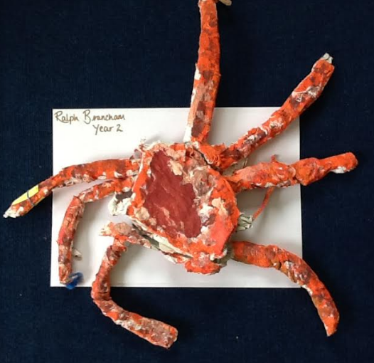
Ralph Year 2 – deep sea animal sculpture

Slide 5
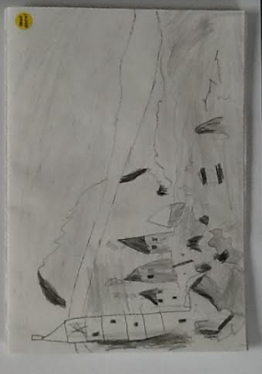
Annabelle Year 2 – a lighthouse scene sketch

Slide 6
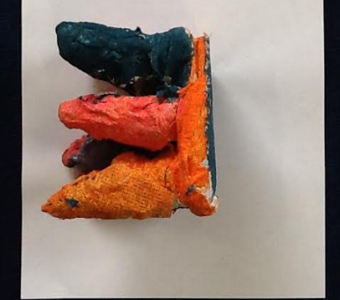
Abi Year 2 – deep sea animal sculpture

Slide 7
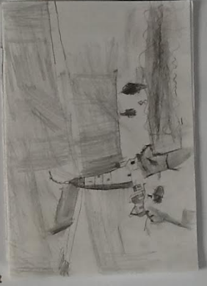
Olivia Year 2 – a lighthouse scene sketch

Slide 8
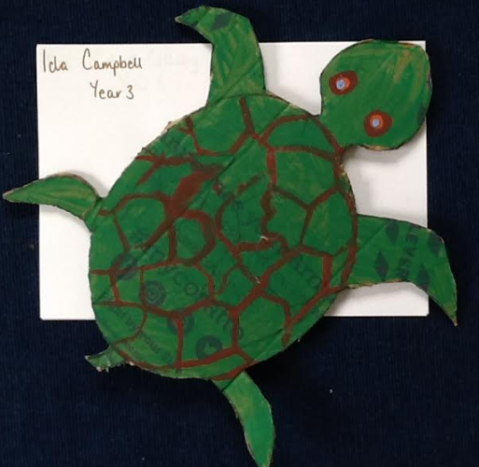
Ida Year 3 – turtle

Slide 9
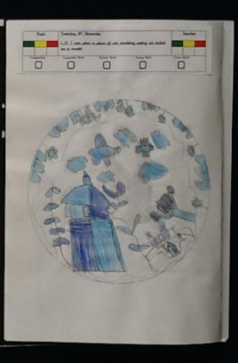
Ronnie Year 3 – A willow pattern plate design

Slide 10
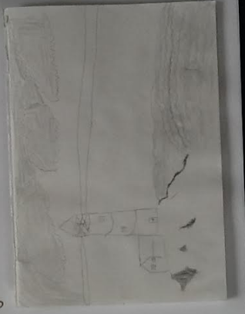
Billy year 3 – a lighthouse scene sketch

Slide 11
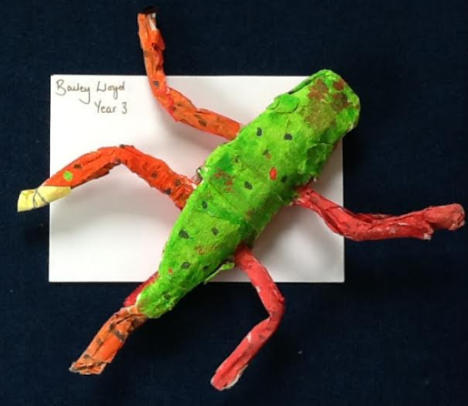
Bailey Year 3 – lizard sculpture

Slide 12
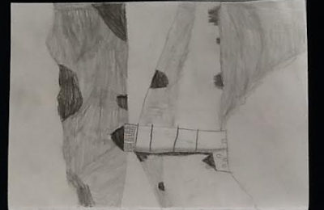
Joel Year 2 – a lighthouse scene sketch

Slide 13
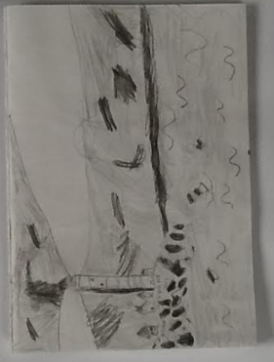
Bella Year 2 - a lighthouse scene sketch

Slide 14
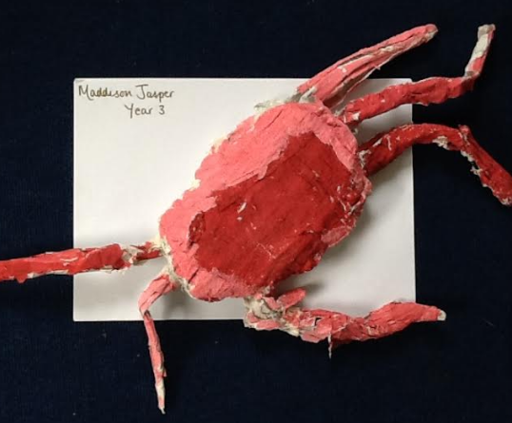
Maddy Year 3- a sea animal sculpture

Slide 15
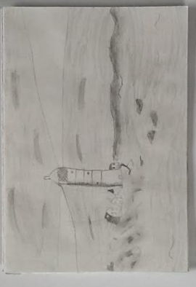
Layla Year 3 – a lighthouse scene sketch

Slide 16
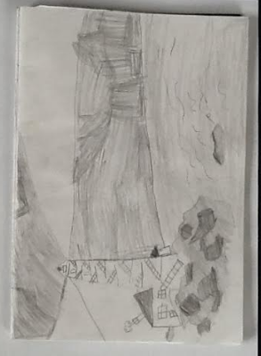
Declan year 3 – a lighthouse scene sketch

Slide 17
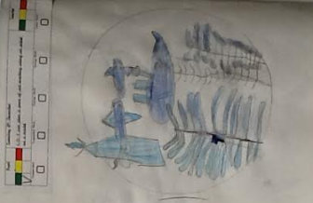
Ella R- Year 2 – a willow pattern design

