Slide 1

Writing a setting description
Today, you are going to be using your map to write a setting description based upon your map that you created yesterday.
You will need to use good description:
Expanded noun phrases
Similes
Metaphor
Include the senses (see, hear, smell, feel etc.)

Slide 2
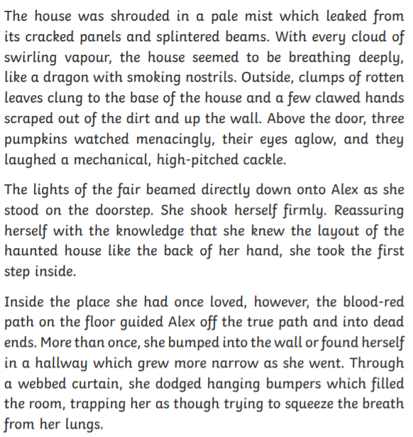
Have a look at this setting description.
What is good about it?

Slide 3
Did you notice?
Paragraphs
Descriptive vocabulary (adjectives, similes, adverbs, verbs)
Different sentence starters (e.g. fronted adverbials)

Slide 4
Mission: Write a description of one or more of the settings from your map.
Use well-chosen adjectives to add detail for your reader – remember not to use too many!
Task 2: Setting Description
Before you write:
What will the reader infer from your language choices?
What clues could you give as to who might live there?
Consider the five senses.

Slide 5
Task 2: Setting Description
Planning your write:
Think of the good features of a setting description (adjectives/expanded noun phrases, similes, metaphors, using the senses).
Add key vocabulary to your map to describe the setting, including ideas about the climate, sights, sounds and smells, as well as where it is located in comparison to other settings. (Try to use the best vocabulary you can).
Discuss different ideas about your setting description with a friend or adult and use this to help you to edit and develop the language on your map.
Say out loud what you are going to write before you commit it to paper.

Slide 6

Task 2: Setting Description
After you have written:
Read your description aloud to yourself and then a second time to a partner (if you are remote learning, this could be someone you live with or a friend on the telephone). Is it engaging and does it leave the reader wanting to find out more?
Read the whole text through. Does it flow? Does it feel like one piece of writing? If not, what could you add or move to make it feel like one piece of writing?
Look carefully at the different types of punctuation in your writing. Is it placed and used accurately?
Notice the language features/ literary devices you have used. What impact do they have on the reader?
Identify the key language in your writing. Have you chosen precise words to build an accurate picture and engage the reader?

