Slide 1
The Baptism of Jesus
Look at the following images of the baptism of Jesus.
Talk about what you see.
What do you like about each picture?
How is the Holy Spirit represented?
Who do you think the people are?

Slide 2
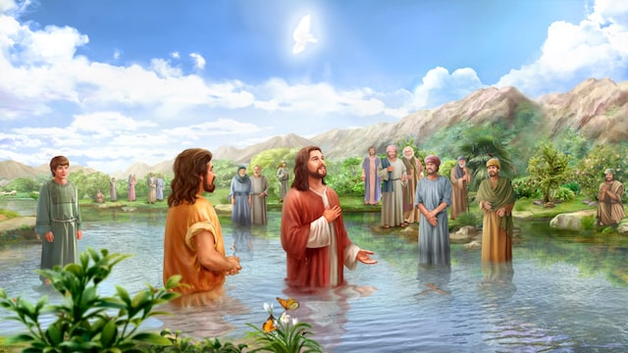

Slide 3
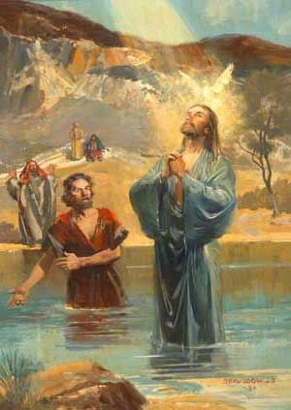

Slide 4
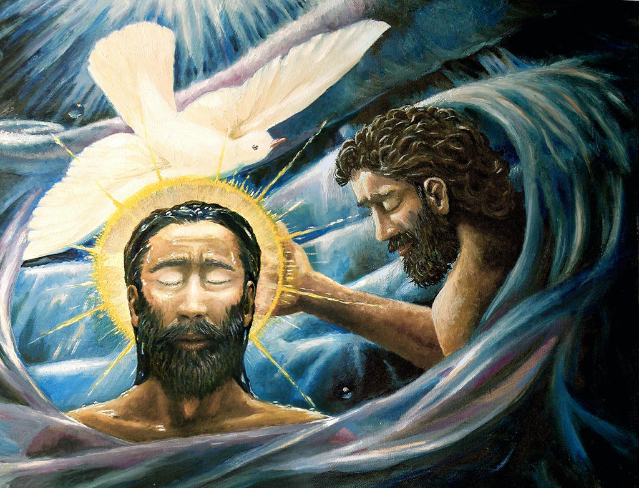

Slide 5
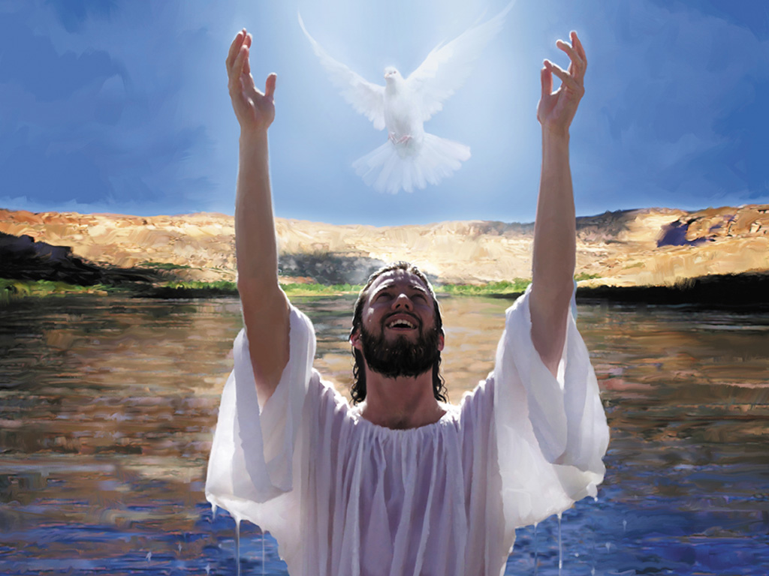

Slide 6


