Slide 1
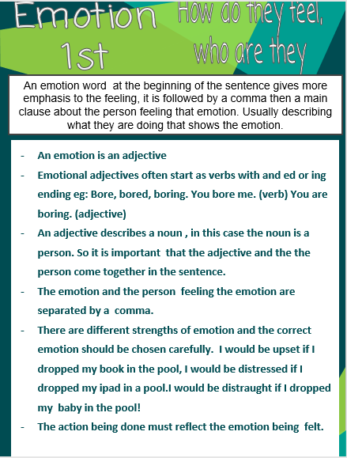

Slide 2
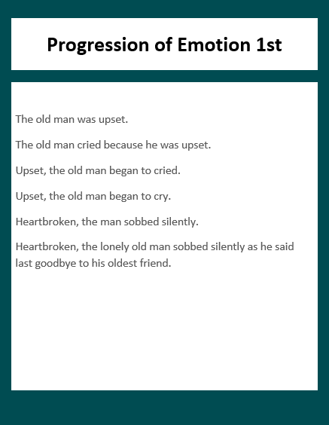

Slide 3
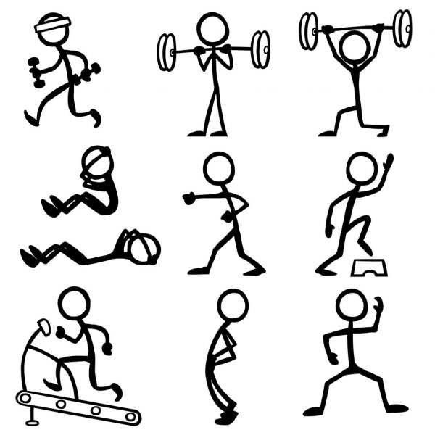
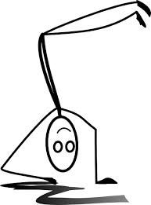
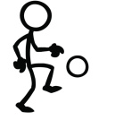

Pick 3 images and write an emotion first sentence about what the stick men are doing and how they feel about it.
For example: Dizzy, the man had been standing on his head for hours.

