Slide 1
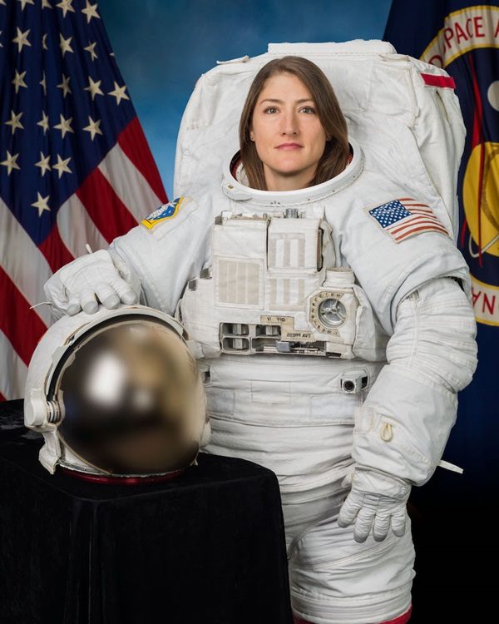
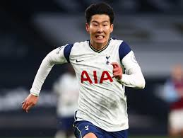
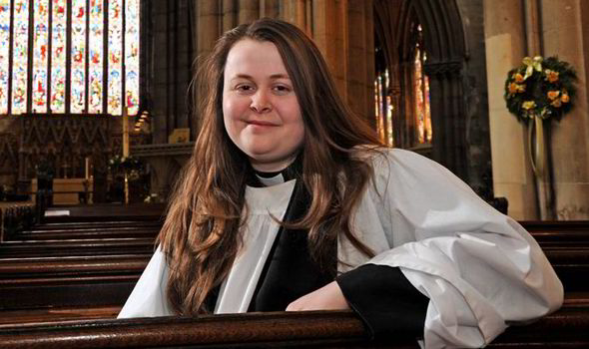
When I am older I want to be …

Slide 2
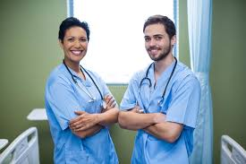
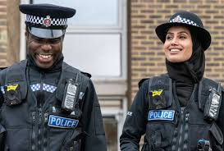
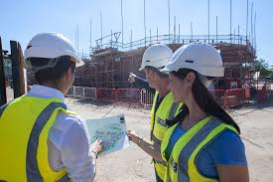
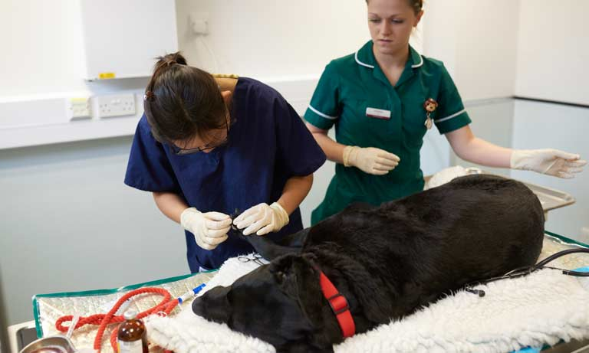
or maybe …

Slide 3
Have you ever thought about all the different jobs there are? Think about the people you know – what jobs do they do?
Have you ever thought about what you would like to be when you are older?
Please write your idea or ideas down. You might like to illustrate your idea/ideas too?
When I am older I would like to be …

Slide 4
This week we are going to be writing letters to a policeman who has had to be brave and go to many emergencies; someone who has worked all over the world in football (Mrs Neary’s husband) and a vet.
We will be sending our letters to them and hopefully they will answer our questions.
Please have a look at the letter that has been written and sent to an engineer and the response they have received!

Slide 5
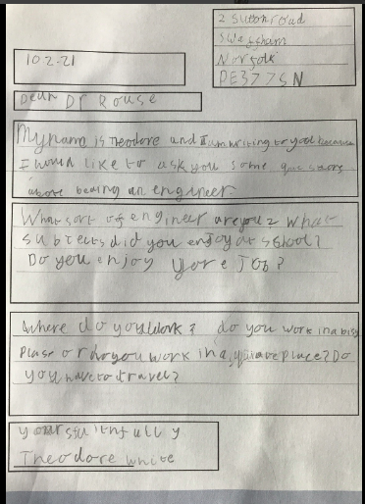

Slide 6


