Slide 1
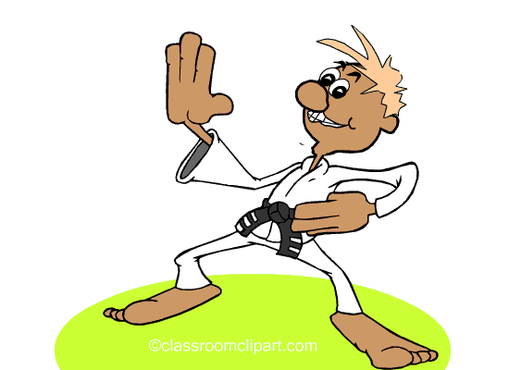
Investigate: How does exercise effect our heart rate?

Slide 2
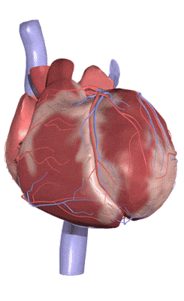
Our heart rate is the number of times our heart beats per minute. We need to discover what happens to our hearts when we exercise.

Slide 3
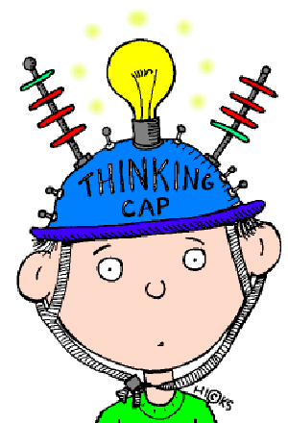
How can we do this?

Slide 4
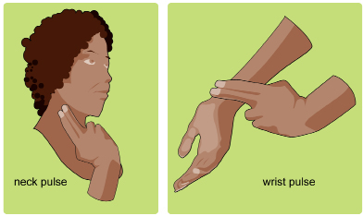
We’ll need to record our heart beats. How can we do this?
Listen to our heart beating in our chest
Listen to our pulse in our wrist
Listen to our pulse in our neck

Slide 5
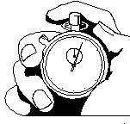
We’ll need to count our heart beats before, during and after exercise.
We’ll need to time our heart/pulse rate to make sure we’re accurate for 1 minute.

Slide 6
I wonder if I can predict what will happen to my heart rate?

Slide 7
It’s always good to predict – what do you think will happen to your heart with exercise? Record your predictions then you can see if you were right after your investigation!

Slide 8
After recording your findings in a table answer the questions on the sheet.
What happens to our heart rate with exercise? What happens when we rest? What happens to our bodies? Why does this happen?

