Slide 2


Direct Speech
When a text uses direct speech, some specific punctuation is required to separate what is said from the rest of the text; this enables the reader to follow what is going on.

Slide 3
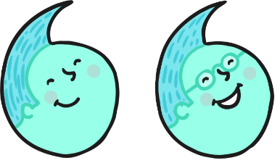

Inverted Commas
The most important rule in punctuating direct speech is that all words spoken must be enclosed by inverted commas.
In British English, a single inverted comma may be used:
‘Get off my bridge.’
However a double inverted comma may also be used:
“Get off my bridge.”
Whichever style you choose, use it consistently across a text.

Slide 4

Punctuation Inside
Inverted Commas
All commas, full stops, question marks and exclamation marks must also be enclosed by inverted commas.
For example:
‘That grass looks delicious,’ said the smallest Billy Goat Gruff.
‘Hey, goat!’ shouted the troll. ‘You are not allowed to cross my bridge.’
‘How can we get to the other side?’ asked the Biggest Goat Gruff.
NOT: ‘Get off my bridge ’ ! shouted the troll.

Slide 5
Commas
Commas are another important tool to help the reader separate direct speech from the rest of the text.
Where direct speech precedes a verb, and does not end in a question mark or exclamation mark, a comma must be used.
For example:
‘We need to get to the other side,’ moaned the goats.
‘Those goats are always disturbing my sleep,’ muttered the troll.

Slide 6
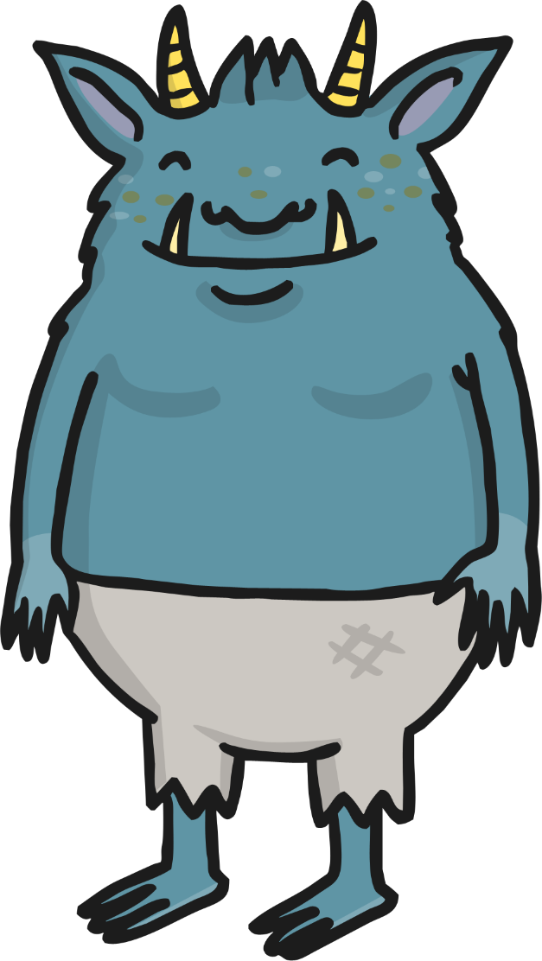
Commas
Where the direct speech before a verb ends in a question mark or exclamation mark however, this punctuation replaces the comma.
For example:
‘Who goes there ?’ shouted the troll.
NOT:
‘Who goes there ?,’ shouted the troll.

Slide 7

Commas
Where the direct speech follows a verb, a comma must be used after the verb to indicate that direct speech is about to begin.
Note: in this context, the direct speech must always begin with a capital letter.
For example:
The smallest Billy Goat Gruff said, ‘I’ll go first.’
The Troll shouted, ‘Who goes there?’
The biggest Billy Goat Gruff shouted, ‘Oh no you won’t!’

Slide 8



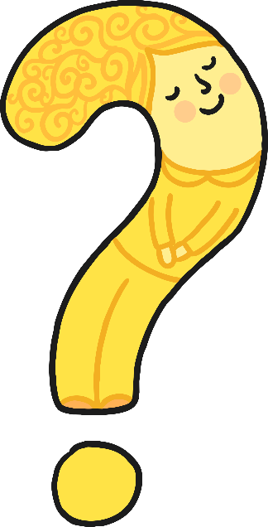

Punctuation Inside
Inverted Commas
In addition, where the direct speech follows the verb, a full stop, exclamation mark or question mark must be used inside the inverted commas to signal the end of the speech.
For example:
The smallest Billy Goat Gruff said, ‘I’ll go first.’
The Troll shouted, ‘Who goes there?’
The biggest goat shouted, ‘Oh no you won’t!’

Slide 9
Punctuating ‘Split’
Direct Speech
If the direct speech is one sentence broken up by information about who is speaking, you need a comma (or a question mark or exclamation mark) to end the first piece of speech and another comma before the concluding part of the sentence (before the inverted comma or commas).
For example:
‘I’m light and quiet,’ said the smallest Billy Goat Gruff, ‘so I’ll go first.’
In this context, use a lower case letter to start the second part of the direct speech.

Slide 10


Punctuating ‘Split’
Direct Speech
If the direct speech is two discrete sentences separated by information about who is speaking, you need a comma (or a question mark or exclamation mark) to end the first piece of speech and full stop after the information about the speaker. The second sentence then begins with a capital letter.
For example:
‘You’re right,’ agreed the Biggest Billy Goat Gruff. ‘We can’t let the Troll beat us.’

Slide 11
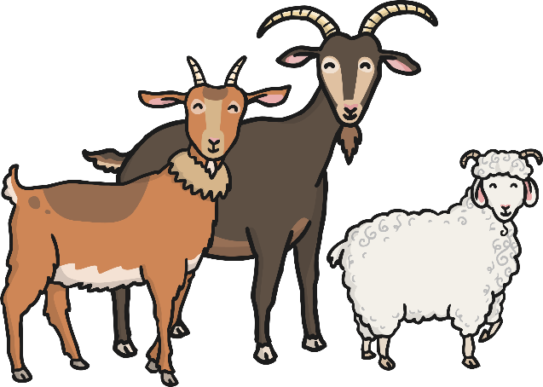
New Speaker, New Line
If the direct speech in a text involves more than one speaker, a new line must be used for each new speaker. This helps the reader to follow what is being said.
For example:
‘We can’t let him win! He’s just a grumpy troll!’ said the smallest Billy Goat Gruff.
‘You’re right,’ agreed the biggest Billy Goat Gruff.
The medium-sized Billy Goat Gruff said, ‘So what shall we do?’

Slide 12

Reporting Clauses
Reporting clauses tell us who is speaking, or who said what. Reporting clauses can be found in both reported speech and direct speech.
For example:
The troll said the goats should get off his bridge. (reported speech)
‘Who goes there?’ shouted the Troll. (direct Speech)
‘That grass looks so green and delicious,’ bleated the Smallest Billy Goat Gruff. (direct speech)

Slide 13
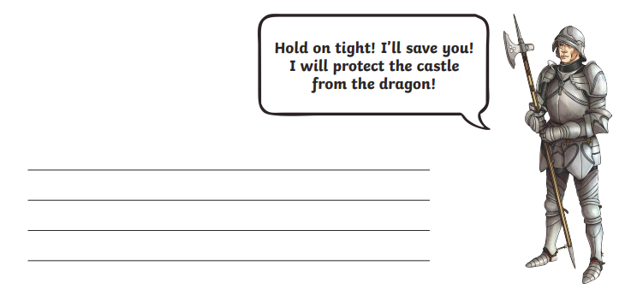

Slide 14
“Hold on tight!” bellowed the Knight as he clutched at his spear. “I’ll save you! I will protect the castle from the dragon!”

