Slide 1
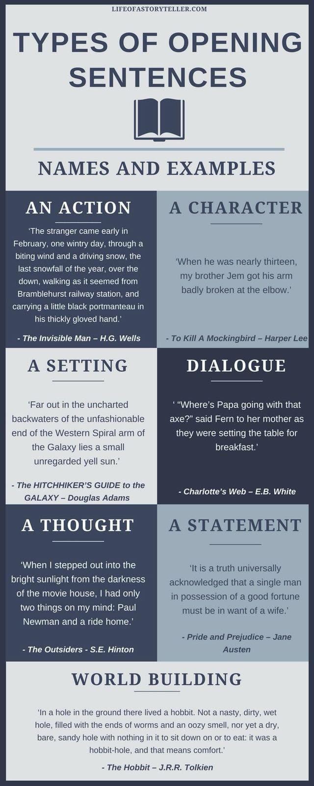

Slide 4
Read through those examples again.
Which story opening is your favourite? Why?
Your task:
Pick one of the just-so stories. Re-write the opening with your chosen story opener.
Miss George’s example for a dialogue opening:
“Oh my, elephant. Your trunk is humongous!” jeered the cheeky monkey as he swung from the vines. “But why is it so gigantic?”
“My dearest monkey,” replied the elephant, “sit still and I will tell you.”
Miss George’s example for a setting opening:
The vast, majestic trees towered above everything in sight while the sun stretched across the sky. Emerald green leaves swayed gently to the rhythm of the wind. There, in amongst the magnificent forest, stood an elephant.

