Slide 1
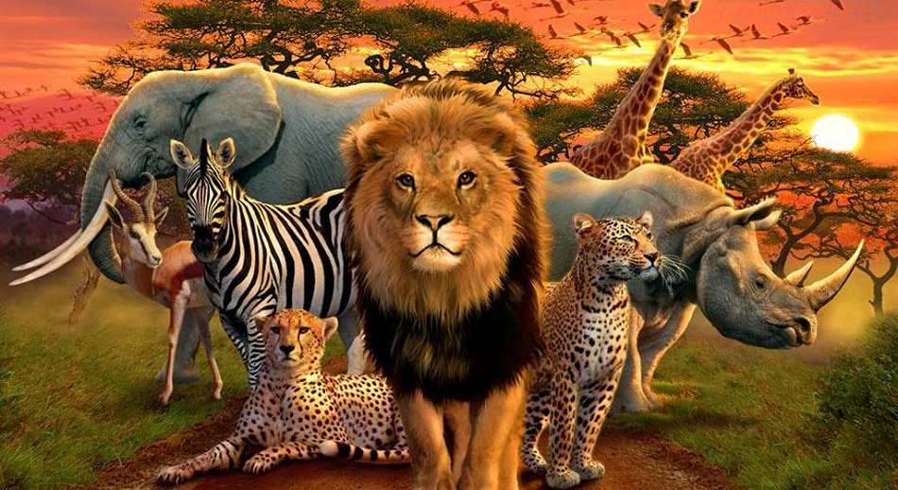
Animals!

Slide 2
Over the next two days we are going to be thinking about animals! There is a competition that you can take part in and we would like you to put your completed art work up in your window or out in your garden if practical!
https://firstsite.uk/the-great-big-art-exhibition-gallery/

Slide 3
There is an interview with Sir Antony Gormley which also has details about the competition in it.
https://www.thesun.co.uk/news13882889/antony-gormley-great-big-art-exhibition/
Parents/carers at home can enter your art work.

Slide 4
Which animal do you think you will choose to create? You might like to create it in different ways – you might draw and colour or paint and make a 3D model of them too?
You might like to listen to a story while you think.
The Magic Bonjabi Tree
https://www.youtube.com/watch?v=nIFOQanZAOg
Do you think you might choose an African animal, a domestic pet, a tiger or …

Slide 5
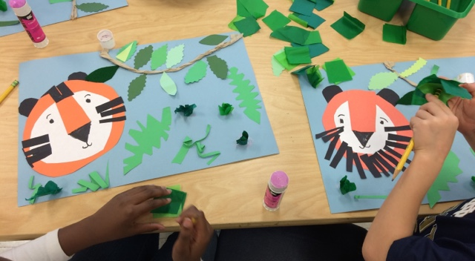
Here are some ideas …

Slide 6
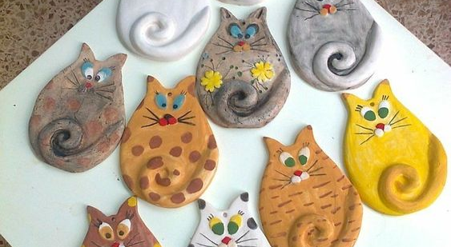

Slide 7
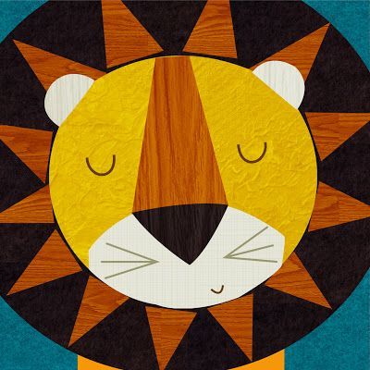

Slide 8
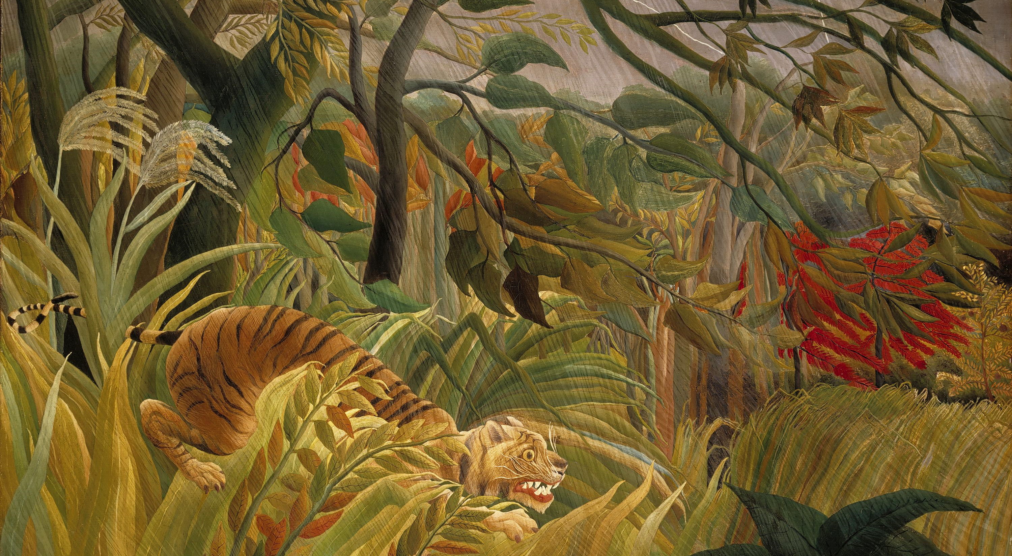

Slide 9
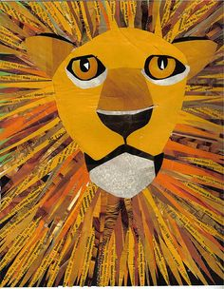

Slide 10
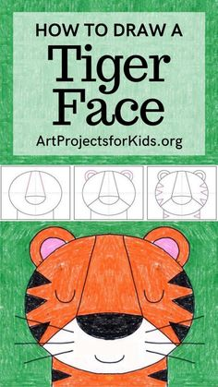

Slide 11
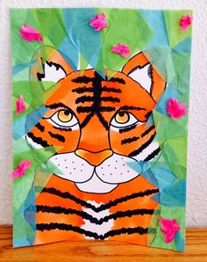

Slide 12
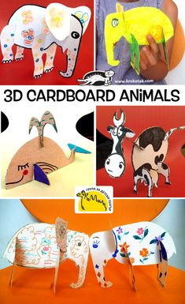

Slide 13
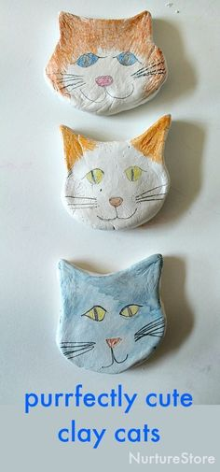

Slide 14
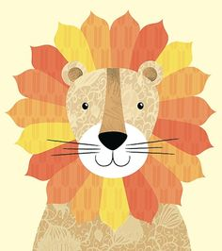

Slide 15
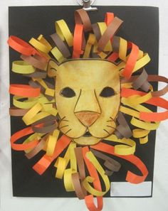

Slide 16
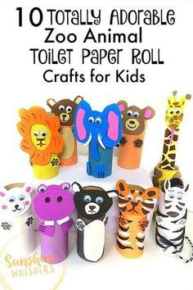

Slide 17
You are going to start by thinking of an animal. On the planning sheet – sketch what you think your animal might look like. You will need to list all the equipment you need to make your animal. Have a look in some books or online for images of the animal you have chosen then …
Have fun and we would love to see all your finished creations.

