Slide 1

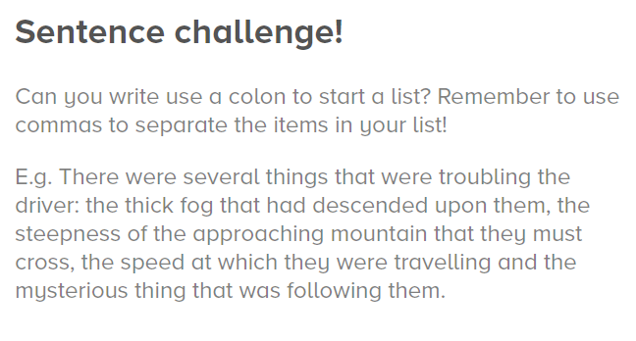
Using a colon to start a list

