Slide 1


LO: To examine the features of a formal letter and create our own questions.

Slide 2
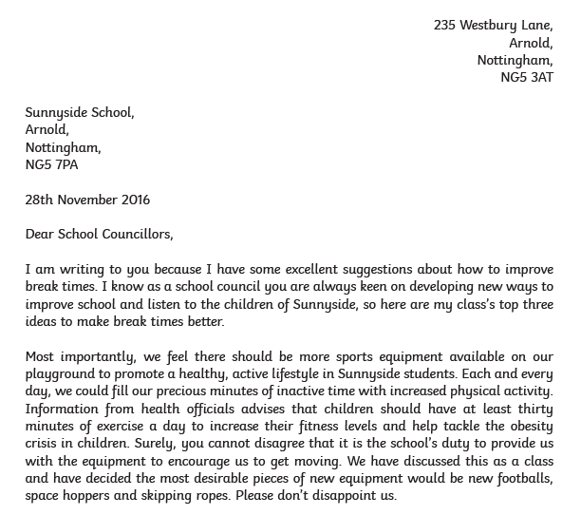

Slide 3
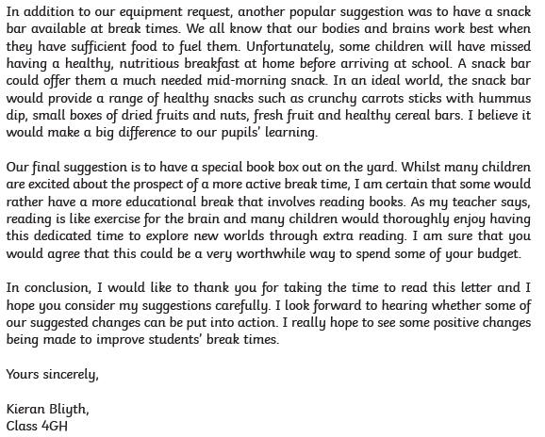

Slide 4
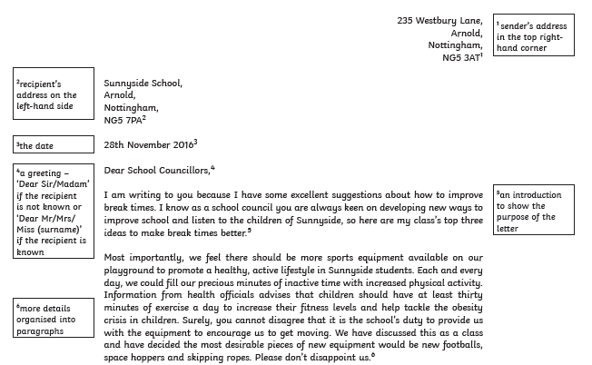

Slide 5
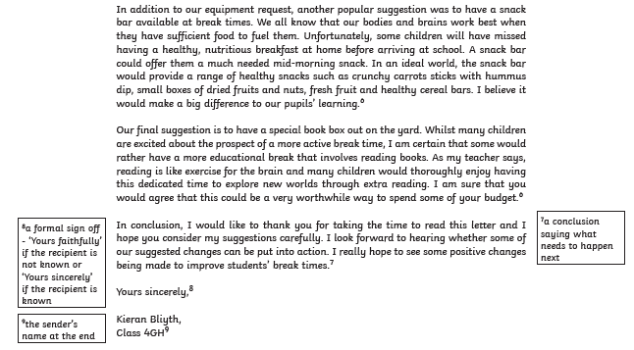

Slide 6
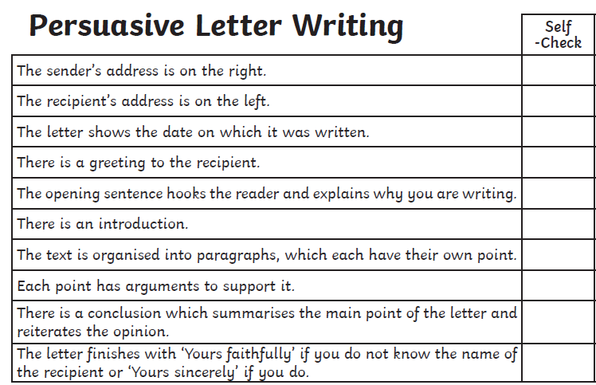


Slide 7
Questions
How did you end up with your job?
What skills do you need?
What inspired you to become ____ ?
What is your favourite thing about being ______ ?

