Slide 1

Non-Chronological Reports
Structure
Title
Introduction
Paragraphs
Subheadings
Conclusion (interesting fact)
Picture/diagram with a caption
Language features
Present tense
Technical (scientific) vocabulary
Third person
Descriptive, factual language
Vary sentence starters

Slide 2
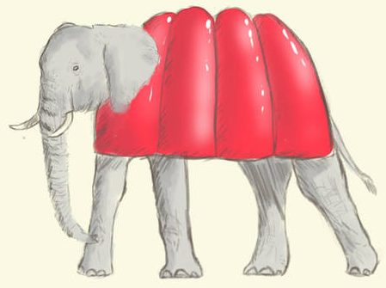
The Jellyphant
For many years, little has been known about these fascinating creatures as they are extremely shy and timid. With many animals wanting to feast on their jelly bodies, the majestic jellyphants have mastered the art of jelly camouflage and are able to reach unstoppable running speeds for means of escape. Thanks to more and more conservation areas being set up, we are now able to explore these magnificent creatures.
With its long, stretched legs, the jellyphant is able to run up to incredible speeds of 150 mph!
Body
The jellyphant, famed for its wibbly, wobbly body, is the largest foodimal of all. With legs that stretch taller than the Eiffel Tower, it is also the quickest foodimal. Its tusks, almost as heavy as a car, are made entirely of bananas, which the jellyphant will snack on throughout the day. Rather interestingly, overnight the jellyphant will grow new banana tusks ready for snacking on the next day. Due to its body being completely made of jelly, the jellyphant cannot live in the water. If it spends more than five minutes fully submerged, the jelly will start to melt away.

Slide 3
Habitat & Diet
The jellyphant can rarely be spotted in its natural habitat; the jungle. Despite its size, it is remarkably great at hiding. The jungle’s temperate conditions are not ideal for a jellyphant, so to find shelter from the rain (in order to avoid melting) the jellyphant’s ears stretch out to act like an umbrella. As well as banana tusks, the jellyphant enjoys feasting on pizza trees in the jungle.
Characteristics
Spotting a lone jellyphant in its natural habitat can be extremely difficult due to their shy and nervous character. They often travel in herds for protection and prefer to avoid all other creatures. Due to the average lifespan of a jellyphant being over a thousand years, they are extremely wise creatures and can speak over 12 different languages.
Did you know?
The longest banana tusk ever recorded was over 100m long!
Famous scientist, Charles Darwin, once managed to ride a jellyphant!
The largest ever jellyphant poo was bigger than the size of your house!

Slide 4


Look back at the plan you produced yesterday.
Do you have enough detail in each paragraph? (Remember a paragraph is not just one sentence. You will need to include detail about you foodimal).
Have you used some scientific vocabulary?

Slide 5
Non-Chronological Reports
What I am looking for (success criteria)
Structure
Title
Introduction
Paragraphs (each paragraph to describe a different characteristic of the foodimal)
Subheadings
Conclusion (interesting fact)
Picture of your foodimal with a caption
Language features
Present tense
Technical (scientific) vocabulary
Third person
Descriptive, factual language
Vary sentence starters
Subordinating and coordinating conjunctions
Punctuation: capital letters, full stops, commas
Challenge: can you use brackets for parenthesis?

