Slide 1

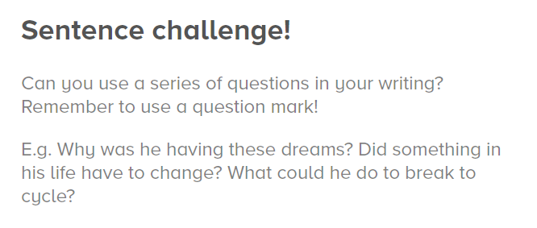
On Repeat
Use the picture for inspiration…
Please remember:
to check you punctuation carefully (your questions should start with a capital letter and end with a question mark)
To make sure your questions make sense

