Slide 1
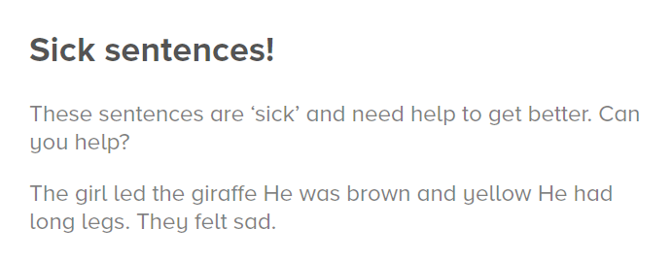

Hints:
Can you improve the vocabulary by using powerful adjectives, adverbs and verbs?
Can you vary the start of the sentences? (e.g. use fronted adverbials, conjunctions)

