Slide 1


Slide 2
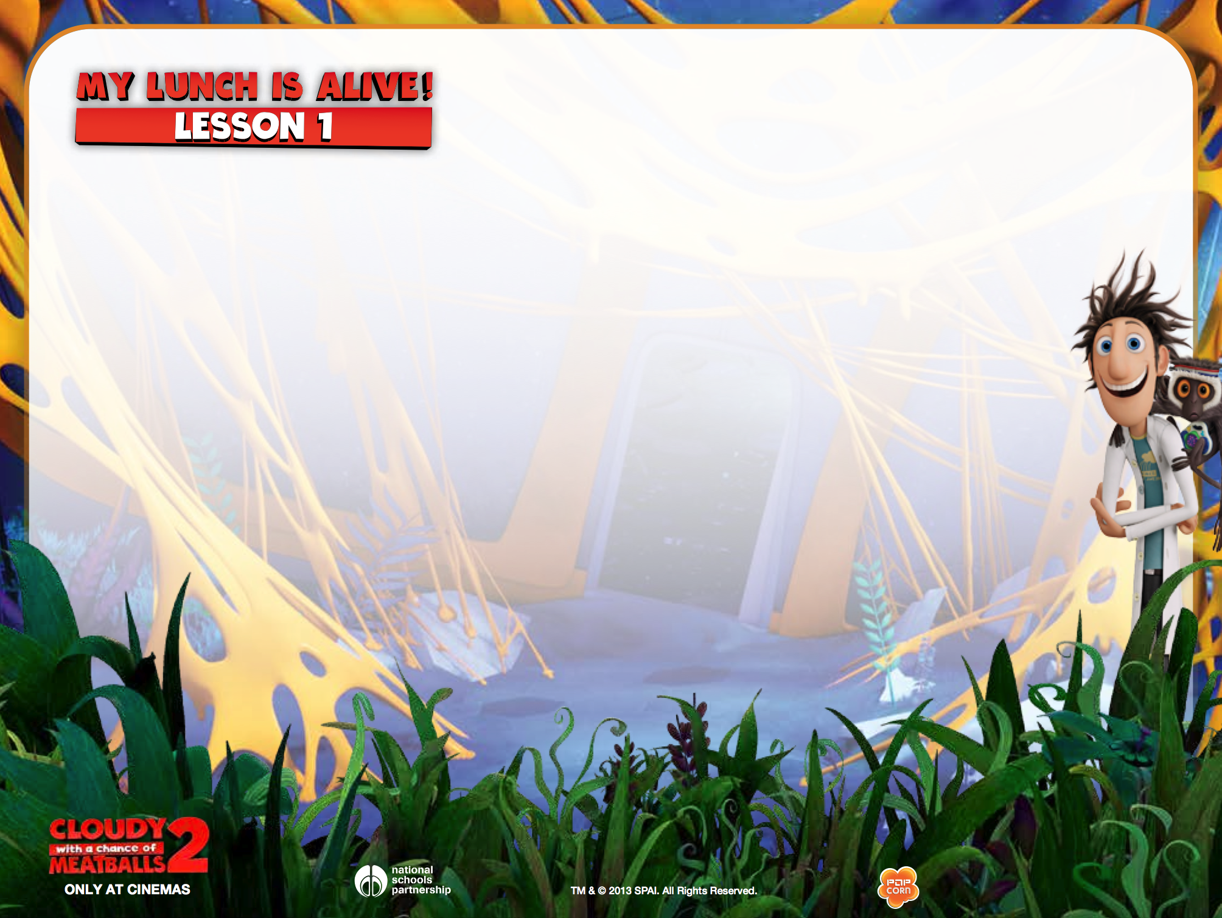


Slide 3
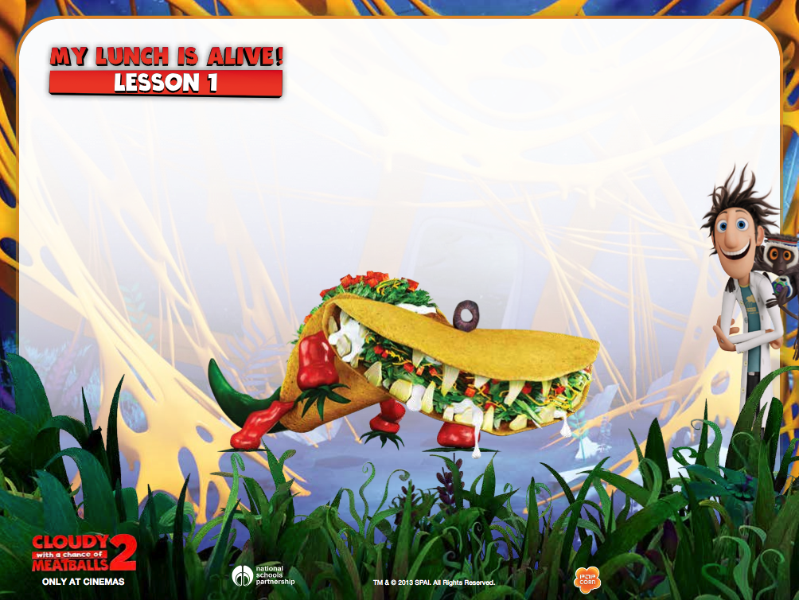
TACODILE - The Latin American
entrée turned river carnivore. Ole!

Slide 4
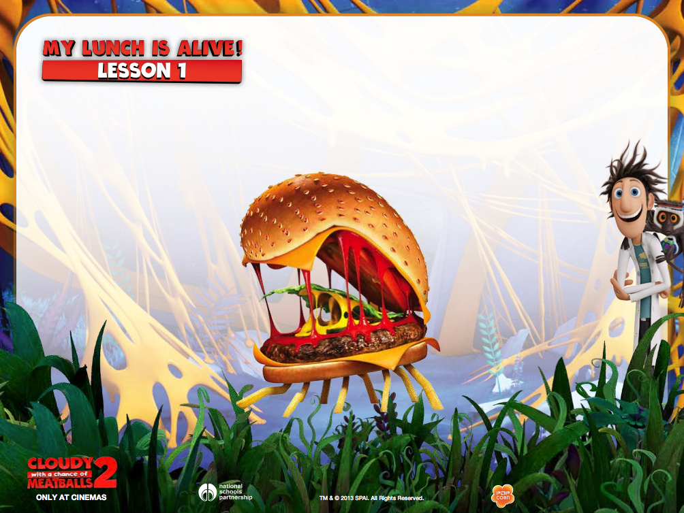
CHEESPIDER - A cheeseburger, turned into a French fry-legged spider – eek!

Slide 5
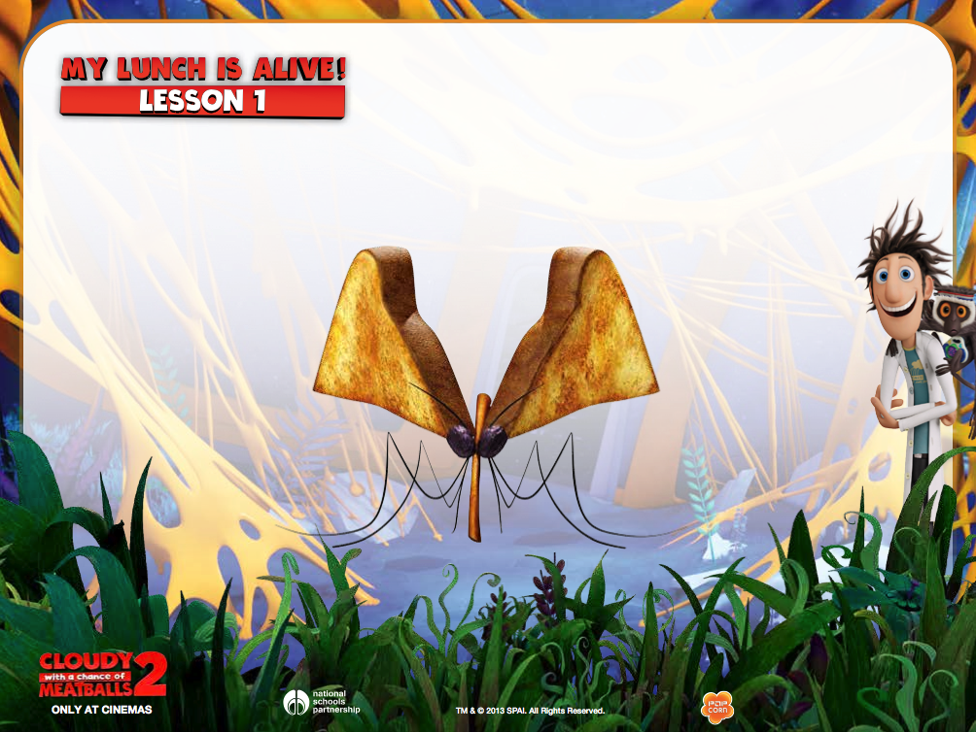
MOSQUITOAST - Browned bread slices with raisin eyes and cinnamon stick beak.

Slide 6
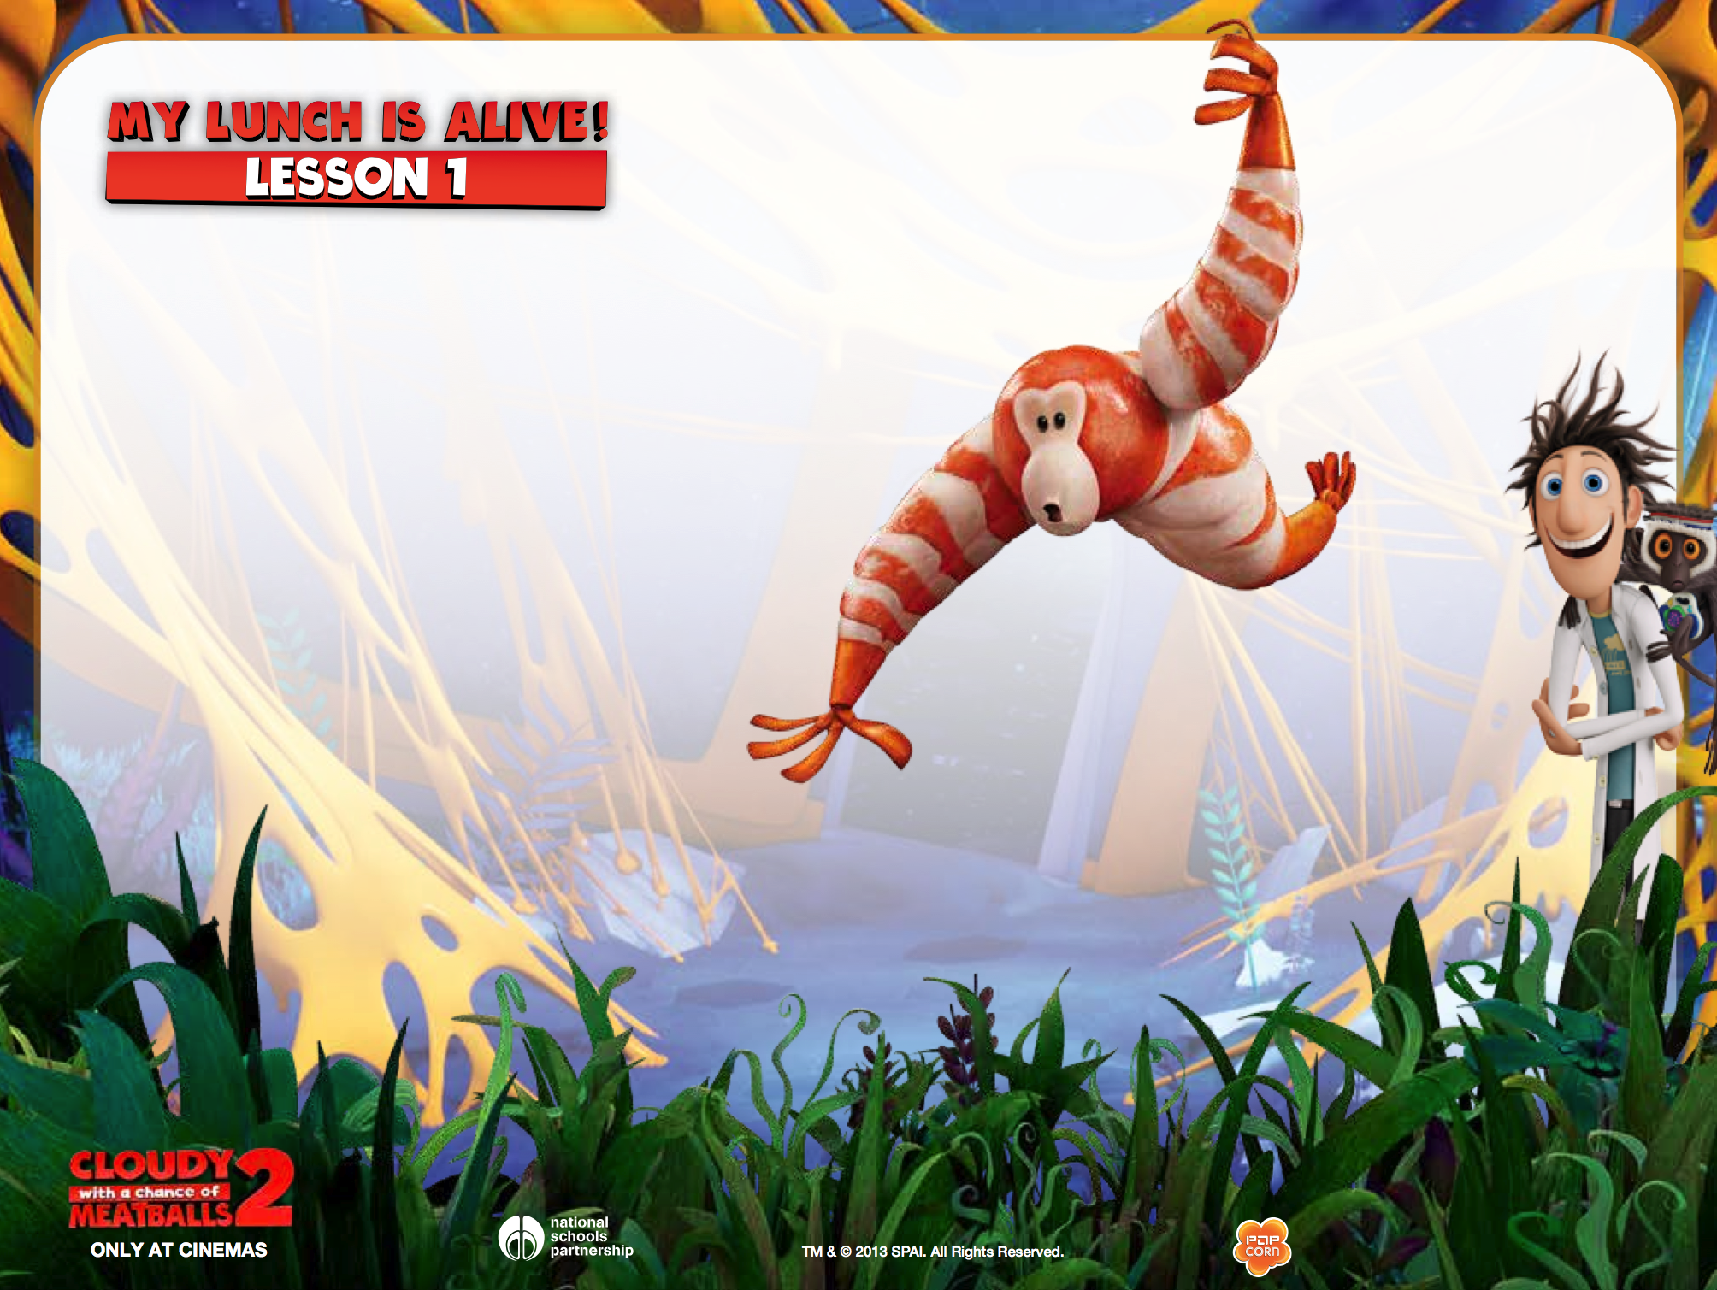
SHRIMPANZEE - Chimpanzees
with shrimp arms and body.

Slide 7
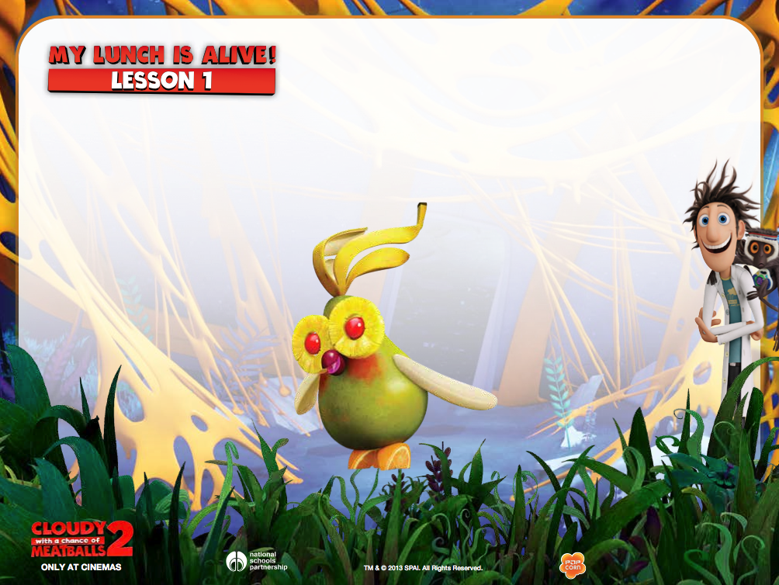
FRUIT COCKATIEL - An exotic bird with
pear body, pineapple-cherry eyes, and
banana peel feathers.

Slide 8
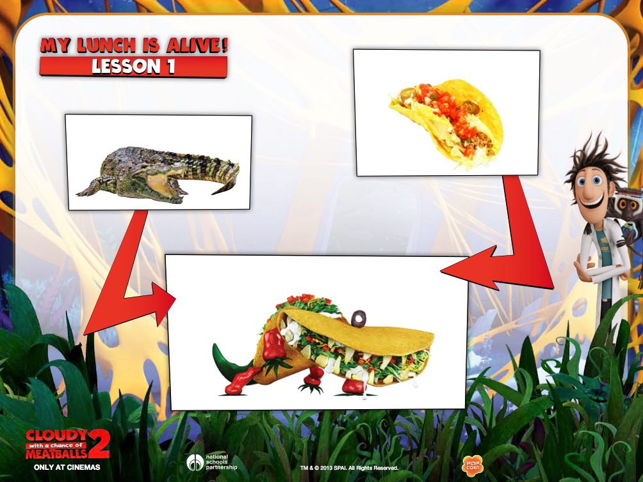
TACO
CROCODILE
TACODILE

Slide 9
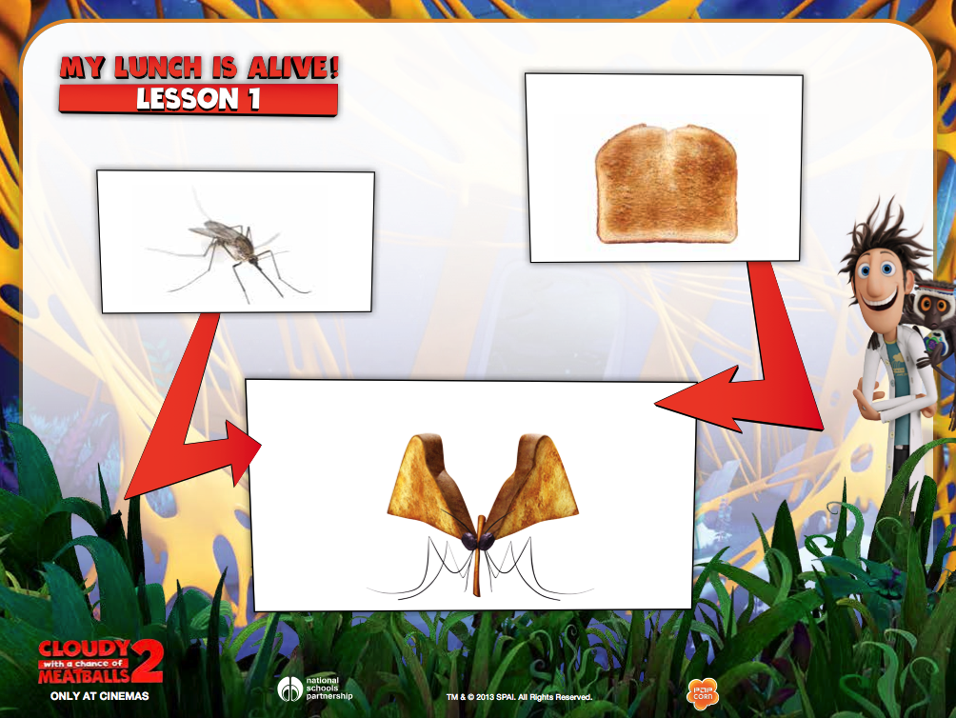
TOAST
MOSQUITO
MOSQUITOAST

Slide 10
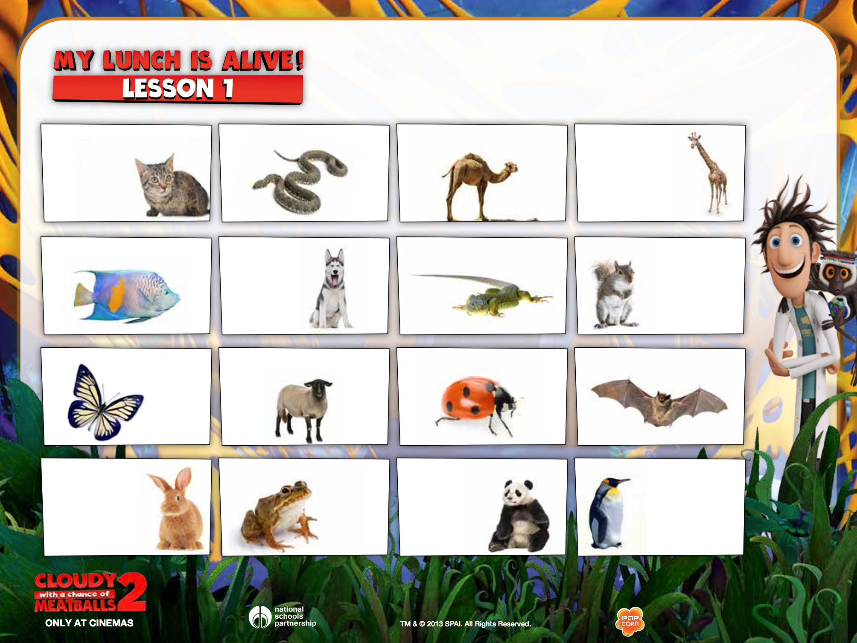
Cat
Snake
Camel
Giraffe
Fish
Dog
Lizard
Squirrel
Butterfly
Sheep
Ladybird
Bat
Rabbit
Frog
Panda
Penguin

Slide 11
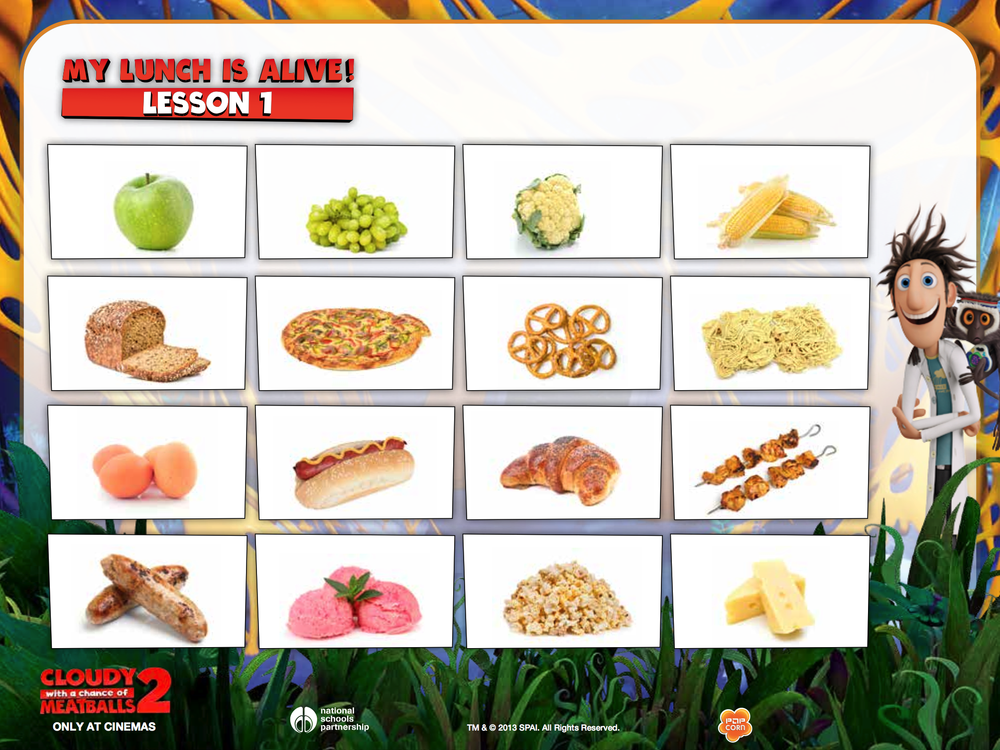
Apple
Grapes
Cauliflower
Sweetcorn
Bread
Pizza
Pretzel
Noodles
Egg
Hotdog
Croissant
Kebabs
Sausage
Ice cream
Popcorn
Cheese

