Slide 1
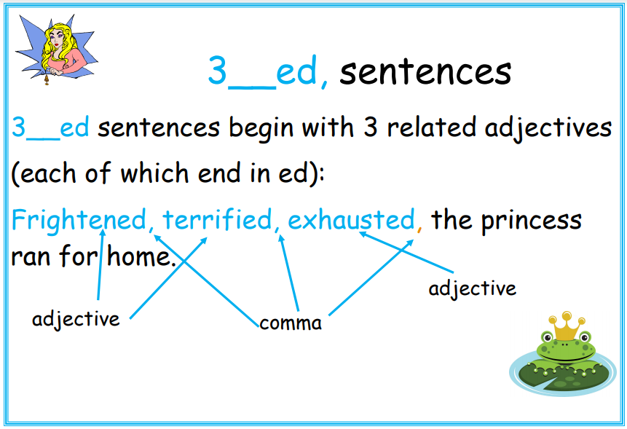

Slide 2
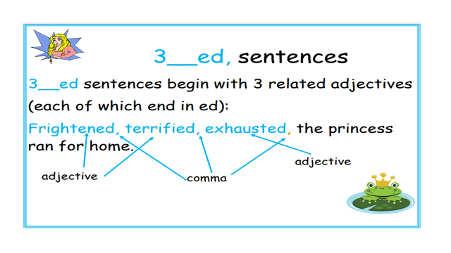
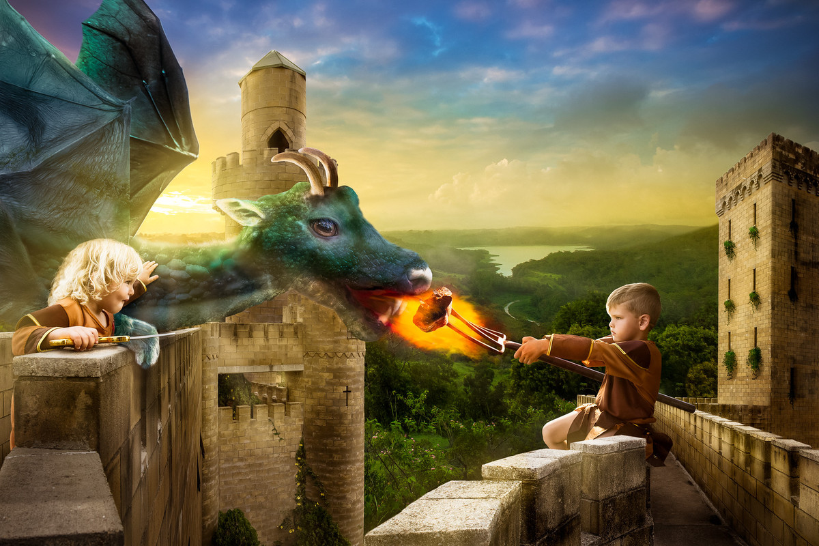
.
Can you write your own 3__ed sentences using the picture for inspiration?
Don’t forget to punctuate your sentence accurately.

Slide 3
‘ed’ adjectives examples
amazed amused bored comforted
Confused depressed disappointed disgusted
embarrassed excited fascinated frightened
frustrated horrified interested irritated
puzzled relaxed satisfied shocked
surprised terrified tired worried

