Slide 1
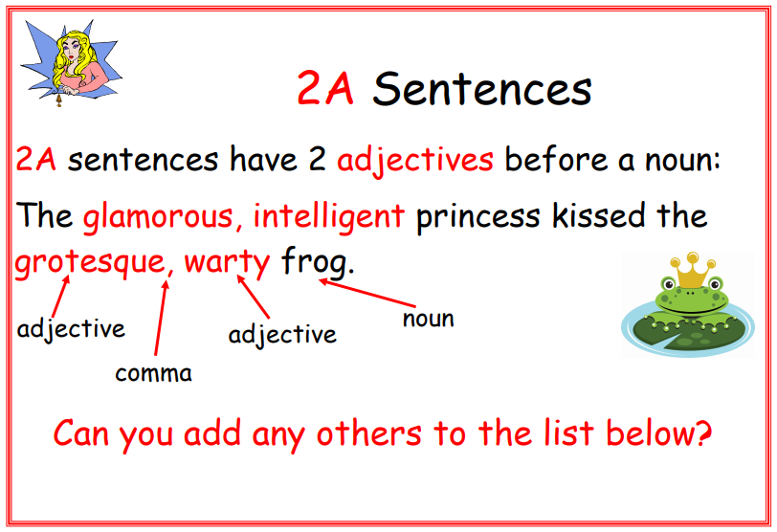

Slide 2
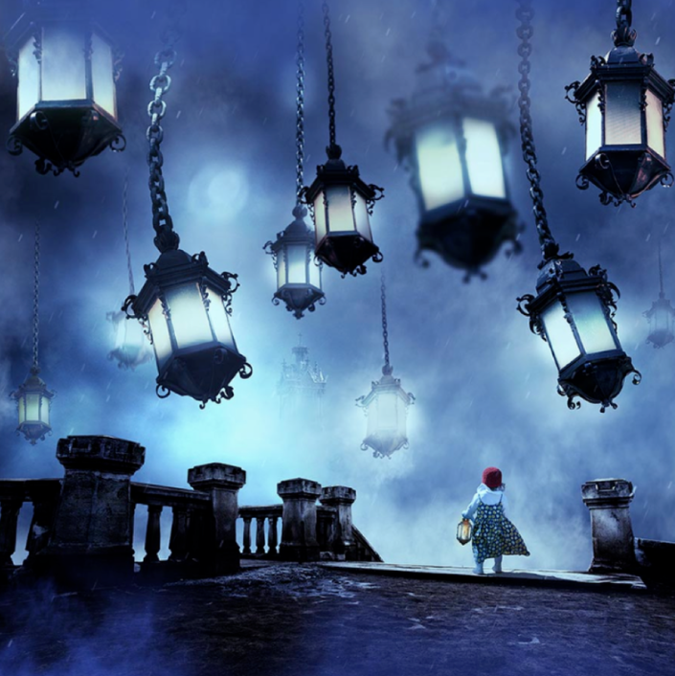
Surreal Dream
Look at this picture. Can you create your own 2A sentences using the picture for inspiration?
Why do you think this picture was given the title ‘Surreal Dream?’

