Slide 1
Edvard Munch
The Scream

Slide 2
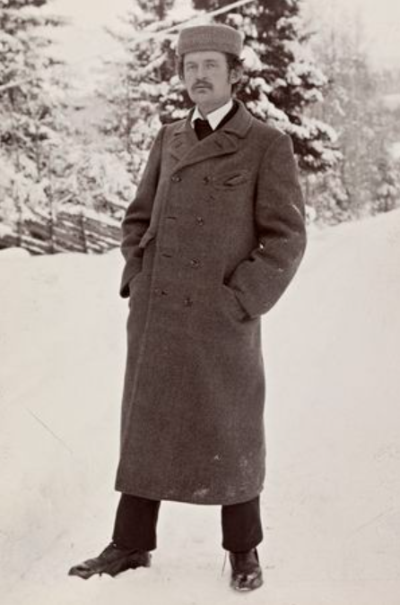
Edvard Munch 1863-1944
Edvard Munch was a Norweigan painter and printmaker.
He was an expressionist who painted 1789 known paintings. Expressionist artists try to express a feeling with what they create. Colours and shapes are not used in a way people see them, but as the artist feels them.
He is known for his artwork based upon conveying emotions, particularly fear.

Slide 3
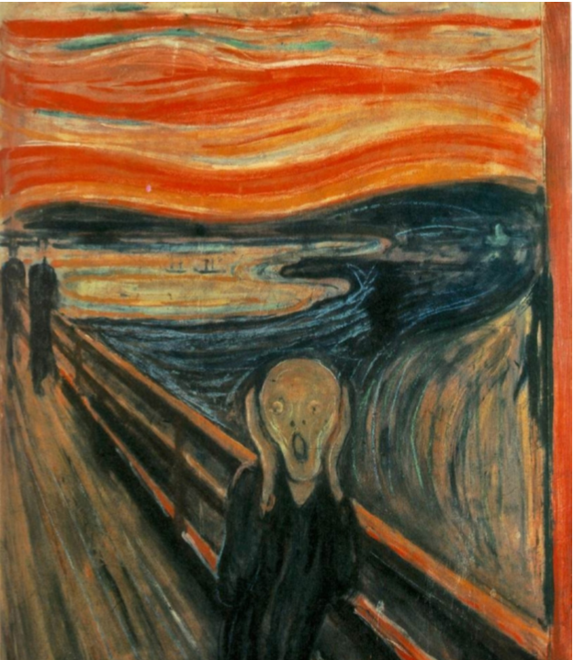
The Scream
This painting called ‘The Scream’ was created by Edvard Munch in the 19th Century. He used oil and tempera paint and pastel on card to create it.
Why do you think it is called ‘The Scream?’

Slide 4
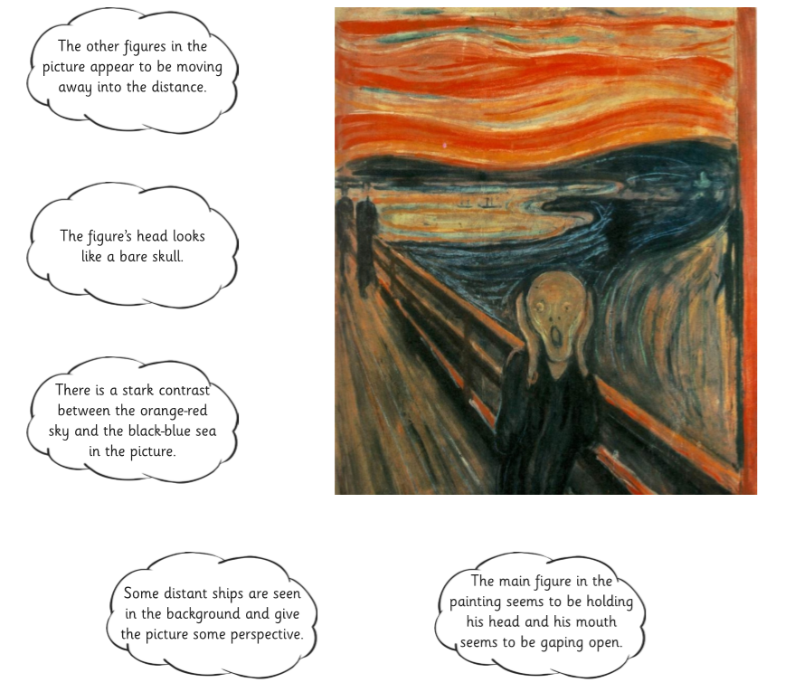
Can you match these labels to the correct part of the picture?

Slide 5
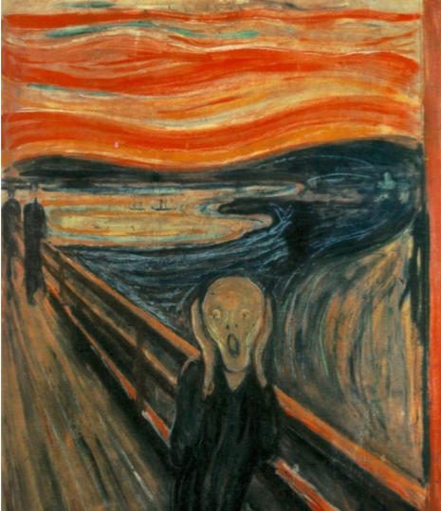
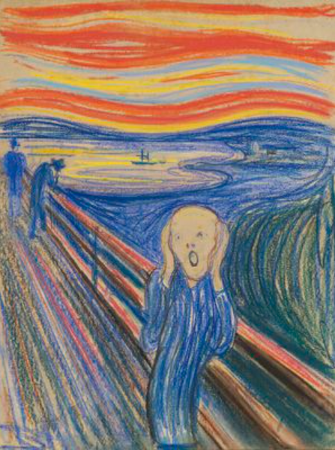
In his lifetime, Munch made several different versions of this painting. Compare the two versions below. What is the same? What is different?
Why do you think he has used swirling lines of colour?

Slide 6
Did you know…?
This version, executed in 1895 in pastel on cardboard, was sold on 2 May 2012 for nearly $120 million - the highest nominal price paid for a painting at auction at that time.

Slide 7
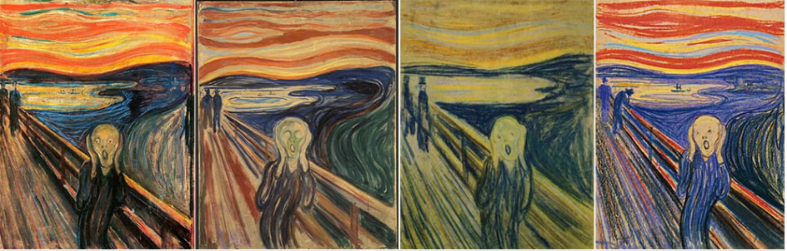
Your turn:
Can you create your own version of ‘The Scream?’
Think carefully about your choice of colour. Which colours would represent fear? Also, try to imitate Munch’s style by including the swirling lines of colour.
I can’t wait to see your finished pictures…will they be worth $120,000,000?

