Slide 1
Pointillism
Wednesday 23rd April 2014
LO: To create a painting using pointillist techniques

Slide 2
Pointillism
Pointillist artists create pictures made from tiny dots of colour. Pointillism can be used to create portraits, landscapes and abstract images.

Slide 3
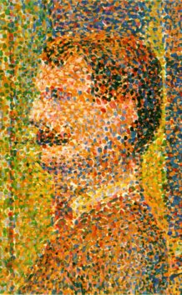
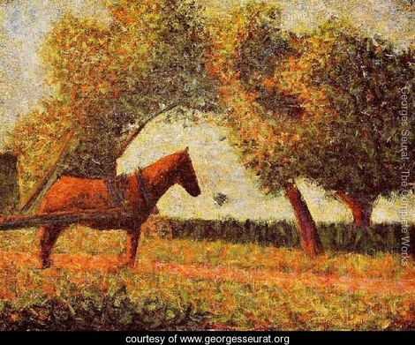
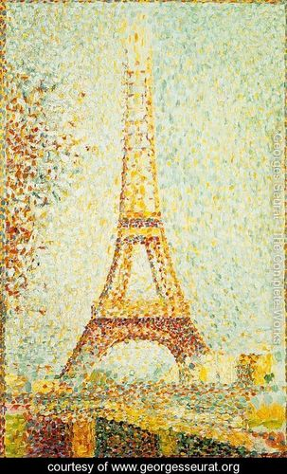
George Seurat – France, 1859-1891
Seurat did not mix colours in a palette; he used dots of many different colours that are blended by the eyes of the viewer.

Slide 4
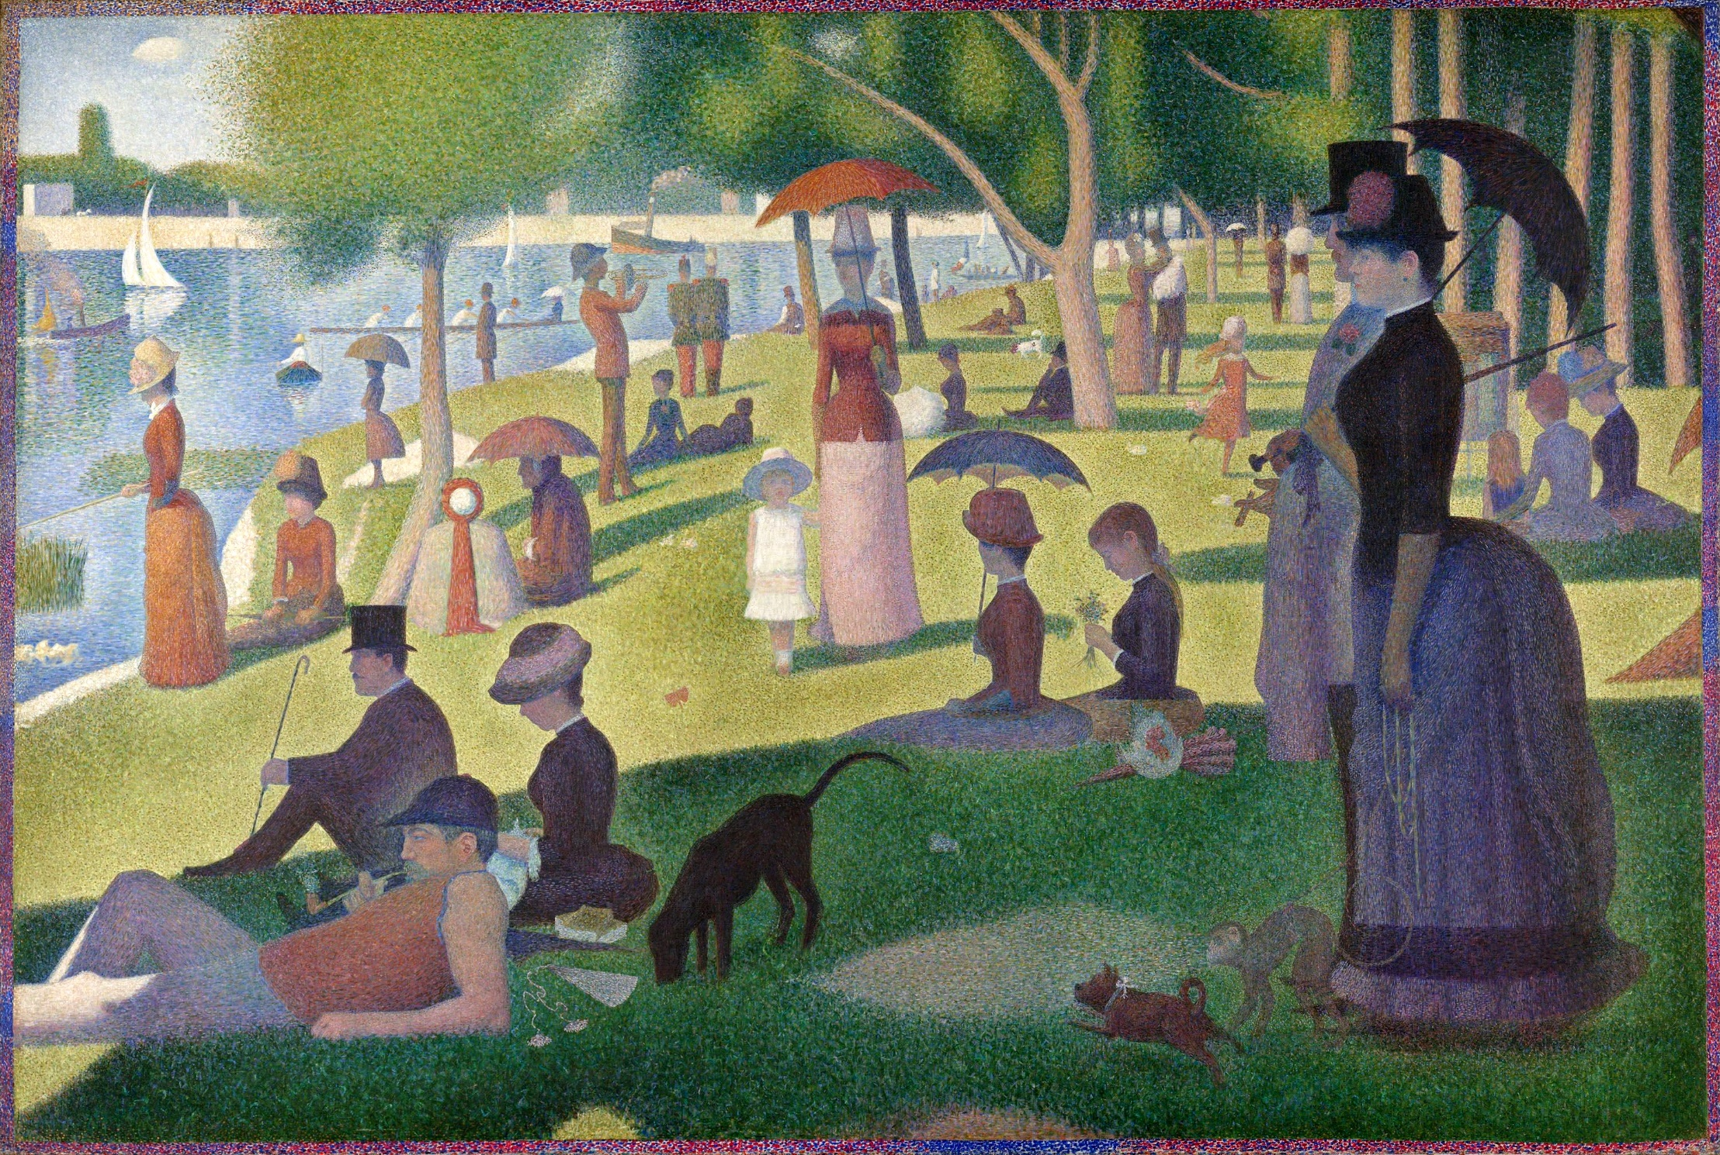
A Sunday Afternoon On The Island Of La Grande Jatte

Slide 5
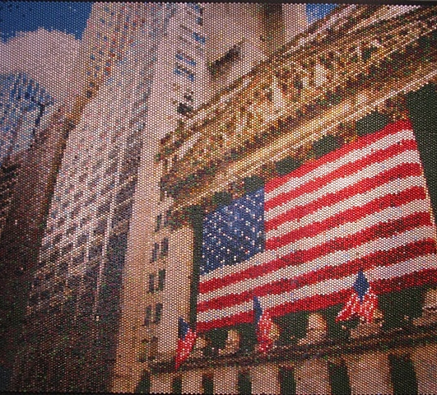
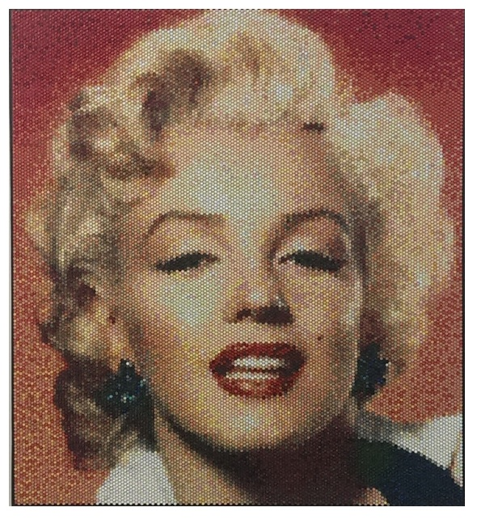
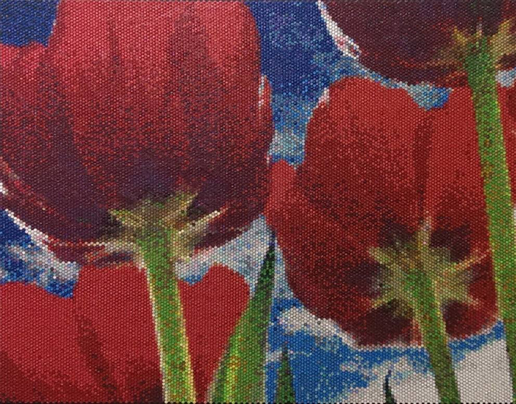
Bradley Hart – New York (Present Day)
Hart is taking pointillism in a new direction; he injects bubble wrap with paint to create images rather than painting onto canvas.

Slide 6
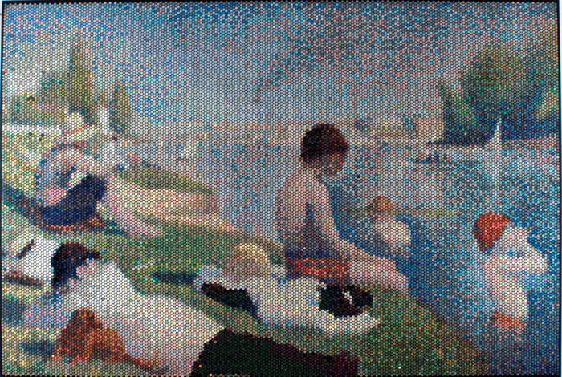
Bathers at Asnieres

Slide 7
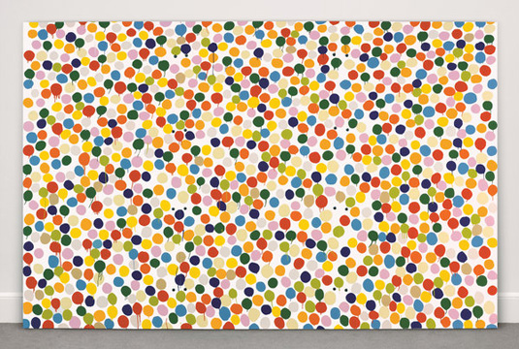
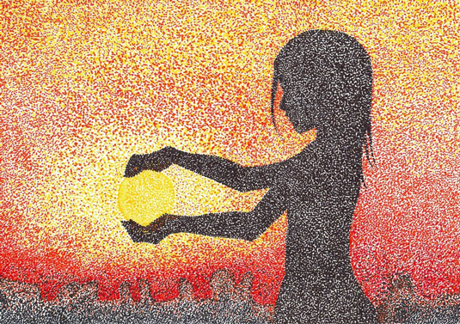
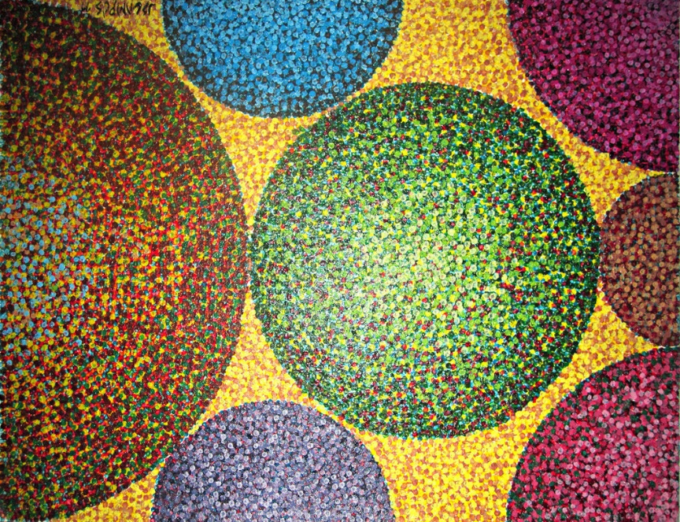
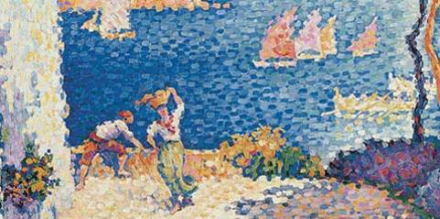
Damien Hurst
Sakura Chrno
Paul Signac
Samuraijose

Slide 8
Creating a Pointillist Picture
We are going to create our own pointillist images. You may choose from the following methods:
Dipping a cotton bud in paint to create a picture (you may sketch your picture outline in pencil first)
Painting onto bubblewrap and printing onto plain paper
You may copy one of the examples on your tables or come up with your own design.

