Slide 1
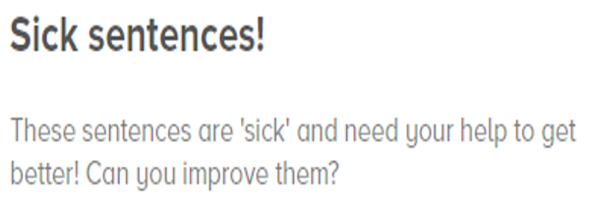
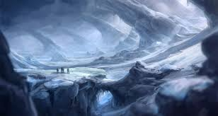
I could see icicles hanging from rocks. I could hear the wind. I felt cold.
Hint: think about adding more detail by creating expanded noun phrases, similes, metaphors and using more
Powerful vocabulary. Also, think of varying the start of the sentences so they don’t all start with ‘I.’ (e.g. fronted adverbials, ‘ing’ words, emotion…)

