Slide 1


RE
Religion and Rituals
Year One
RE | Year 1 | Religion and Rituals | Holy Communion | Lesson 4

Slide 3
Aim
To explore what happens during Holy Communion.
Success Criteria
I can tell a friend about an object that holds a memory or special meaning for me.
I can talk about why bread and wine are used in Holy Communion.
I can explain why Holy Communion is important for Christians.
I can use key vocabulary about Holy Communion.

Slide 4


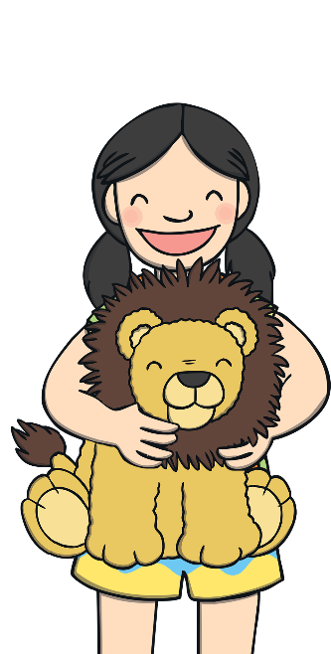
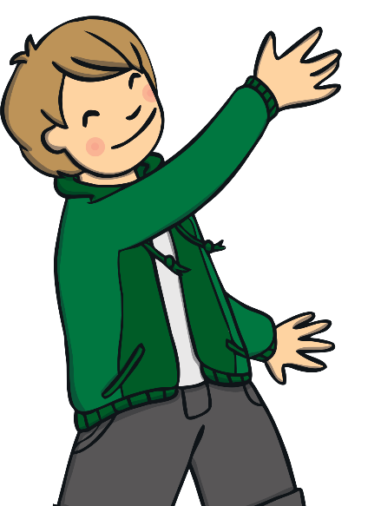

Objects and Memories
These children are talking about things that remind them of something.
This boomerang
reminds me of
my amazing holiday
in Australia.
We keep this teapot on the shelf at home. Every time I look at it, I remember my grandma. It belonged to her.
My dad bought me a toy lion to remind me that I am strong like a lion.

Slide 5
Objects and Memories
Can you think of an object which:
reminds you of something you have experienced;
reminds you of someone you know;
or reminds you of an important message?
Draw the object on your whiteboard and tell your talk
partner about it.
Use these ideas to help you think of something.
places you have visited
people who are special to you
gifts you have been given

Slide 6

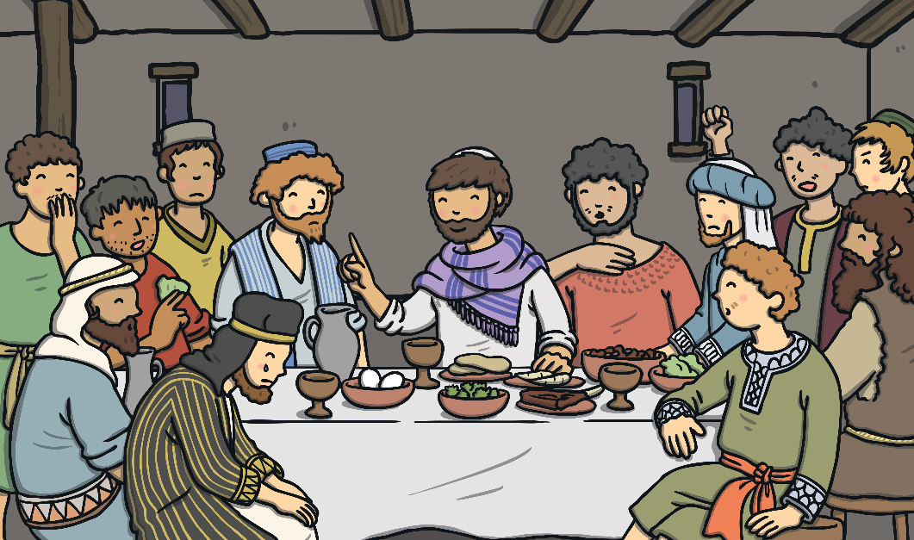
Bread and Wine
Christians believe that Jesus is the Son of God. They believe he came to Earth and lived as a real human being.
Christians believe that Jesus died on a cross. They believe that he
knew he was going to die. Before he died, he had a last meal with his closest friends, who were called his disciples.
Do you know what this last meal was called?
It was called the Last Supper.

Slide 7
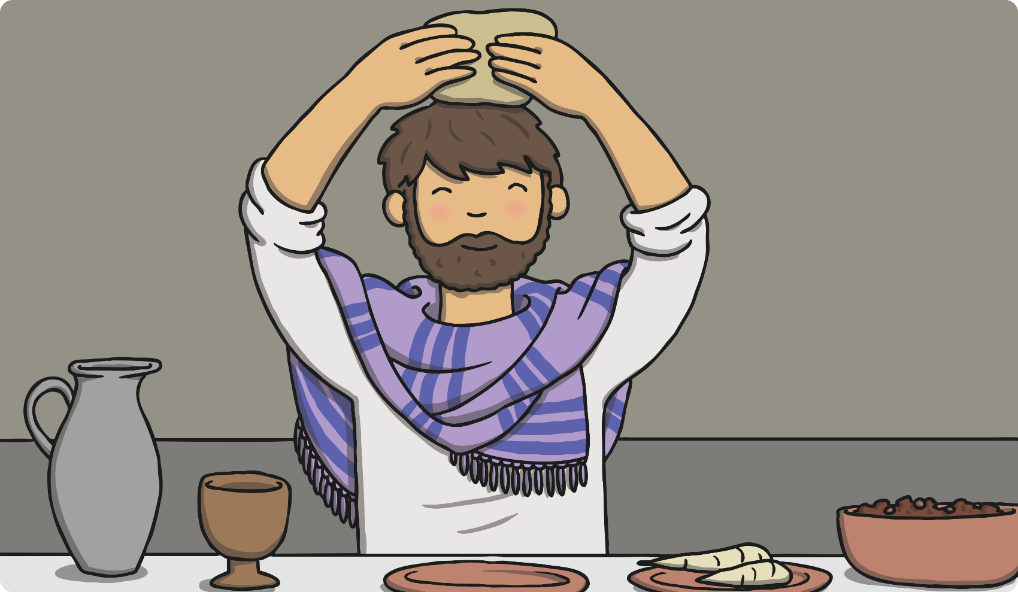
Bread and Wine
At the Last Supper, Jesus thanked God for the bread.

Slide 8
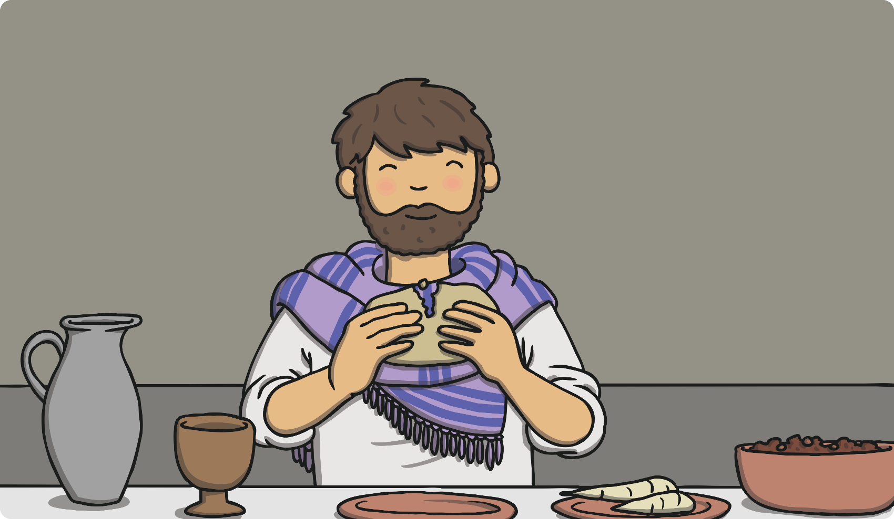
Bread and Wine
He broke it apart to share with everyone.

Slide 9
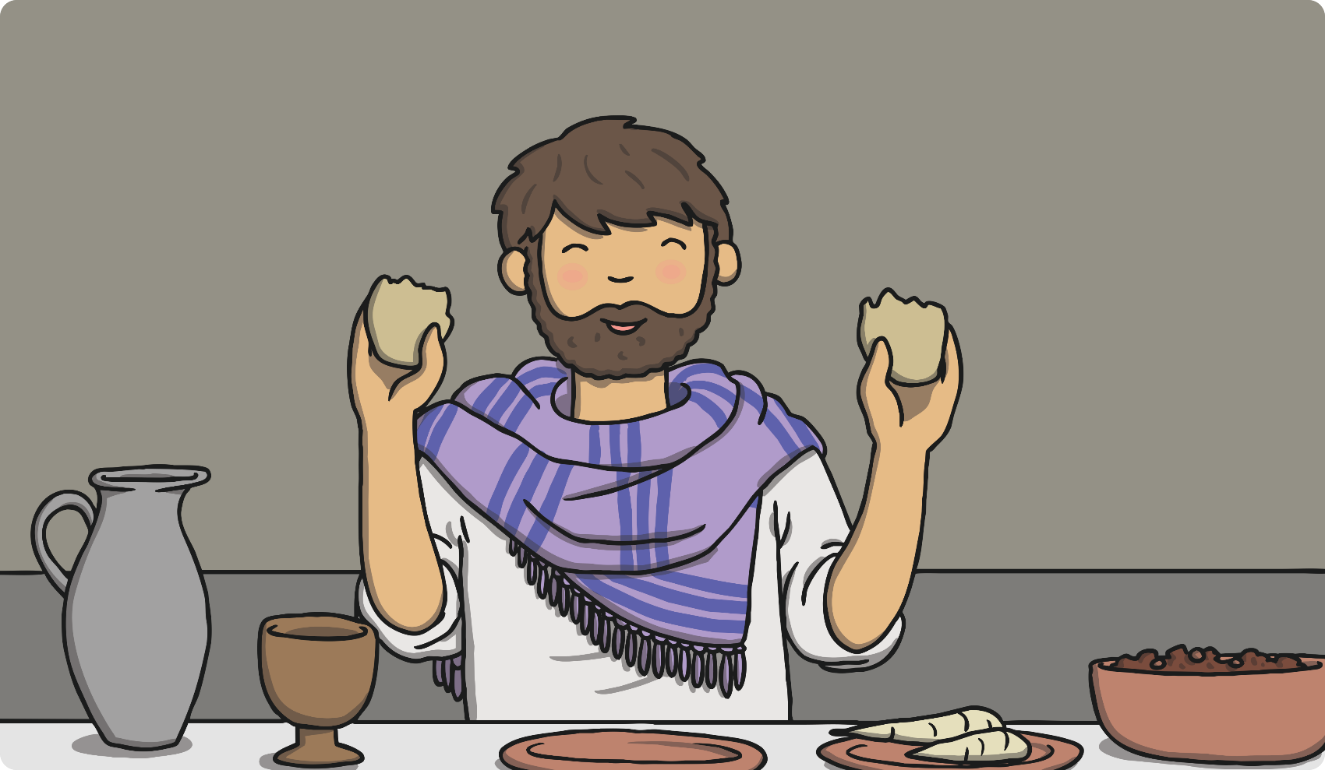
Bread and Wine
‘‘Take this and eat it. This is my body which is given
for you,’’ he announced.
What did Jesus say the bread represented?
His body

Slide 10
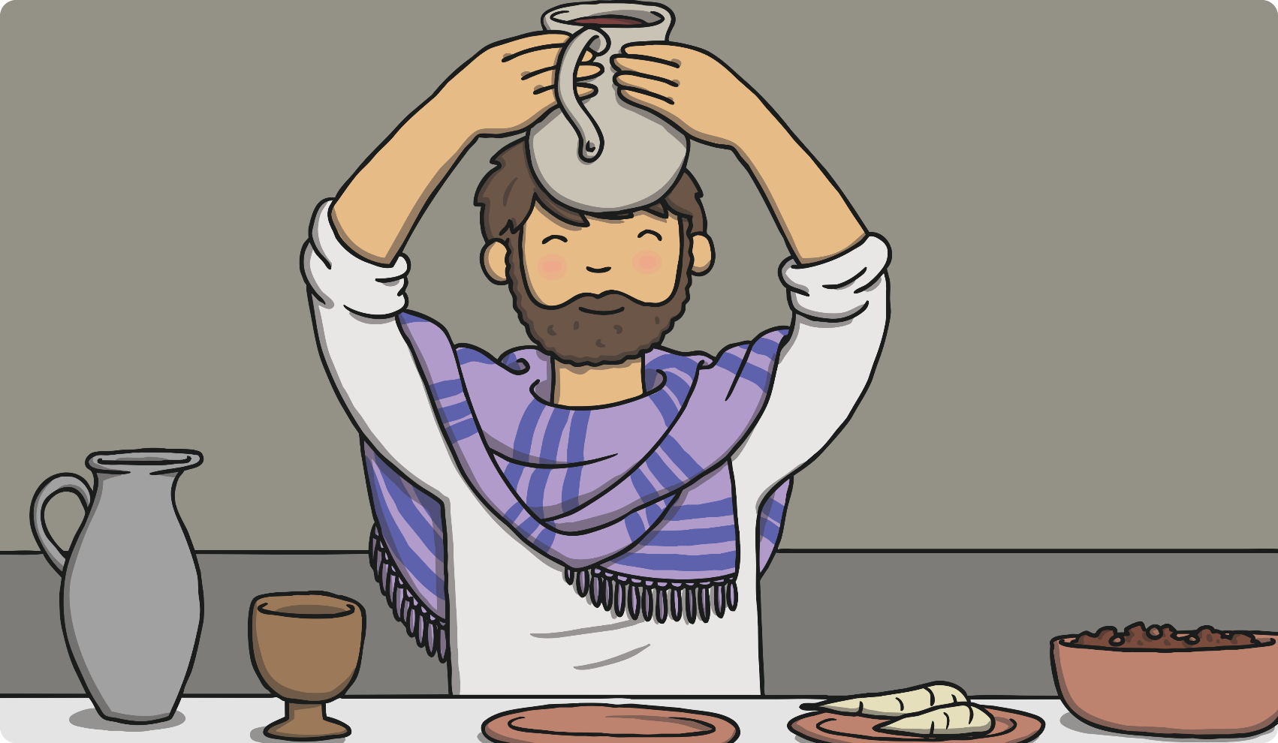
Bread and Wine
He then held up a cup of red wine.

Slide 11
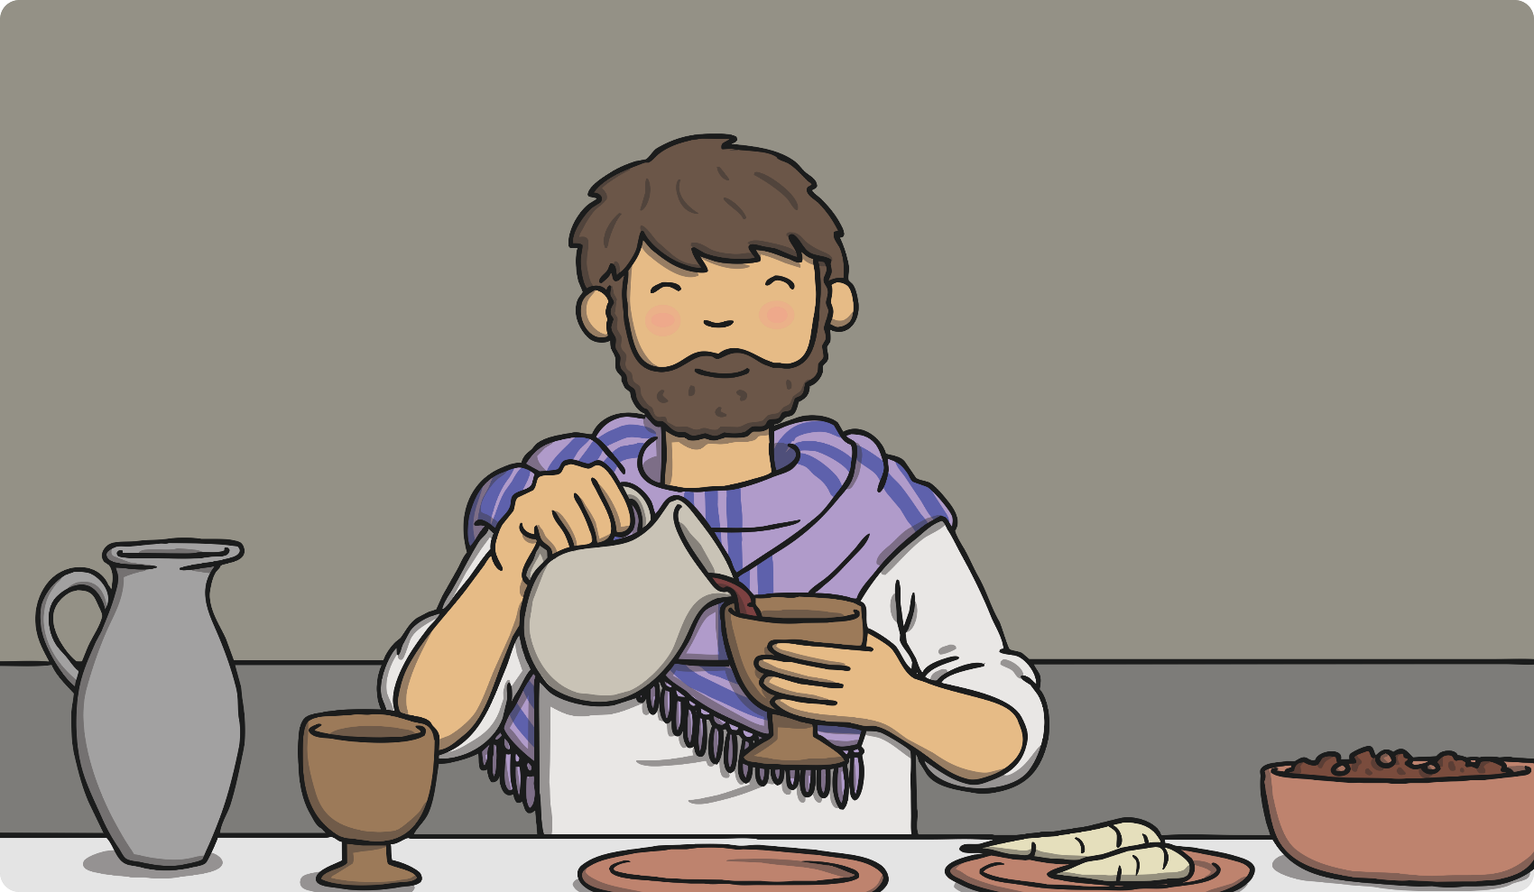
Bread and Wine
‘‘This is my blood, which will be poured out for many
people so their sins may be forgiven,’’ Jesus said.
What did Jesus say the wine represented?
His blood

Slide 12
Bread and Wine
Christians believe that when Jesus died on the cross, his death meant that the bad things (sins) that all human beings do could
be forgiven.
Christians think about Jesus when they think about the bread and wine in Holy Communion.
The bread represents
the body of Jesus.
The wine represents
the blood of Jesus.

Slide 13
Bread and Wine
Do This in Memory of Me
What do you think Jesus wanted the disciples to do after he had died?
He wanted them to think of him when eating bread and drinking wine during Communion, thinking about how the bread was like his body and the wine was like his blood.

Slide 14
Re-Enacting the Last Supper
Thousands of years after Jesus told his disciples to use bread and wine to remember him, Christians still re-enact the Last
Supper regularly.
Do you know what the word ‘re-enact’ means?
It means to act out something that happened in the past.
During services in many different types of Christian places of worship, Christians take part in a ritual where they eat a small piece of bread and have a sip of wine (or grape juice) just as the disciples did with Jesus at the Last Supper.
This ritual can be known as:
Holy Communion;
the Lord’s Supper;
the Eucharist.

Slide 15
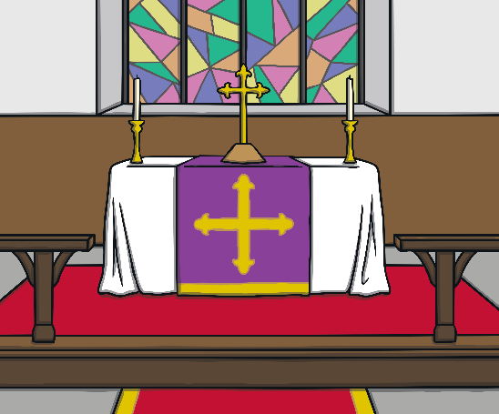
Re-Enacting the Last Supper
Different churches have different beliefs about what happens to the bread and wine after it is blessed.
Some churches believe that the bread and wine actually changes once it is blessed. Some churches believe they do not change but
are symbols.
During Holy Communion, there are Bible readings, prayers and Christians come up to the altar to receive the bread and wine from the priest or vicar.
An altar is a holy table. In a Christian church, it is the table where the bread and wine are blessed.

Slide 16

Re-Enacting the Last Supper
Christians taking part in Holy Communion are given a small piece of bread to eat. Sometimes they might be given a small wafer in place of bread.
A sip of wine or grape juice is taken from a
special cup called a chalice.

Slide 17

Holy Communion Poem
Prayers are read out in a Holy Communion service in a church. The words often have special meaning. They remind Christians of Jesus and help them understand what each object and part of the
ritual means.
What words could you use to talk about Holy Communion?
Use some of the words you thought of to create a poem
that could be read out during a Holy Communion service.

Slide 18
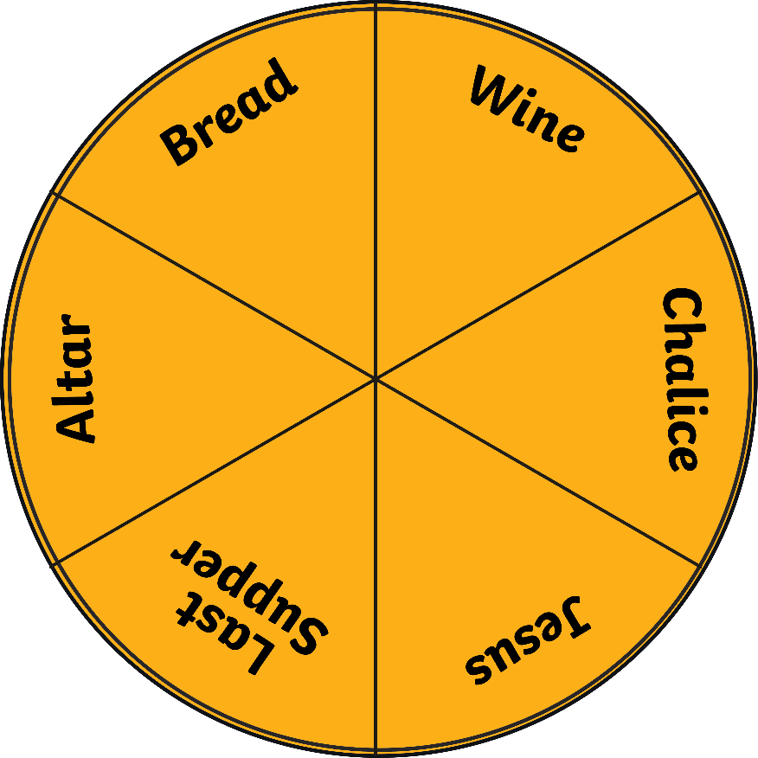
Spin the Wheel
This spinner has some words that are associated with Holy Communion. When the spinner lands on a word, can you tell your partner everything you know about that word

Slide 19

Aim
To describe what happens during Holy Communion.
Success Criteria
I can tell a friend about an object that holds a memory or special meaning for me.
I can talk about why bread and wine are used in Holy Communion.
I can explain why Holy Communion is important for Christians.
I can use key vocabulary about Holy Communion.

