Slide 1
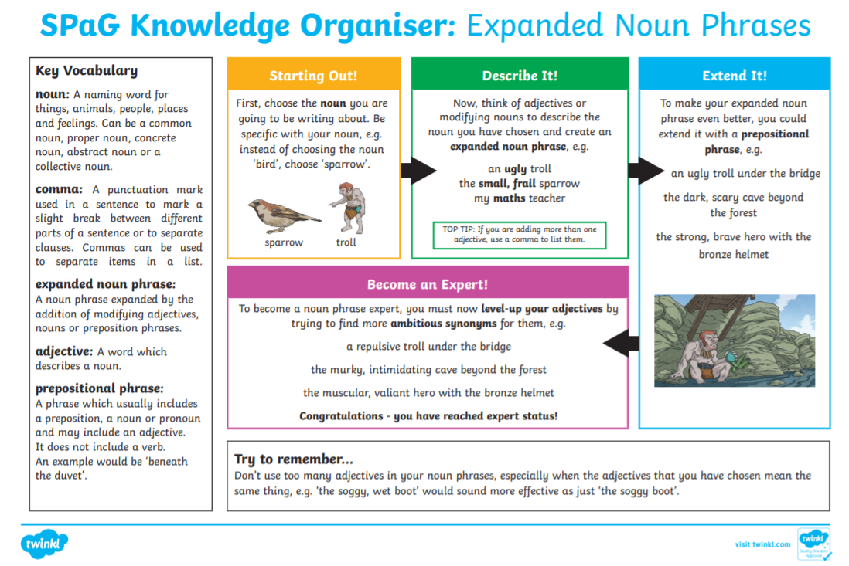
This time, can you add prepositional phrases to your expanded noun phrases

Slide 2
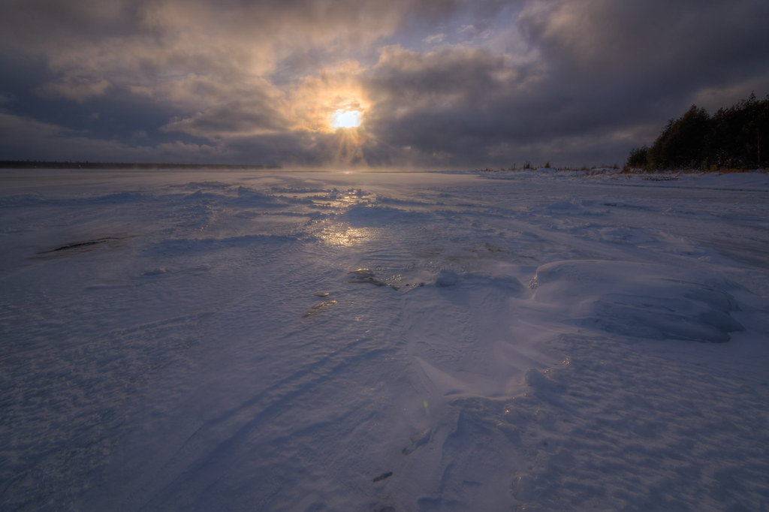
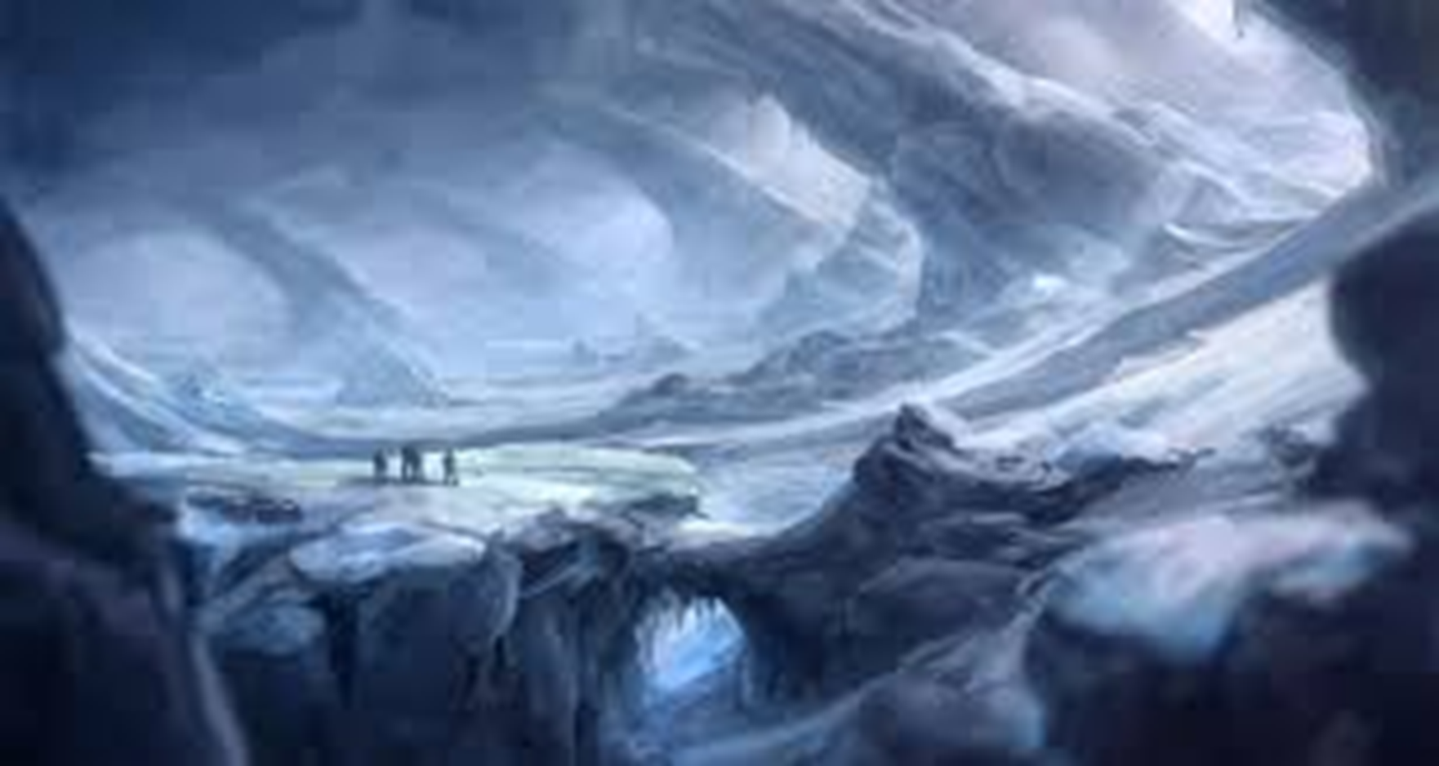
Expanded noun phrases:
Using the images below, can you create your own expanded noun phrases to include a prepositional phrase.
E.g. the vast, icy plain beneath the cloudy, dappled sky.

