Slide 1
Types of Food
And what they do…

Slide 2
L.O. To know the names of the 5 food types, and know their jobs.
+ I can understand why each food type is important.
+ I can group foods into types.

Slide 3
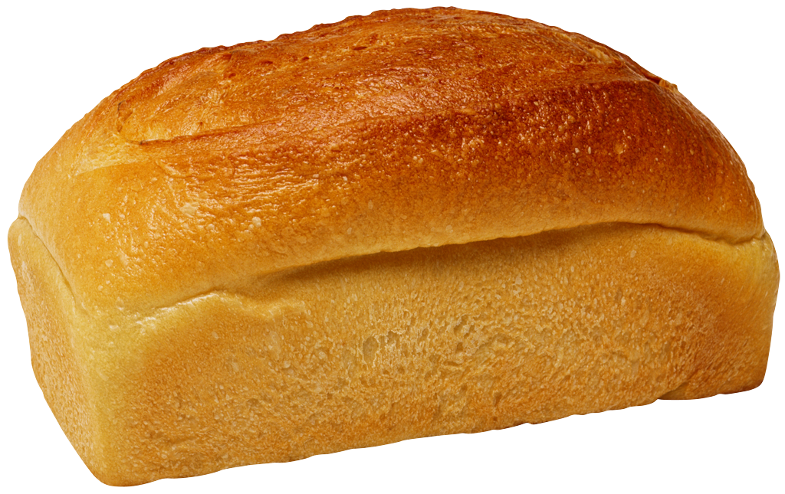

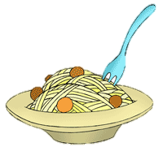
Carbohydrates…
Give us steady energy and keep us full up.
The energy is easy for our bodies to use, so lots of athletes eat carbohydrates before races and training.
You should try and eat carbohydrates every meal…

Slide 4
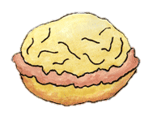

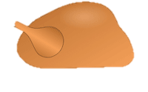
Proteins…
Help our bodies grow and repair themselves.
Without protein, you won’t have a strong body because your muscles won’t develop. You’ll also take longer to heal when you injure yourself…
People who eat meat get lots of proteins from the meat that they eat. Vegetarians need to eat nuts and things like quorn to give them protein.

Slide 5

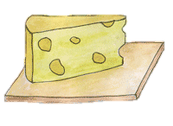

Dairy…
Dairy provides calcium.
Your body needs calcium to help keep bones and teeth strong and healthy. Be careful though… some of dairy like ice-cream and cheese is high in fat, so you shouldn’t eat too much!

Slide 6



Fruit and Vegetables…
Fruit and vegetables provide fibre and vitamins.
If you don’t eat enough fibre, it can become difficult to go for a poo. Vitamins help keep you fit and healthy- they create an army which can fight off bugs and bacteria.
You should eat at least 5 portions of fruit and veg each day…

Slide 7
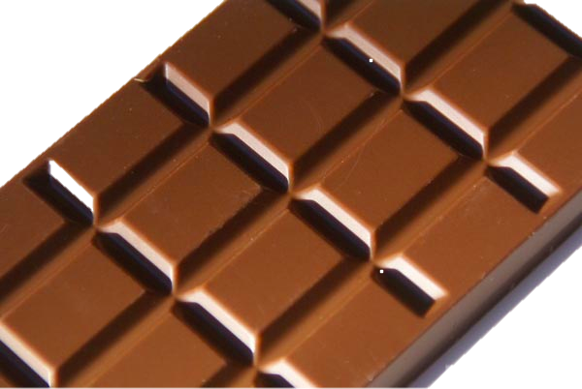
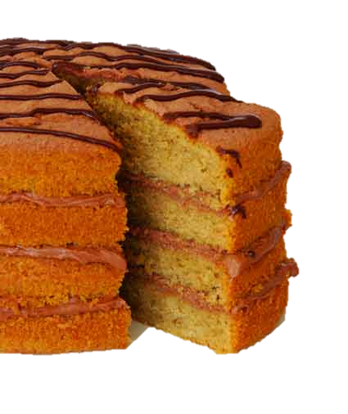

Fats and sugars…
Fats and sugars help provide energy.
Our bodies are really clever, and store the spare energy from fats until your body needs it, but you shouldn’t eat too many fats! Sugars provide short bursts of energy, which don’t last for
very long and might make you a little
hyperactive!

Slide 8
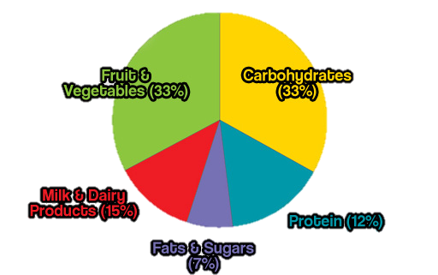
So how much should you eat?
This plate shows you how much of each food group you should eat each day…

