Slide 1
Today we are going to be describing a storm.
Before we do that we just need to remember a few things about sentences.
They must have a verb to make sense. In other words to say what ever is happening or doing.
If not, it is not a sentence, just a phrase

Slide 2
So which ones of these are not sentences?
The golden, delicious, sticky honey.
The white lightning struck down on the boat below.
The red bus drove down the road.
The brightly coloured, feathery birds.

Slide 3
So which ones of these are not sentences?
The golden, delicious, sticky honey.
The white lightning struck down on the boat below.
The red bus drove down the road.
The brightly coloured, feathery birds.
The red ones are not sentences because they don’t say where or what the birds or honey were doing.

Slide 4
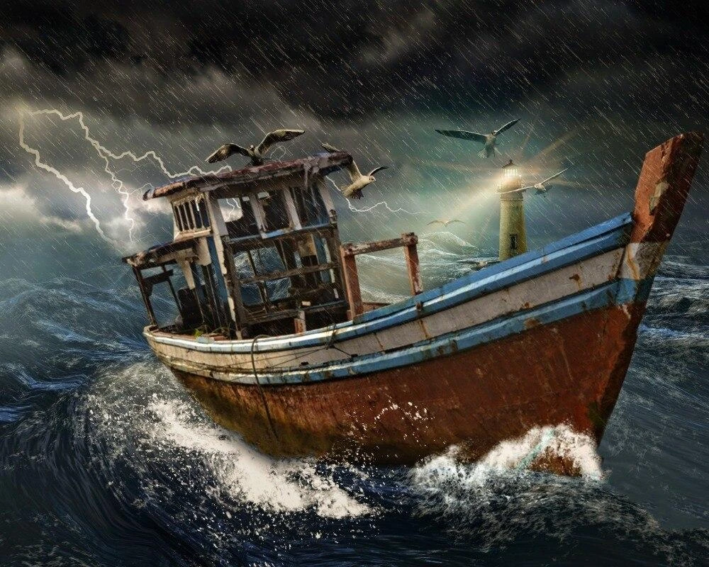

Slide 5
Look at the picture. What do you see?
Can you think of some expanded noun phrases to go with it?

Slide 6

Can you see how for each one I’ve improved the sentence a second time?
The lightning flashed in the sky.
The white, jagged lightning flashed in the dark sky.
The waves hit against the side of the boat.
Colossal, white waves crashed against the side of the boat.

Slide 7
Your challenge is to describe what is happening in this picture by using expanded noun phrases.
Describe the:
-waves
- rain
- lightning
- gulls
- boat

