Slide 1
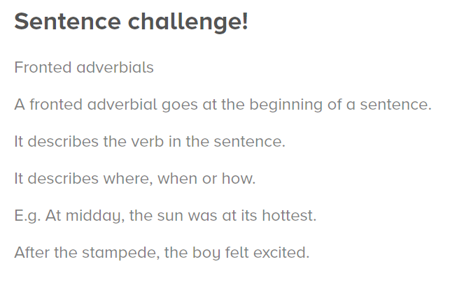

Fronted adverbials
A fronted adverbial is also followed by a comma.
Can you write your own sentences containing a fronted adverbial and correctly punctuated?
Hint: the next slide gives you some examples of fronted adverbials you could use.

Slide 2


