Slide 1
Menu Language
Look carefully at the menus on the following slides.
What language have they used to describe each dish to make it sound delicious and enticing?
Remember, you can ‘magpie’ (steal) ideas to use in your own menu

Slide 2
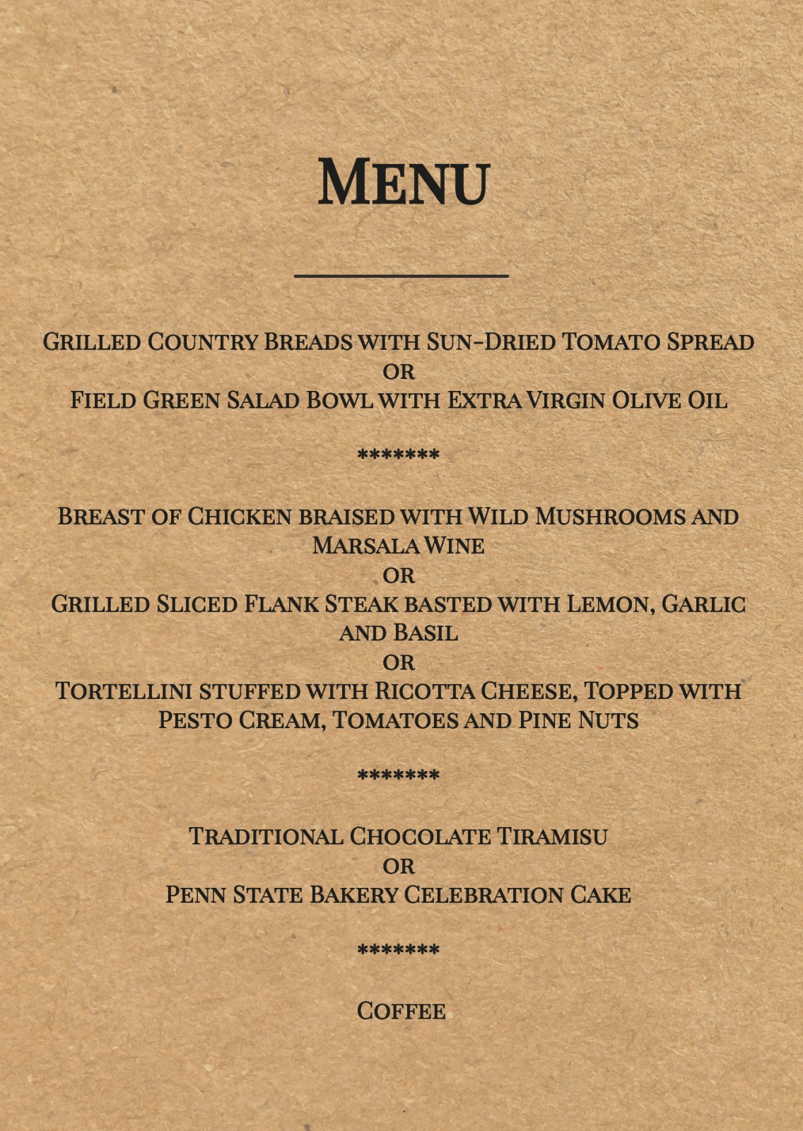
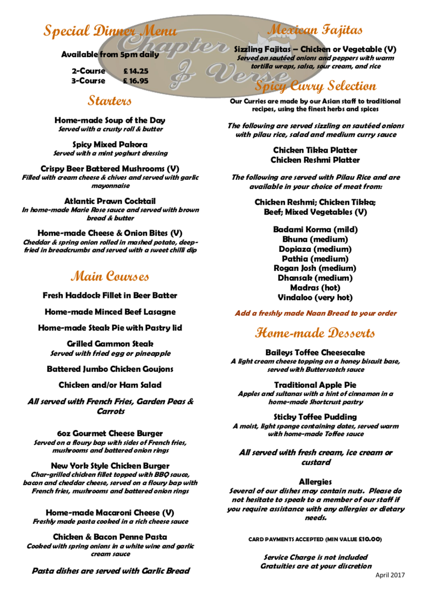

Slide 3
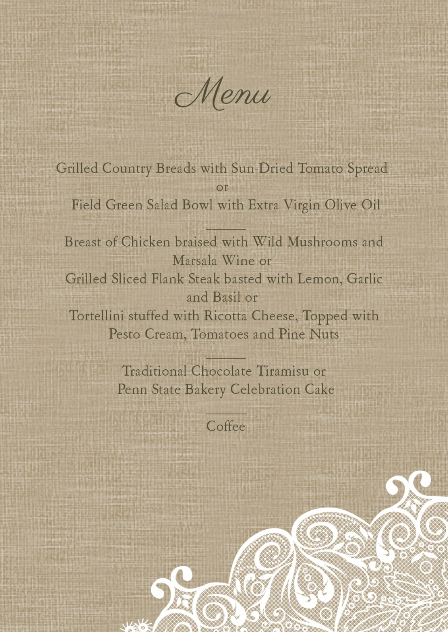
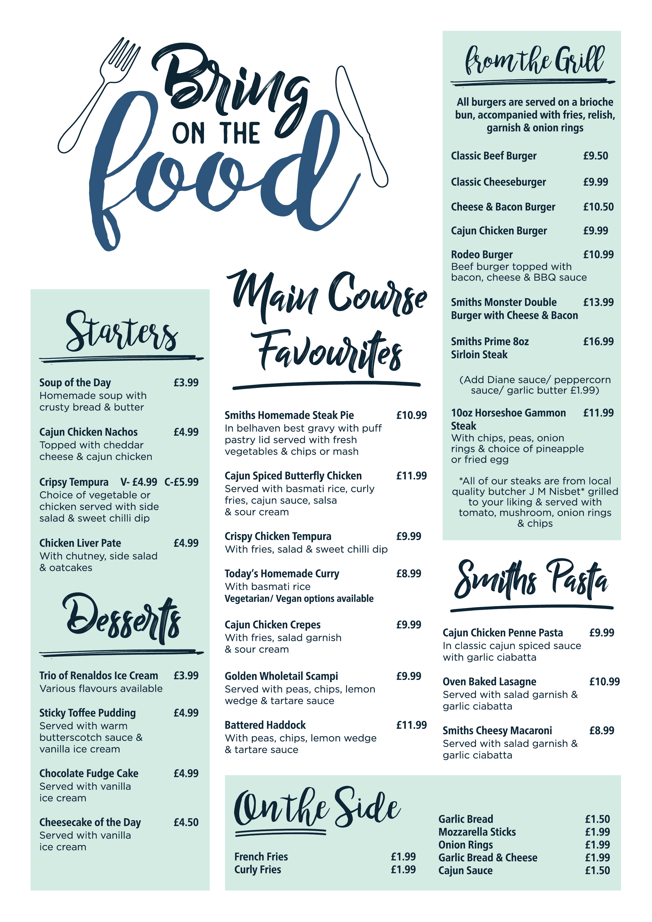

Slide 4
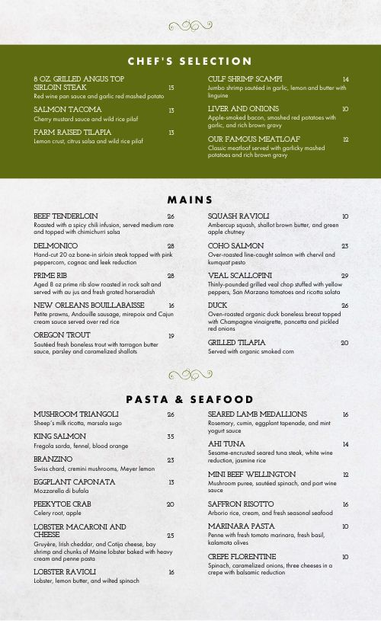
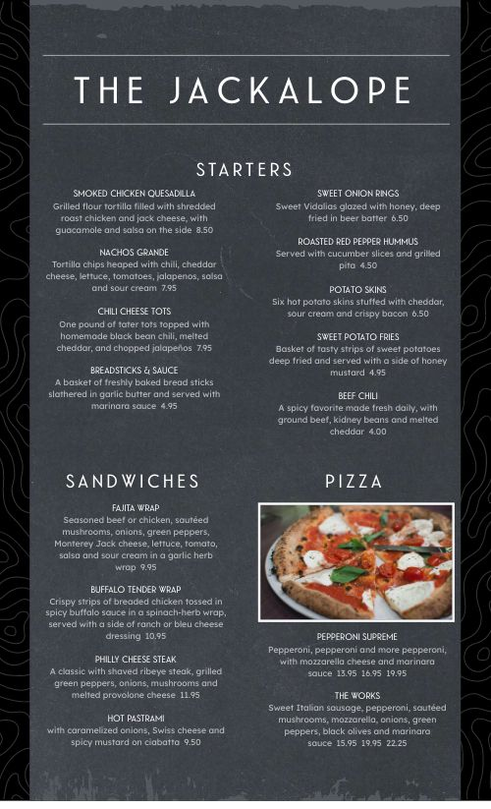

Slide 5
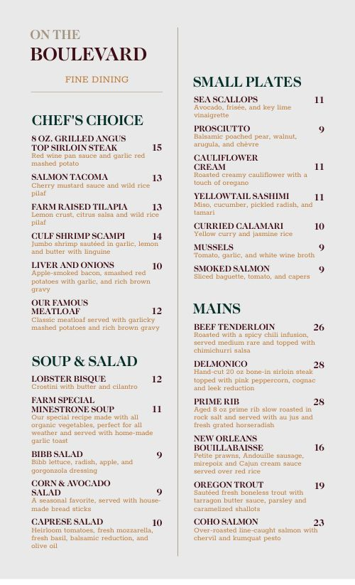
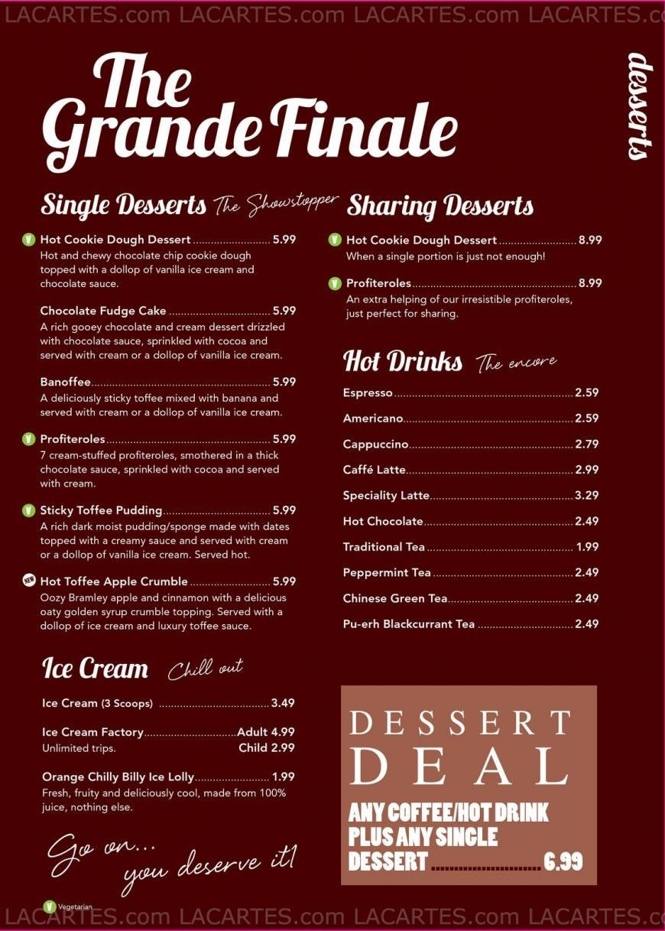

Slide 6
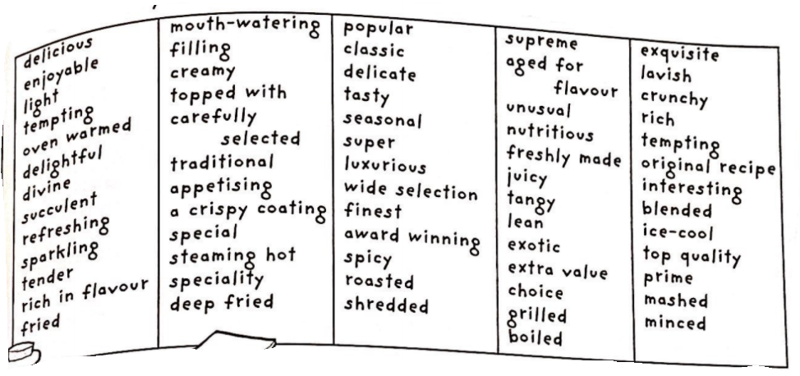
Your turn: Can you create descriptions for your revolting menu dishes? You may choose to include some of the words and phrases from the word bank below to help you, or choose your own.

