Slide 1
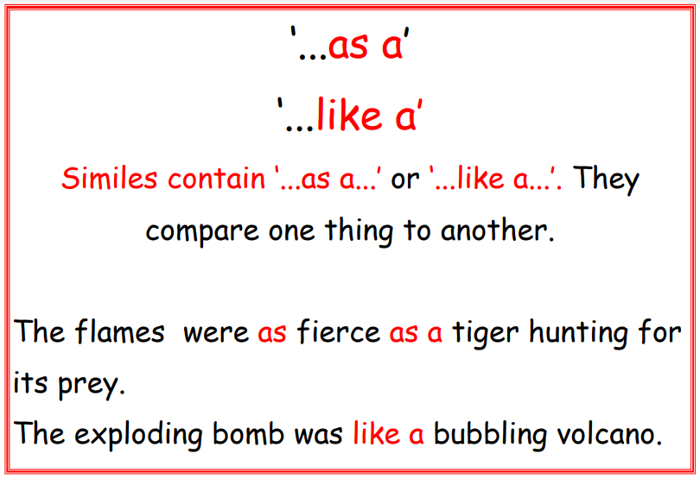
4

Slide 2
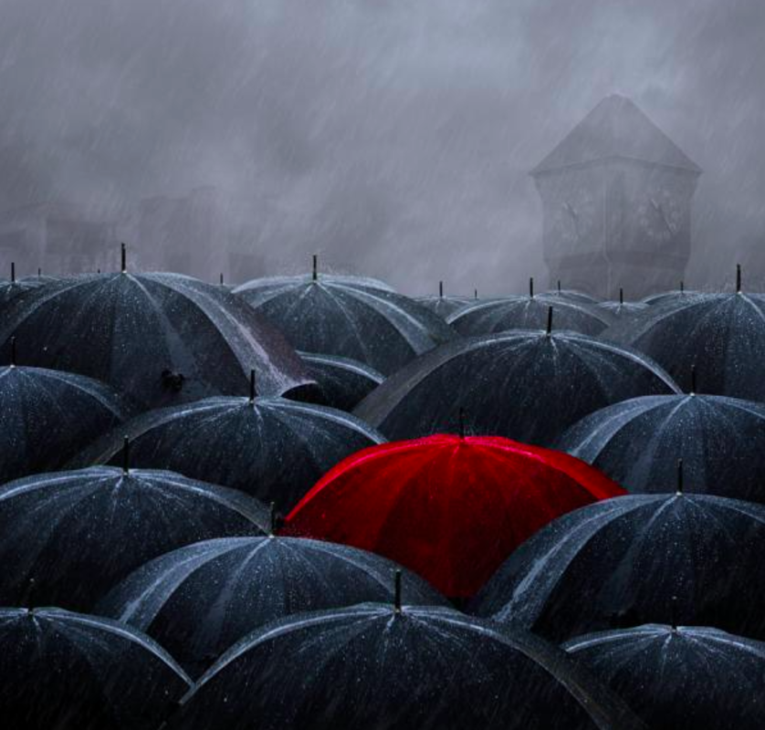
4
Can you write some similes using this picture for inspiration?

