Slide 1


Slide 3
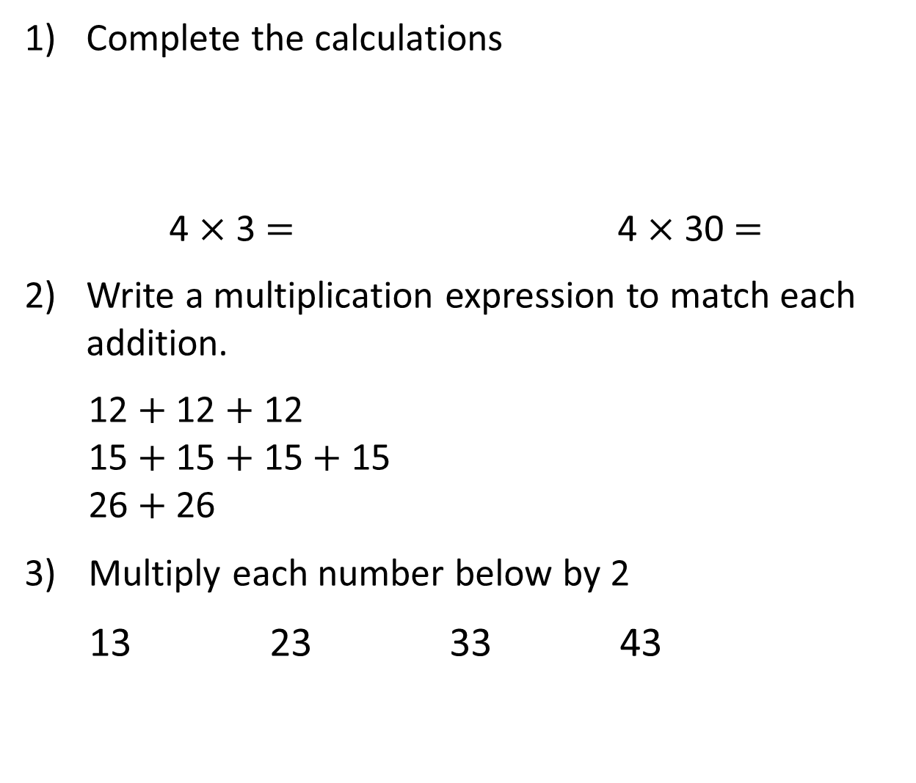
Complete the calculations
4 $×$ 3 $=$ 4 $×$ 30 $=$
Write a multiplication expression to match each addition.
12 $+$ 12 $+$ 12
15 $+$ 15 $+$ 15 $+$ 15
26 $+$ 26
3) Multiply each number below by 2
13 23 33 43

Slide 4
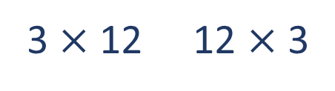
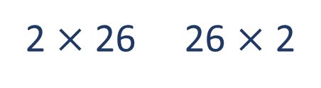
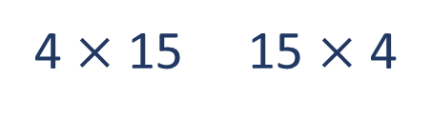
Complete the calculations
4 $×$ 3 $=$ 4 $×$ 30 $=$
Write a multiplication expression to match each addition.
12 $+$ 12 $+$ 12
15 $+$ 15 $+$ 15 $+$ 15
26 $+$ 26
3) Multiply each number below by 2
13 23 33 43
12
120
3 $×$ 12 12 $×$ 3
4 $×$ 15 15 $×$ 4
2 $×$ 26 26 $×$ 2
26
46
66
86

Slide 6

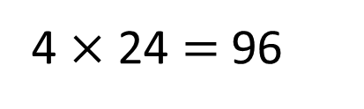
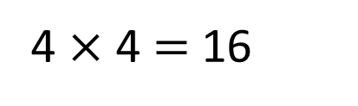
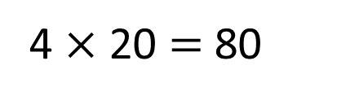
Each shelf has 24 rolls.
How many rolls are there in total?
24
4 $×$ 24 $=$ 96
20
4
There are 96 rolls in total.
4 $×$ 20 $=$ 80
4 $×$ 4 $=$ 16

Slide 7


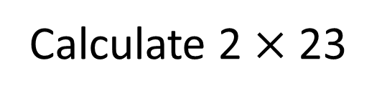
Calculate 2 $×$ 23
46
23
40 $+$ 6 $=$ 46
20
3
2 $×$ 20 $=$ 40
2 $×$ 3 $=$ 6

Slide 8

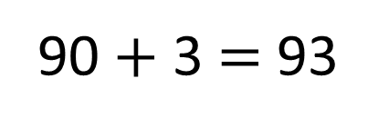
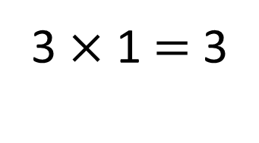
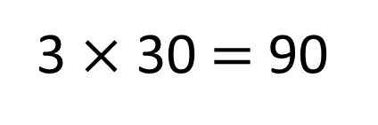
Calculate 3 $×$ 31
Have a think
93
31
90 $+$ 3 $=$ 93
30
1
3 $×$ 30 $=$ 90
3 $×$ 1 $=$ 3

Slide 9
We can use his method by setting it out using a grid

Slide 10

4 $×$ 24
x | 10 | 10 | 4
4 | 40 | 40 | 16
40 + 40 + 16 = 96

Slide 11
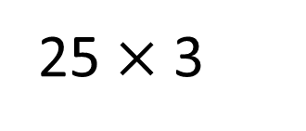
25 $×$ 3
x | 20 | 5
3 | 60 | 15
60 + 15 = 75

