Slide 1


YEAR 1
Addition & Subtraction
Related facts
Compare number sentences
Block 1 – Week 4

Slide 2

Lesson 1
Step: Related facts
Practical

Slide 3
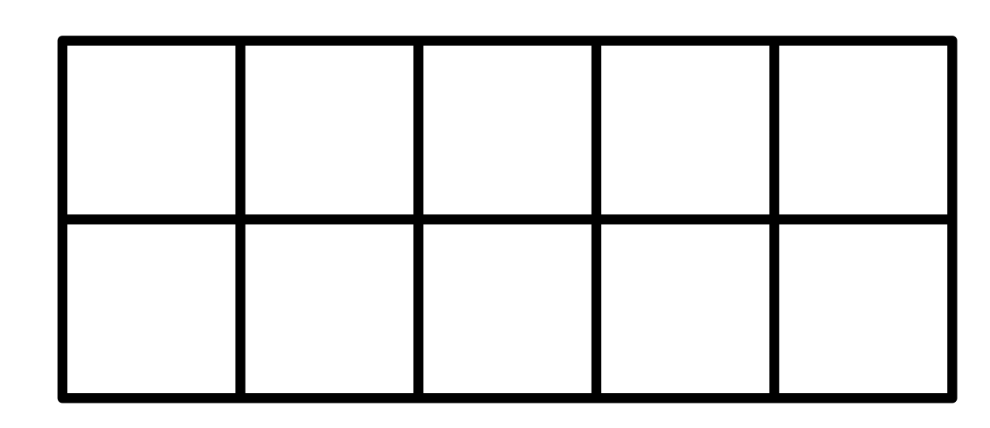

Fluency
Use the counters to complete the fact families.
4
6
10
_____ + _____ = _____
_____ + _____ = _____
_____ - _____ = _____
_____ - _____ = _____
6
4
10
10
4
6
10
6
4

Slide 4
Fluency
Use the counters to complete the fact families.
7
3
10
_____ + _____ = _____
_____ + _____ = _____
_____ - _____ = _____
_____ - _____ = _____
3
7
10
10
7
3
10
3
7

Slide 5
Fluency
Use the counters to complete the fact families.
8
4
12
_____ + _____ = _____
_____ + _____ = _____
_____ - _____ = _____
_____ - _____ = _____
4
8
12
12
8
4
12
4
8

Slide 6
Fluency
Use the counters to complete the fact families.
6
8
14
_____ + _____ = _____
_____ + _____ = _____
_____ - _____ = _____
_____ - _____ = _____
8
6
14
14
6
8
14
8
6

Slide 7
Fluency
Use the counters to complete the fact families.
9
7
16
_____ + _____ = _____
_____ + _____ = _____
_____ - _____ = _____
_____ - _____ = _____
7
9
16
16
9
7
16
7
9

Slide 8
Fluency
Use the counters to complete the fact families.
8
5
13
_____ + _____ = _____
_____ + _____ = _____
_____ - _____ = _____
_____ - _____ = _____
5
8
13
13
8
5
13
5
8

Slide 9
Fluency
Use the counters to complete the fact families.
7
8
15
_____ + _____ = _____
_____ + _____ = _____
_____ - _____ = _____
_____ - _____ = _____
8
7
15
15
7
8
15
8
7

Slide 10
Fluency
Use the counters to complete the fact families.
9
8
17
_____ + _____ = _____
_____ + _____ = _____
_____ - _____ = _____
_____ - _____ = _____
8
9
17
17
9
8
17
8
9

Slide 11
Reasoning
Spot the mistake. Explain your answer.
5
8
13
_____ + _____ = _____
_____ + _____ = _____
_____ - _____ = _____
_____ - _____ = _____
8
5
13
13
5
8
13
8
5
The ten frames are showing 4 + 9 = 13.
The stem sentences are showing 5 + 8 = 13.

Slide 12
Problem solving
Which calculations match the ten frames?
A
B
17
9
8
8
9
17
_____ + _____ = _____
_____ + _____ = _____
_____ - _____ = _____
_____ - _____ = _____
_____ + _____ = _____
_____ + _____ = _____
_____ - _____ = _____
_____ - _____ = _____
17
8
9
9
8
17
9
8
17
17
9
8
8
9
17
17
8
9
The calculations under column B match the ten frames.

Slide 13
Lesson 2
Step: Related facts
(Part-whole diagrams)

Slide 14
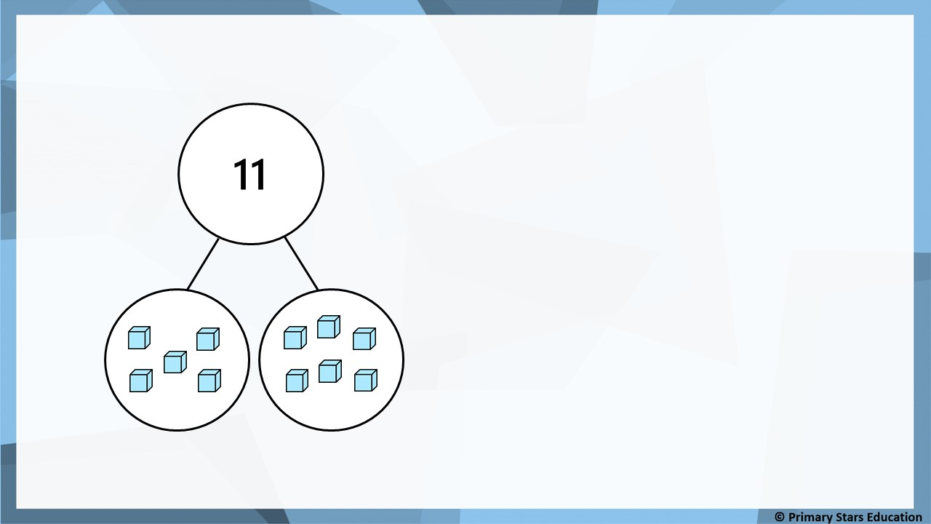
Fluency
Use the base ten to complete the stem sentences.
5
6
11
_____ + _____ = _____
_____ + _____ = _____
_____ - _____ = _____
_____ - _____ = _____
6
5
11
11
5
6
11
6
5

Slide 15
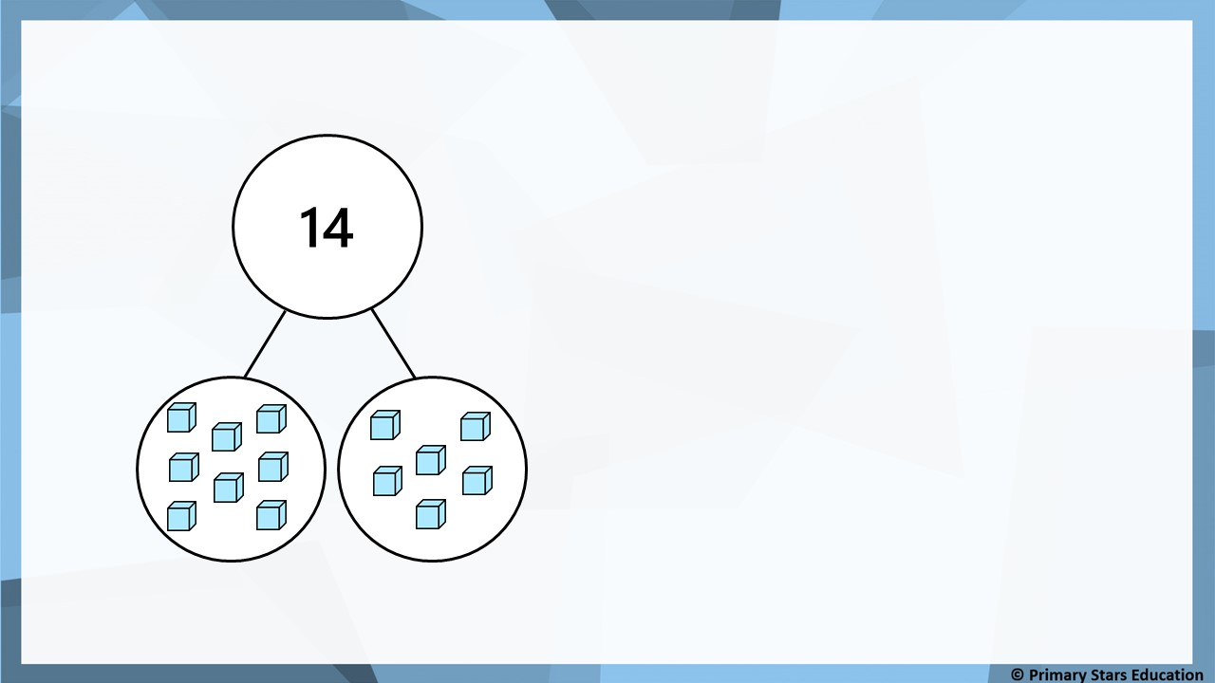
Fluency
Use the base ten to complete the stem sentences.
8
6
14
_____ + _____ = _____
_____ + _____ = _____
_____ - _____ = _____
_____ - _____ = _____
6
8
14
14
8
6
14
6
8

Slide 16

Fluency
Use the base ten to complete the stem sentences.
8
4
12
12
_____ + _____ = _____
_____ + _____ = _____
_____ - _____ = _____
_____ - _____ = _____
4
8
12
12
8
4
12
4
8

Slide 17

Fluency
Use the base ten to complete the stem sentences.
9
7
16
16
_____ + _____ = _____
_____ + _____ = _____
_____ - _____ = _____
_____ - _____ = _____
7
9
16
16
9
7
16
7
9

Slide 18


Fluency
Use the base ten to complete the stem sentences.
7
5
12
12
_____ + _____ = _____
_____ + _____ = _____
_____ - _____ = _____
_____ - _____ = _____
5
7
12
12
7
5
12
5
7

Slide 19

Fluency
Use the base ten to complete the stem sentences.
5
8
13
13
_____ + _____ = _____
_____ + _____ = _____
_____ - _____ = _____
_____ - _____ = _____
8
5
13
13
5
8
13
8
5

Slide 20

Fluency
Use the base ten to complete the stem sentences.
9
5
14
14
_____ + _____ = _____
_____ + _____ = _____
_____ - _____ = _____
_____ - _____ = _____
5
9
14
14
9
5
14
5
9

Slide 21

Fluency
Use the base ten to complete the stem sentences.
8
7
15
15
_____ + _____ = _____
_____ + _____ = _____
_____ - _____ = _____
_____ - _____ = _____
7
8
15
15
8
7
15
7
8

Slide 22
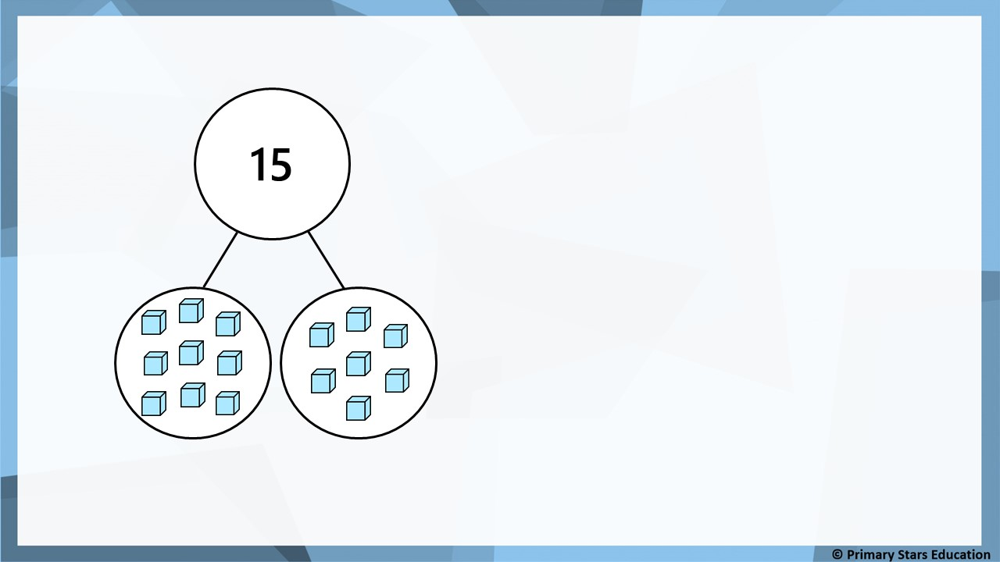
Reasoning
Spot the mistake. Explain your answer.
8
7
15
_____ + _____ = _____
_____ + _____ = _____
_____ - _____ = _____
_____ - _____ = _____
7
8
15
15
8
7
15
7
8
One part of the part-whole model is showing 9 cubes not 8.

Slide 23


Problem solving
How many fact families can you find?
Addition | Addition | Subtraction | Subtraction
0 + 7 = 7 | 7 + 0 = 7 | 7 – 0 = 7 | 7 – 7 = 0
1 + 6 = 7 | 6 + 1 = 7 | 7 – 1 = 6 | 7 – 6 = 1
2 + 5 = 7 | 5 + 2 = 7 | 7 – 2 = 5 | 7 – 5 = 2
3 + 4 = 7 | 4 + 3 = 7 | 7 – 3 = 4 | 7 – 4 = 3

Slide 24
Lesson 3
Step: Related facts
(Bar models)

Slide 25
Fluency
Which calculations match the bar model?
12
4 | 8
4 + 8 = 12 | 12 + 8 = 4
12 + 4 = 8 | 8 + 4 = 12
12 – 4 = 8 | 8 – 4 = 12
4 – 8 = 12 | 12 – 8 = 4

Slide 26
Fluency
Which calculations match the bar model?
14
9 | 5
14 + 5 = 9 | 5 + 9 = 14
9 + 5 = 14 | 14 + 9 = 5
5 – 9 = 14 | 14 – 5 = 9
14 – 9 = 5 | 9 – 5 = 14

Slide 27
Fluency
Complete the stem sentences.
8
4
12
_____ + _____ = _____
_____ + _____ = _____
_____ - _____ = _____
_____ - _____ = _____
12
8 | 4
4
8
12
12
8
4
12
4
8

Slide 28
Fluency
Complete the stem sentences.
8
6
14
_____ + _____ = _____
_____ + _____ = _____
_____ - _____ = _____
_____ - _____ = _____
14
8 | 6
6
8
14
14
8
6
14
6
8

Slide 29
Fluency
Complete the stem sentences.
9
4
13
_____ + _____ = _____
_____ + _____ = _____
_____ - _____ = _____
_____ - _____ = _____
13
9
4
9
13
?
4
13
9
4
13
4
9

Slide 30
Fluency
Complete the stem sentences.
8
7
15
_____ + _____ = _____
_____ + _____ = _____
_____ - _____ = _____
_____ - _____ = _____
15
8
7
8
15
?
7
15
8
7
15
7
8

Slide 31
Fluency
Complete the stem sentences.
5
6
11
_____ + _____ = _____
_____ + _____ = _____
_____ - _____ = _____
_____ - _____ = _____
11
 | 6
6
5
11
?
5
11
5
6
11
6
5

Slide 32
Fluency
Complete the stem sentences.
8
9
17
_____ + _____ = _____
_____ + _____ = _____
_____ - _____ = _____
_____ - _____ = _____
17
 | 9
9
8
17
?
8
17
8
9
17
9
8

Slide 33
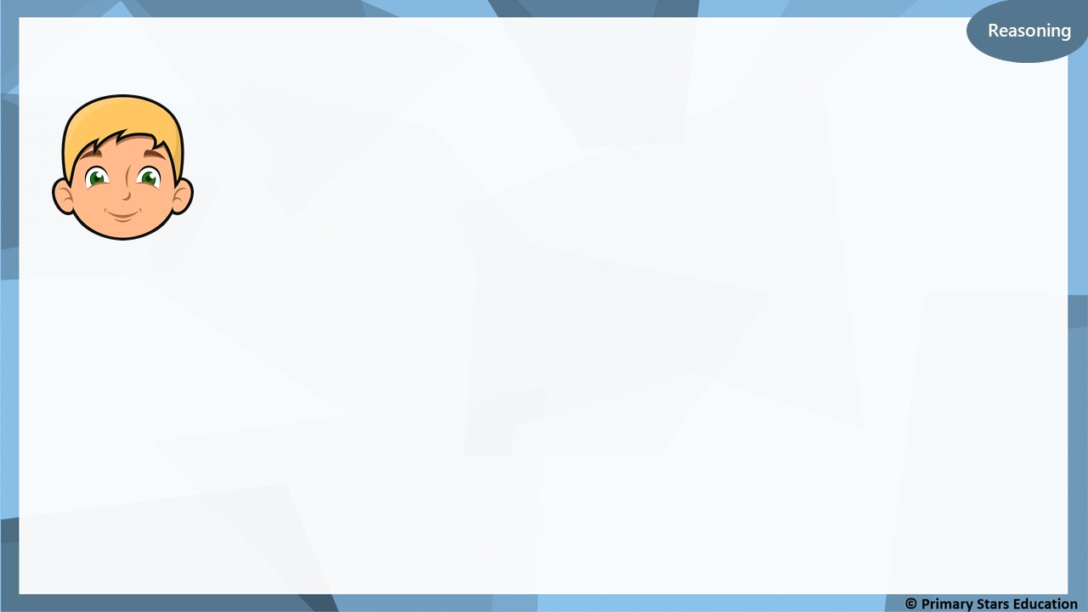
8
6 | ?
The missing number is 14.
Is Ben correct?
If not, what mistake might Ben have made?
No Ben is not correct, he has mistaken the missing number for the answer. 8 + 6 = 14.

Slide 34
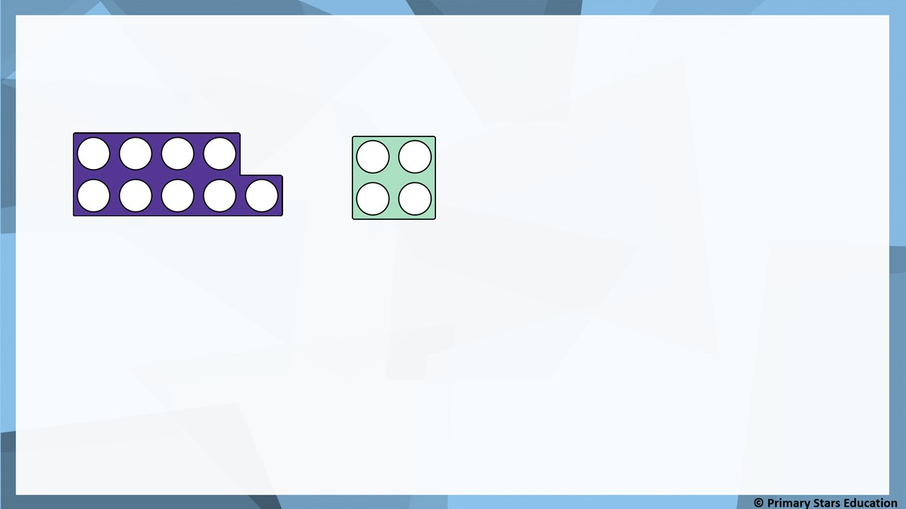
Problem solving
Use the number frames to complete the bar model.
List the related facts.
+
9
4
13
_____ + _____ = _____
_____ + _____ = _____
_____ - _____ = _____
_____ - _____ = _____
9
4
13
13
?
13
9
4
4
9
?
?
13
4
9

Slide 35
Lesson 4
Step: Comparing number sentences
Practical

Slide 36
Fluency
Which card will correctly compare the number sentence?
is more than
is less than
3 + 4
is equal to
4 + 3

Slide 37
Fluency
Which card will correctly compare the number sentence?
is more than
is less than
is equal to
5 + 6
3 + 9

Slide 38
Fluency
Which card will correctly compare the number sentence?
is more than
is less than
is equal to
6 + 9
16 - 3

Slide 39
Fluency
Which card will correctly compare the number sentence?
is more than
is less than
7 + 8
19 - 5
is equal to

Slide 40
Fluency
Which card will correctly compare the number sentence?
is more than
is less than
15 - 2
7 + 6
is equal to

Slide 41
Fluency
Which card will correctly compare the number sentence?
is more than
is less than
4 + 9
6 + 8
is equal to

Slide 42
Fluency
Which card will correctly compare the number sentence?
is more than
is less than
5 + 8
7 + 6
is equal to

Slide 43
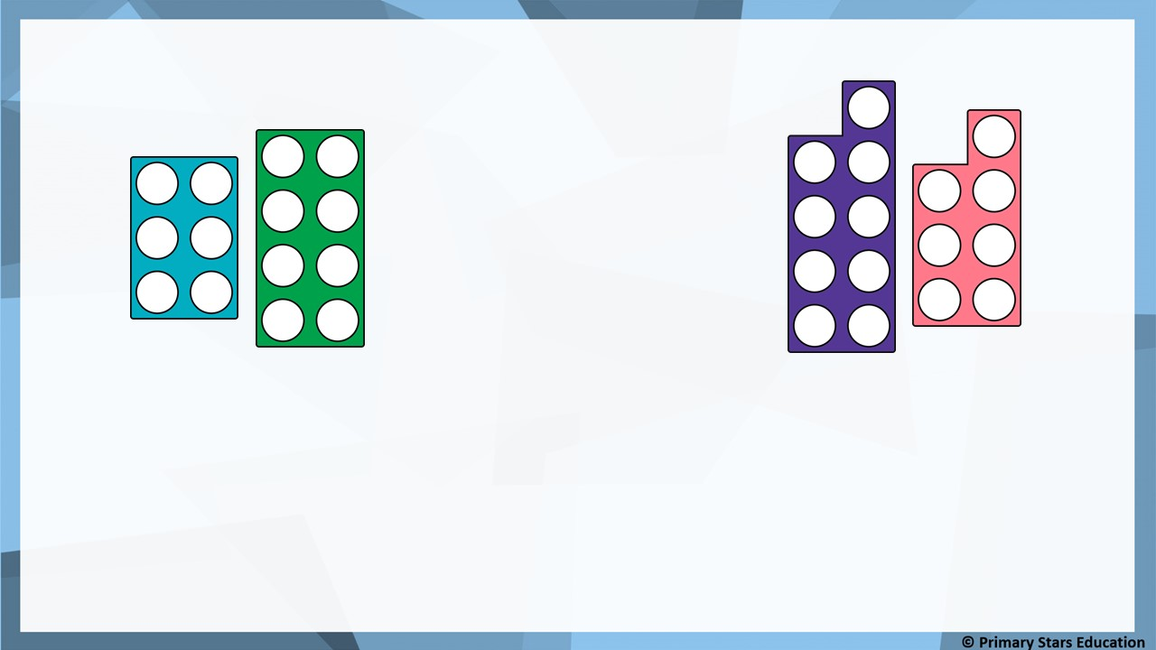
Fluency
True or false? The comparison is correct.
is more than
is less than
6 + 8
is equal to
9 + 7
False, 9 + 7 = 16 which is more than 6 + 8 = 14.
The answer should be less than.
How could you make it correct?

Slide 44

Problem solving
Complete the number sentence comparison to make it true.
5 + _____ < 2 + _____.
Can you think of any more answers?

Slide 45
Lesson 5
Step: Subtraction – Crossing 10 (5)

Slide 46
Fluency
RECAP:
Which card will correctly compare the number sentence?
is more than
is less than
5 + 3
is equal to
3 + 5

Slide 47
Fluency
RECAP:
Which card will correctly compare the number sentence?
is more than
is less than
is equal to
5 + 7
8 + 5

Slide 48
Fluency
Which card will correctly compare the number sentence?
is equal to
5 + 9 ___________________ 8 + 6
14
14
is more than
is less than
is equal to

Slide 49
Fluency
Which card will correctly compare the number sentence?
is less than
3 + 9 ___________________ 8 + 5
12
13
is more than
is less than
is equal to

Slide 50
Fluency
Which card will correctly compare the number sentence?
is more than
8 + 4 ___________________ 5 + 6
12
11
is more than
is less than
is equal to

Slide 51
Fluency
Compare the number sentences using >, < or =.
=
5 + 9 ______ 9 + 5
14
14
<
6 + 9 ______ 19 - 3
15
16

Slide 52
Fluency
Compare the number sentences using >, < or =.
<
3 + 8 ______ 14 - 2
11
12
>
16 - 3 ______ 5 + 7
13
12

Slide 53
Fluency
Compare the number sentences using >, < or =.
=
17 - 4 ______ 9 + 4
13
13
>
8 + 8 ______ 9 + 6
16
15

Slide 54
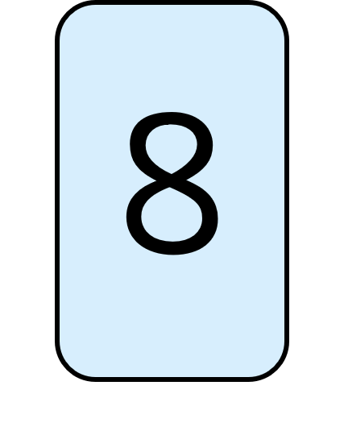
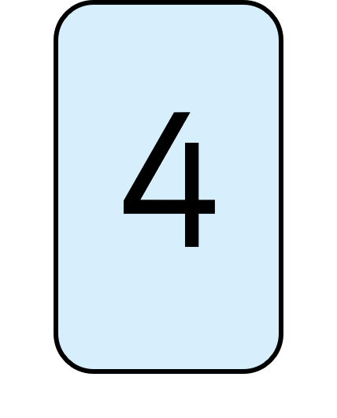
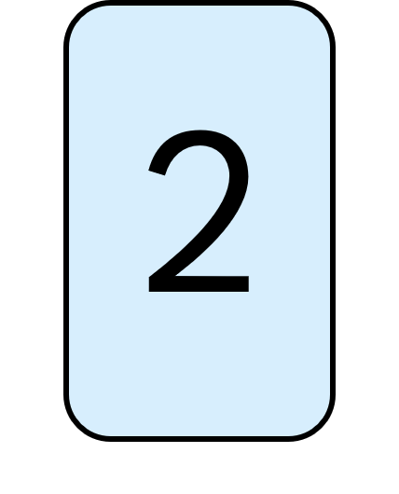
Fluency
Using the digit cards once, complete the stem sentences
so the comparisons are correct.
2
13 – ____
=
9 + 2
5 + 7
>
8
19 -____
4
<
17 – ____
8 + 6

Slide 55
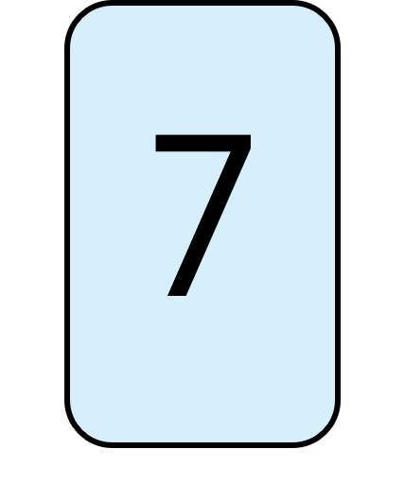
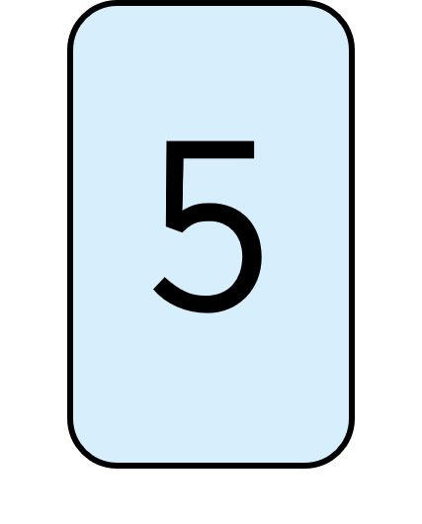
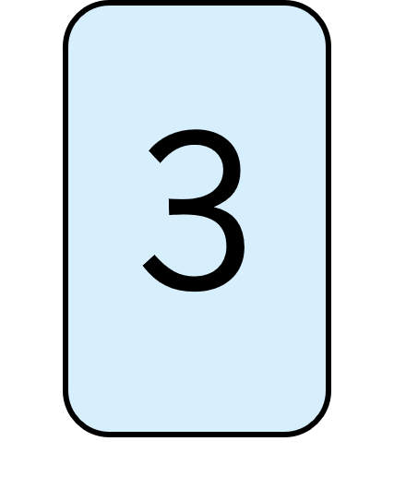
Fluency
Using the digit cards once, complete the stem sentences
so the comparisons are correct.
14 – 3
5
<
7 + ____
5 + 4
=
7
16 -____
3
>
15 – ____
8 + 3

Slide 56

I can put a 3 in the space to make the comparison true.
3
13 – 2 < 9 + _____
Is Kat correct?
Explain your answer.
Yes Kat is correct.
13 – 2 = 11 which is < 9 + 3 = 12.

Slide 57
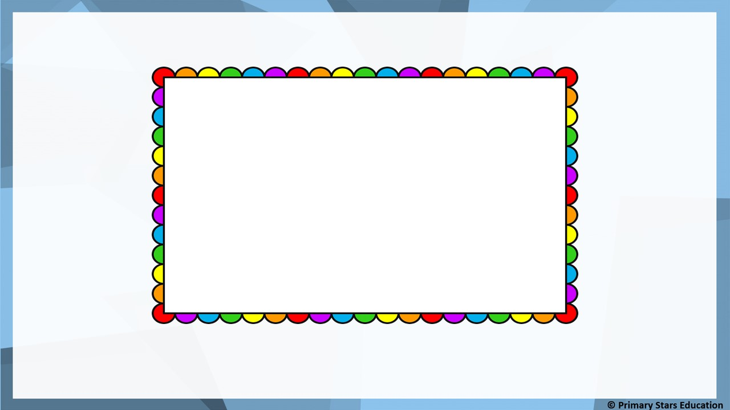
Problem solving
What numbers could make the story true? List all possibilities.
Mo has 17 grapes and eats 4 of them.
Jack has 9 grapes.
He then gets ________ more.
Jack has less grapes than Mo.
Jack has either 1, 2, 3 or 0 more grapes.

