Slide 1
Quick write challenges: Notes for parents
These activities are designed to revise grammar terms whilst also practising writing sentences with different structures. Children should read each slide carefully and complete the challenges, writing their sentences and making sure they have punctuated them correctly (capital letters, full stops, commas)

Slide 2
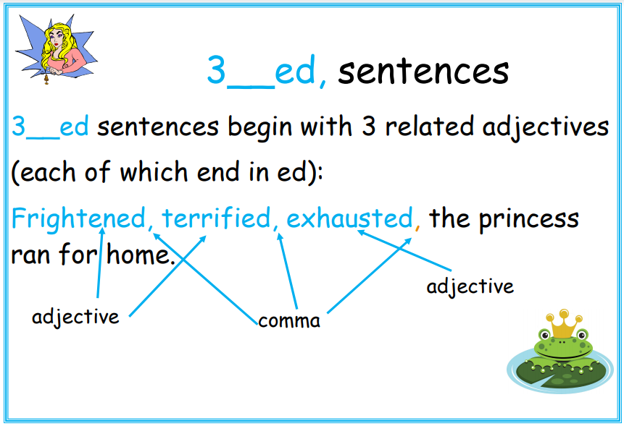
2

Slide 3
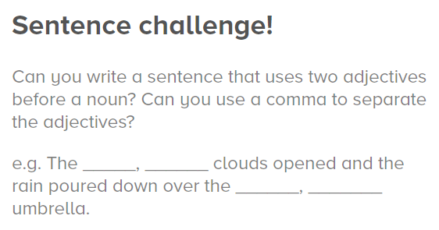

2

Slide 4
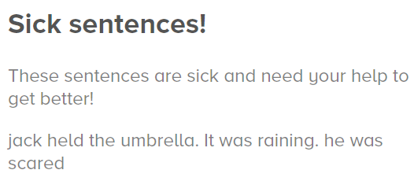
2

Slide 5
2
Can you write your own 3__ed sentences based around the picture?

