Slide 1
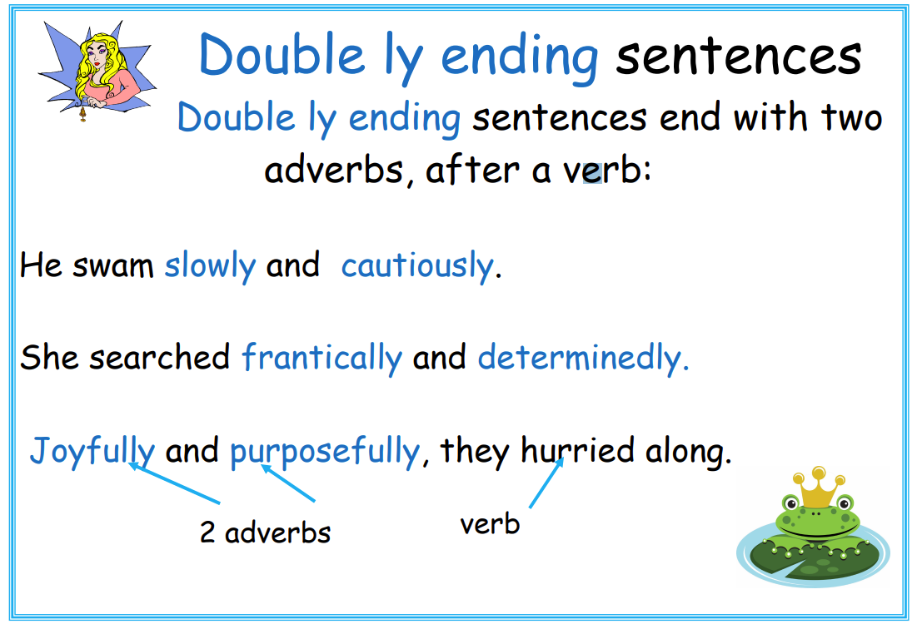
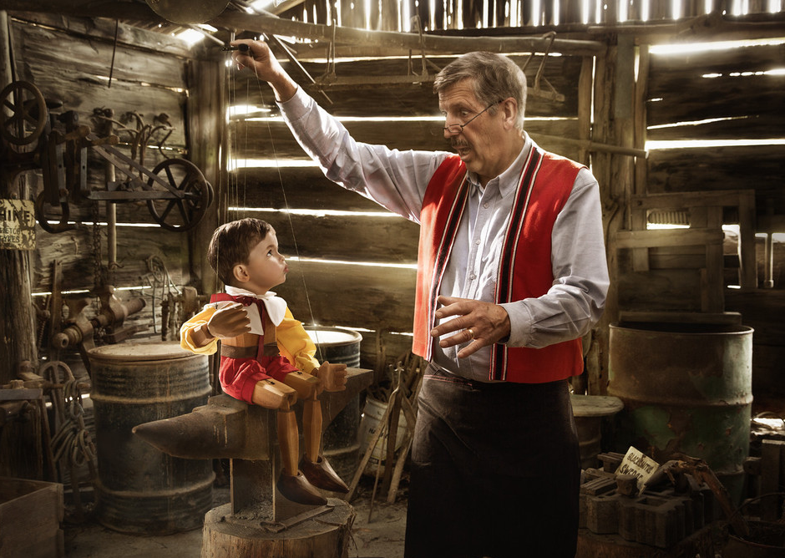
The boy transformed slowly and magically.
The old man stared anxiously and dumbfoundedly.
Magnificently and incredibly, he was no longer just a toy.

