Slide 1
Epiphany
Do you know what this means?

Slide 2
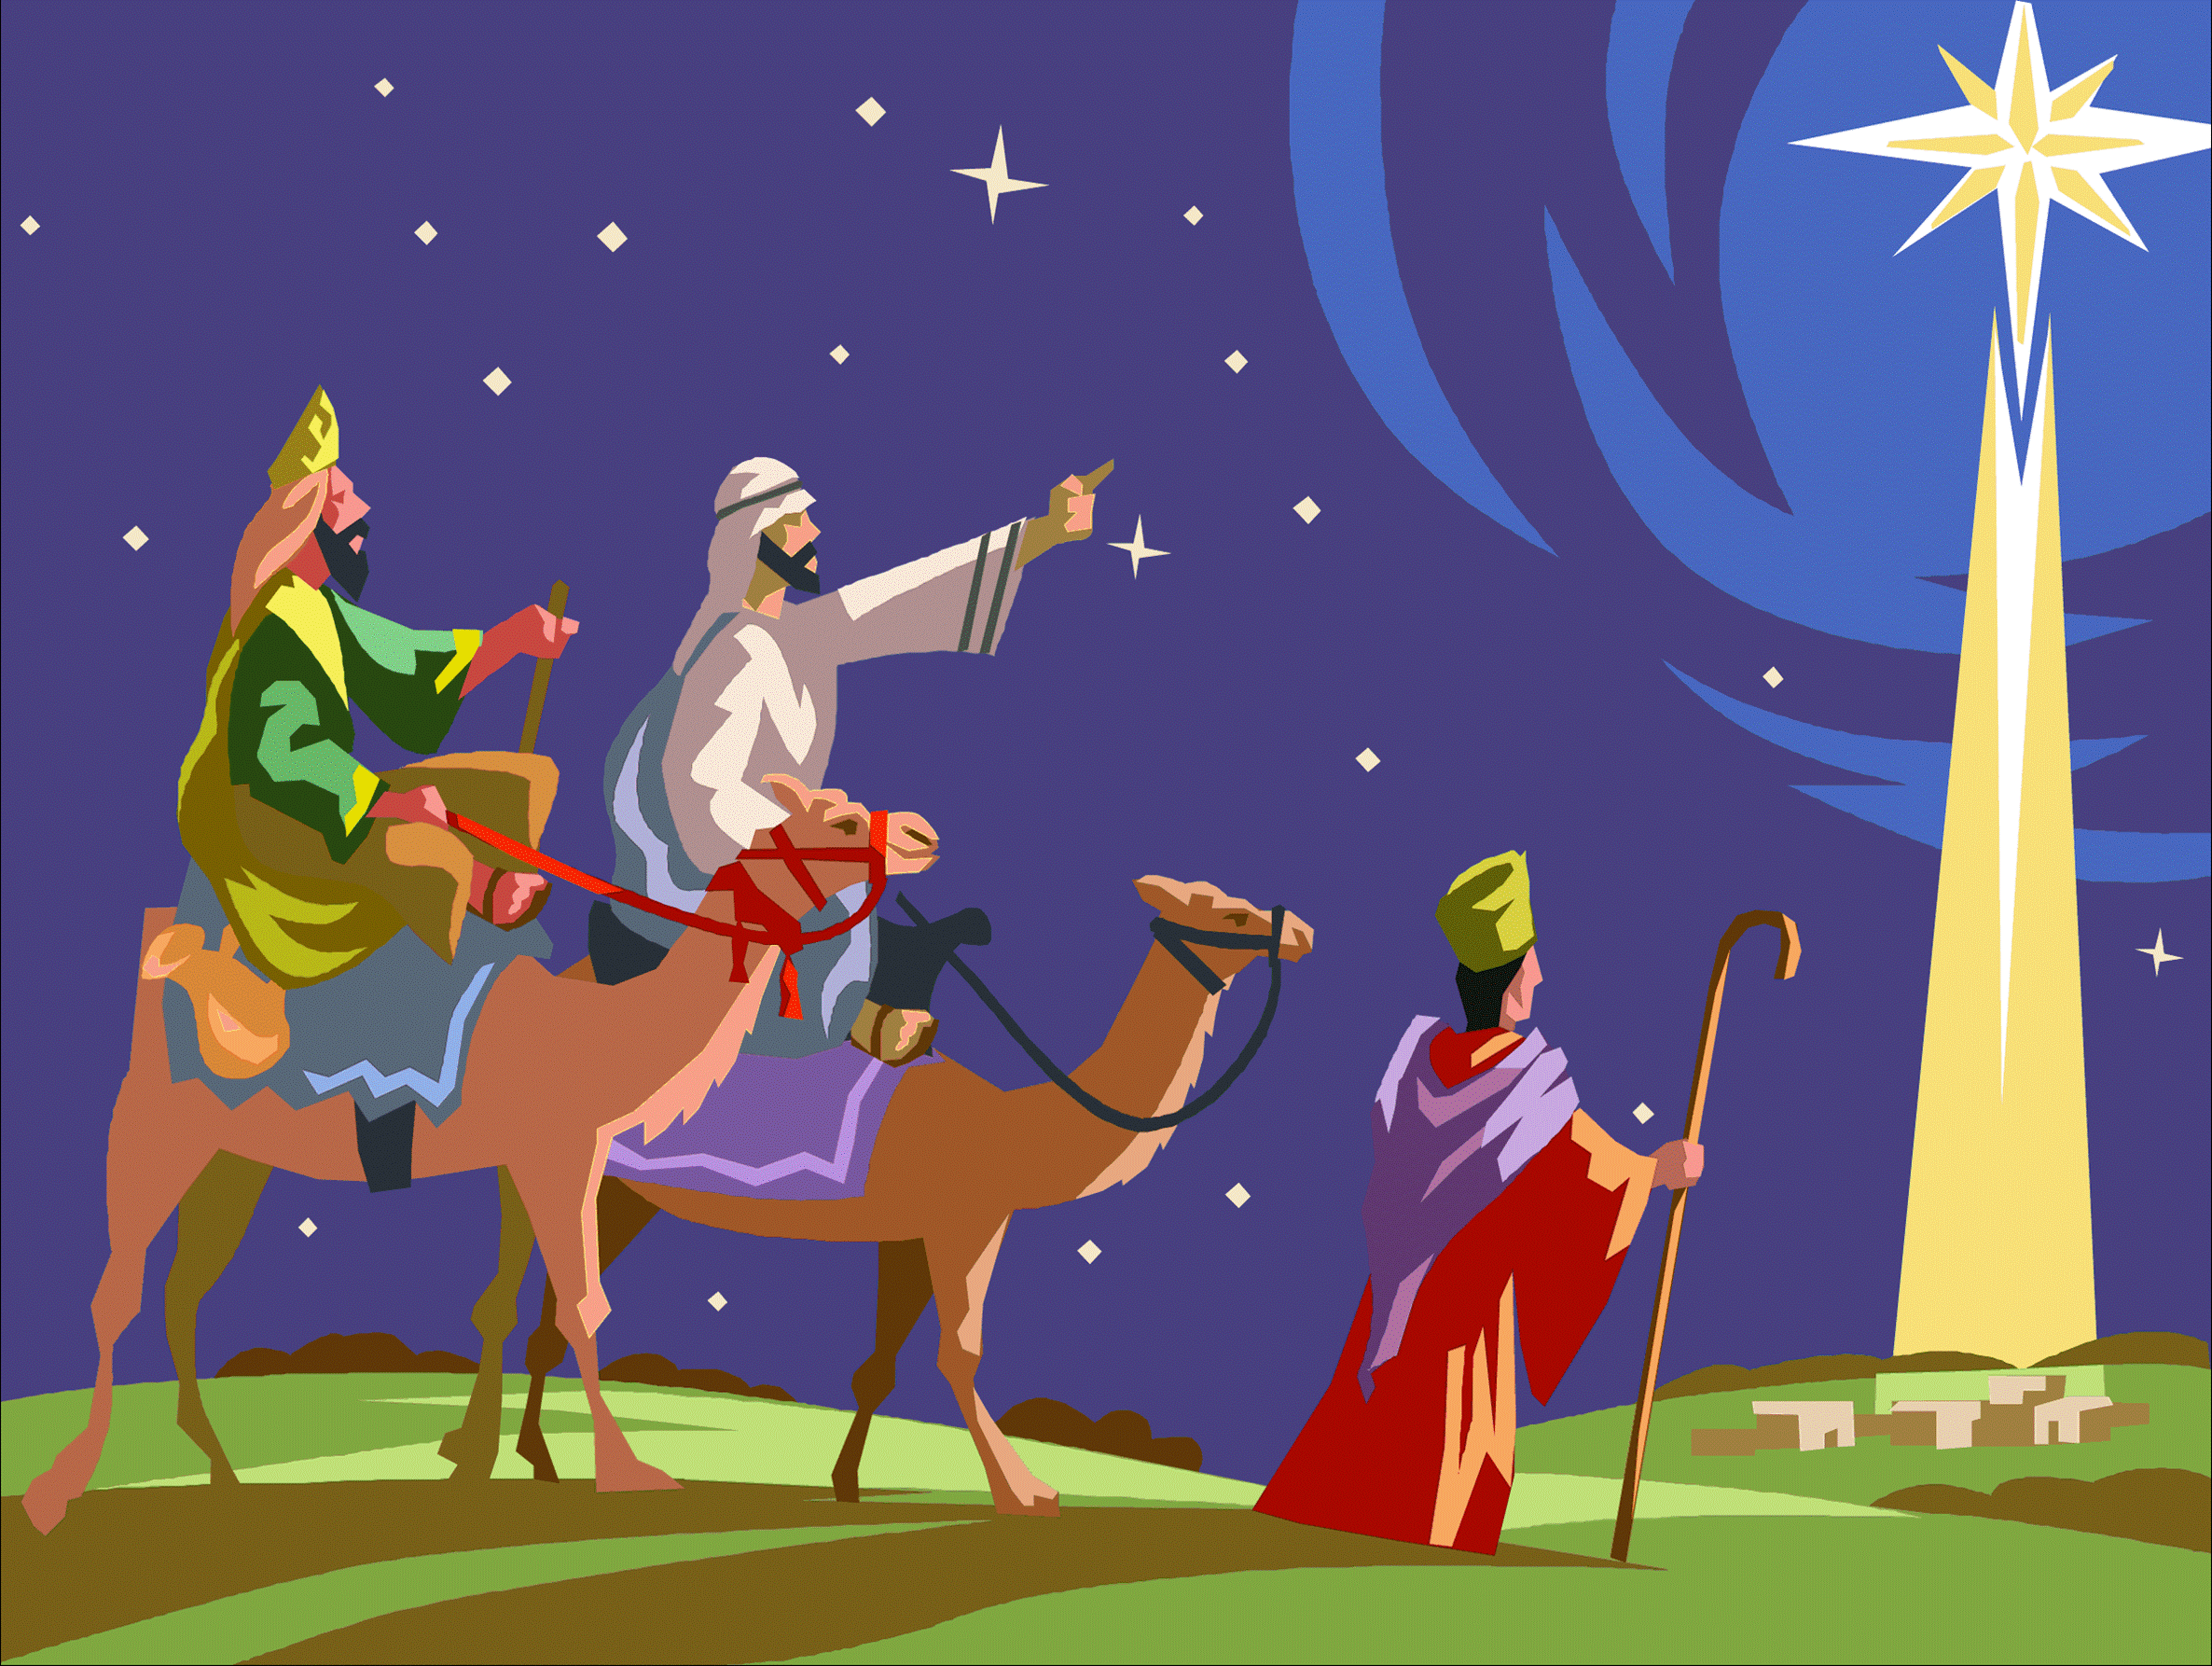
Which pictures of the Magi do you like best? Why?

Slide 3
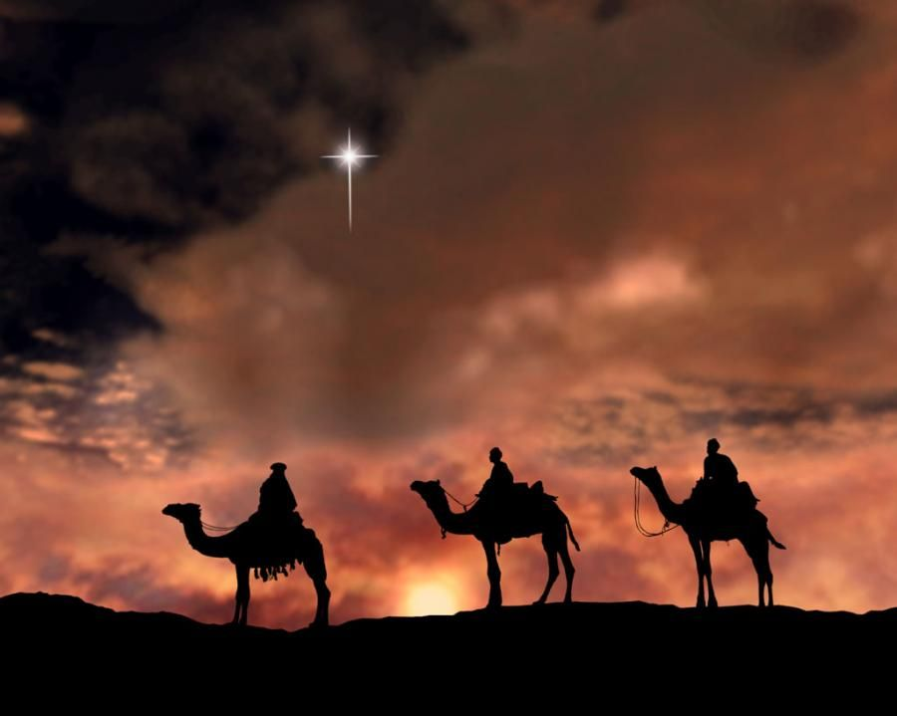

Slide 4
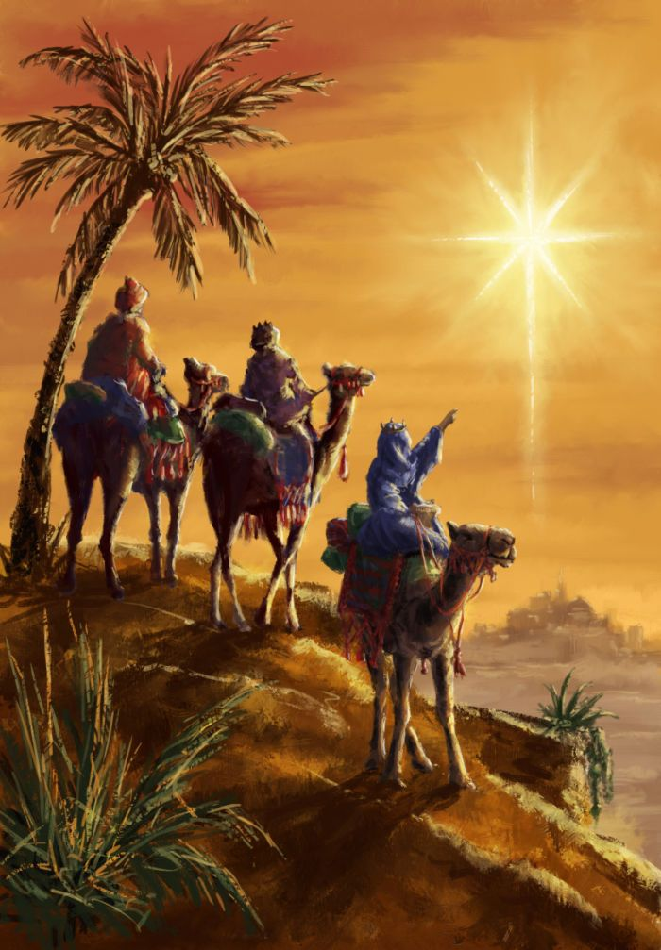

Slide 5
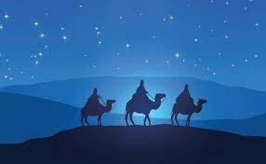

Slide 6
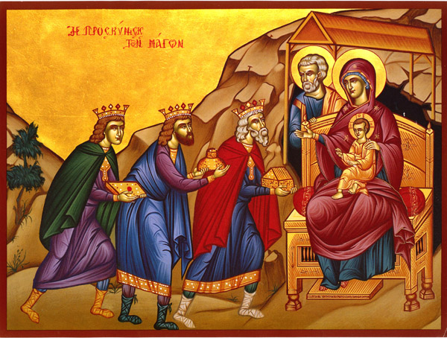

Slide 7


