Slide 1
Epiphany
Do you know what this means?

Slide 2
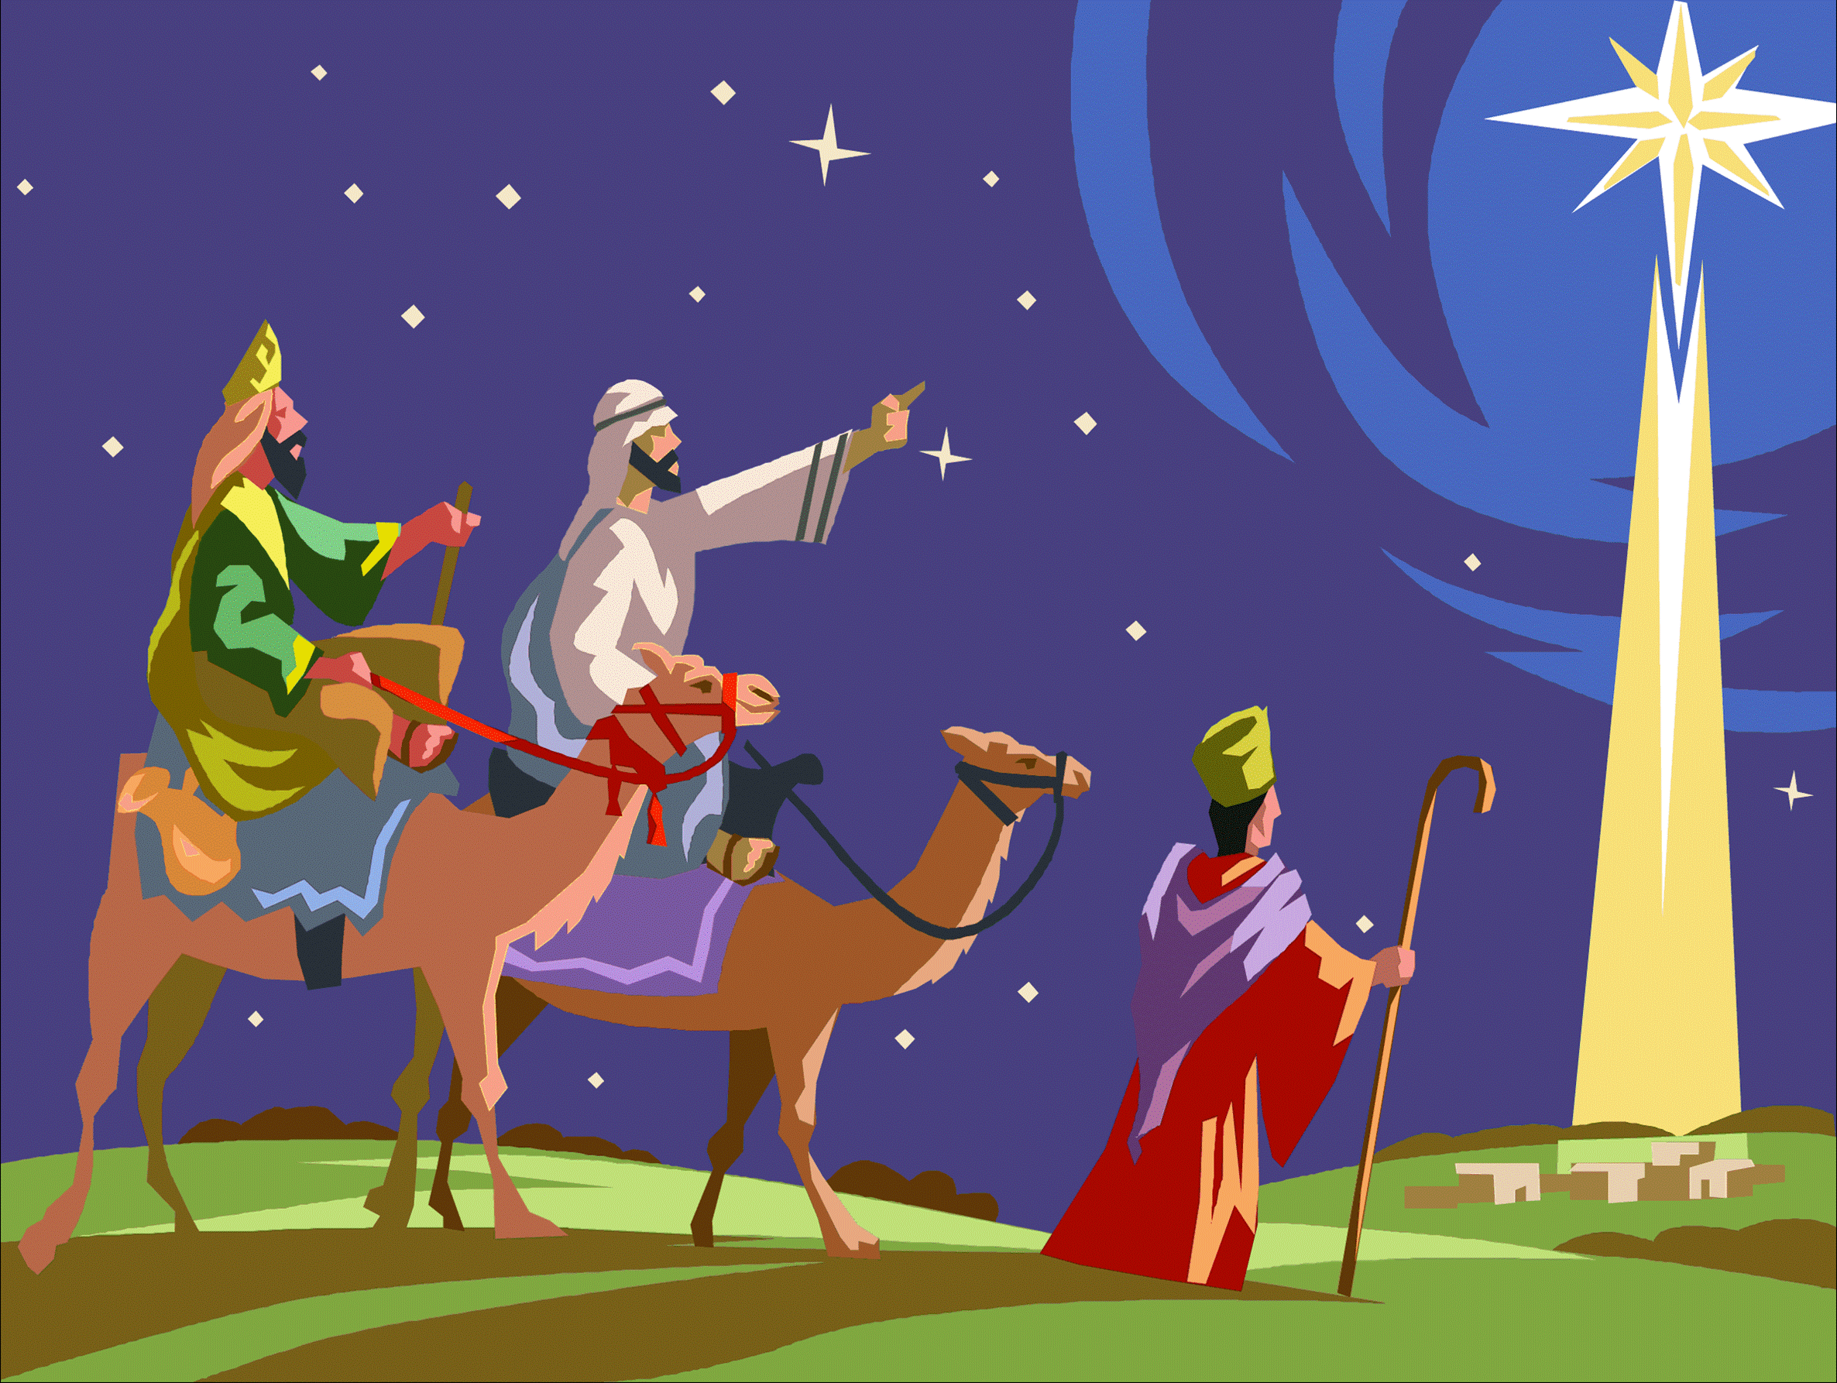
Which pictures of the Magi do you like best? Why?

Slide 3
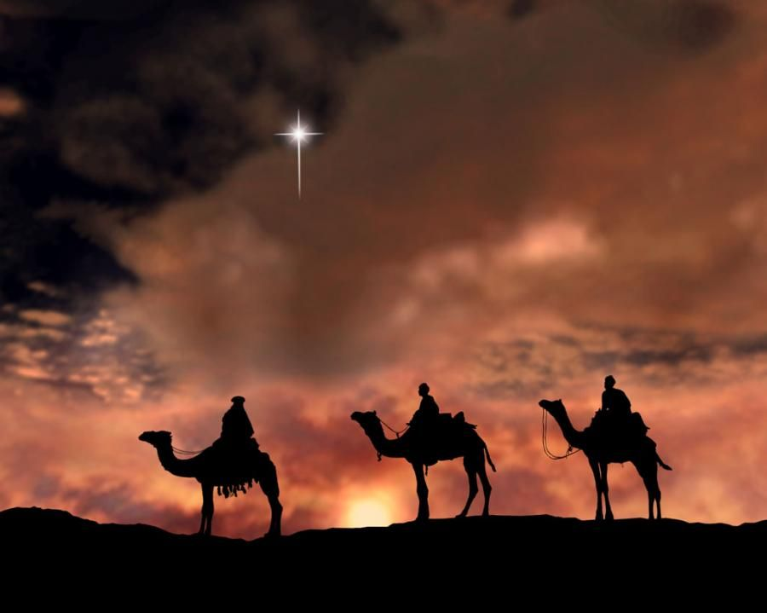

Slide 4
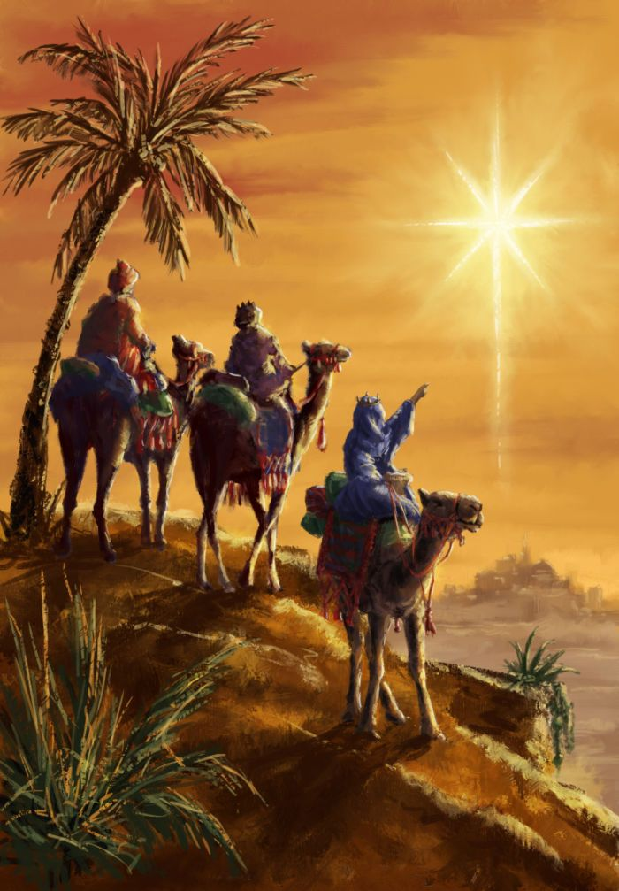

Slide 5
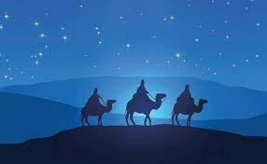

Slide 6
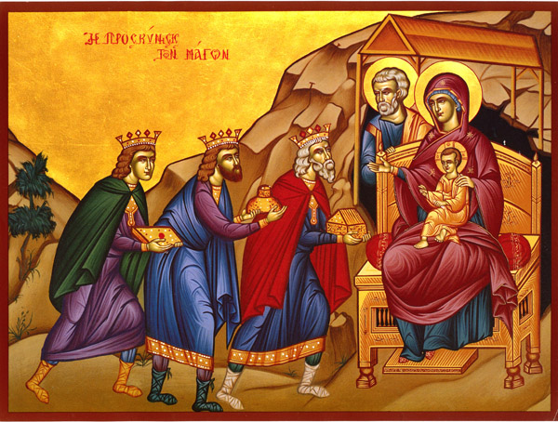

Slide 7
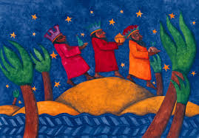

Slide 8
Your turn…
Can you create your own artwork to illustrate the Epiphany?
Think carefully:
What will you need to include in your picture? (It will need to clearly show what the Epiphany is about)
What materials/colours you want to use (use what you can get your hands on…felt tips, paint, coloured pencils, collage, anything goes…)
If you only have a pencil, think about using the pencil drawing techniques you learned about last half term (e.g. hatching, cross-hatching, stippling, scumbling etc)
Upload a photo of your finished picture to dojo. I would love to see them!

