Slide 1
Today we are learning to add ‘er’ and ‘est’ to adjectives.

Slide 2
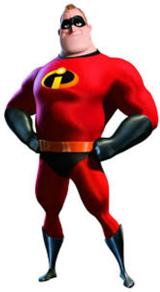
What has changed about this adjective?
Small
Smaller
Smallest

Slide 3
Which words are better?
We add ‘er’ and ‘est to adjectives to help make them even better!!!
bright
brighter
brightest
strong
stronger
strongest
taller
tallest
tall

Slide 4
How can these adjectives be changed to make them even better?
high
small
slow

Slide 5
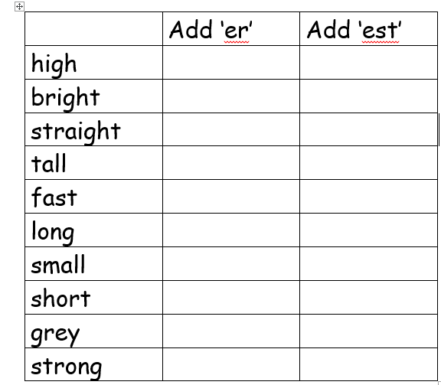
Your task….
Complete the table by adding ‘er’ and ‘est’ to adjectives to make them even better

