Slide 1
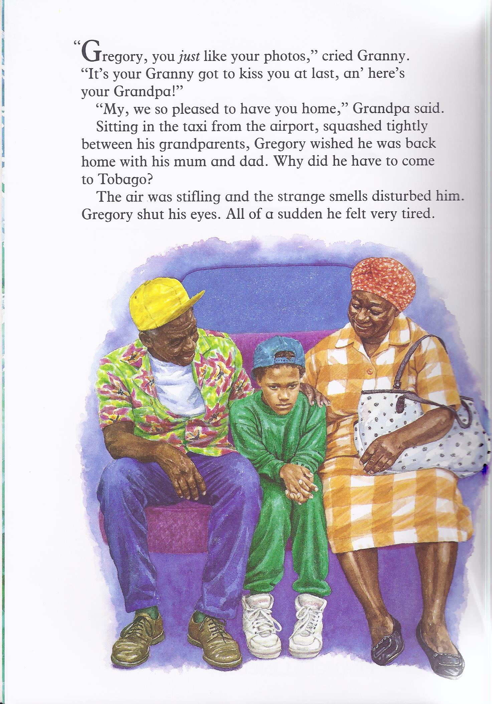
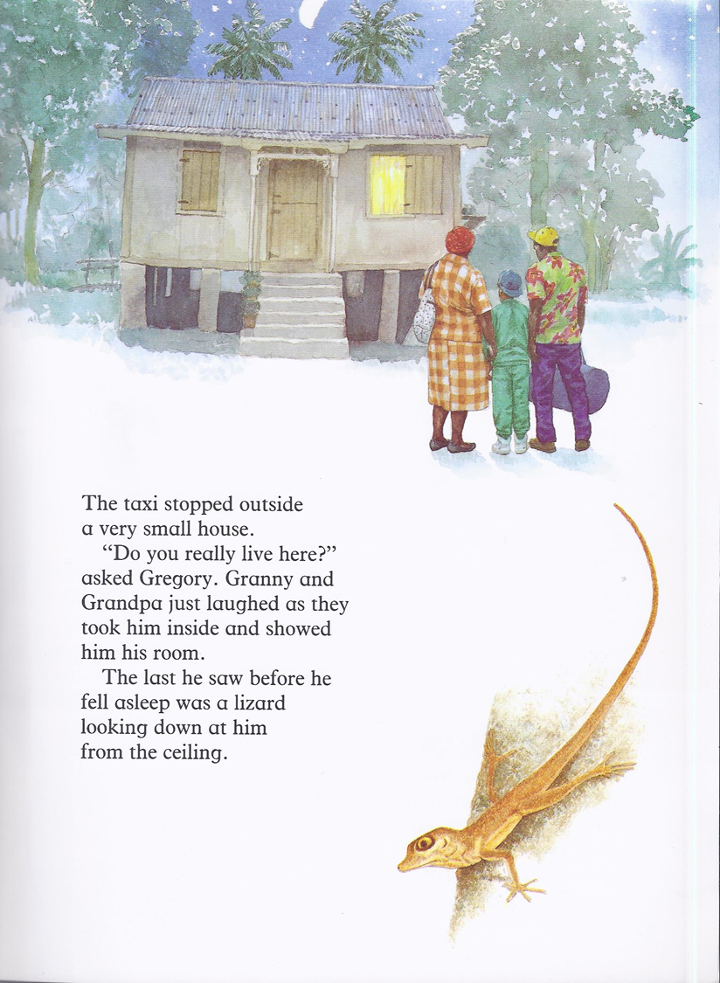

Slide 2
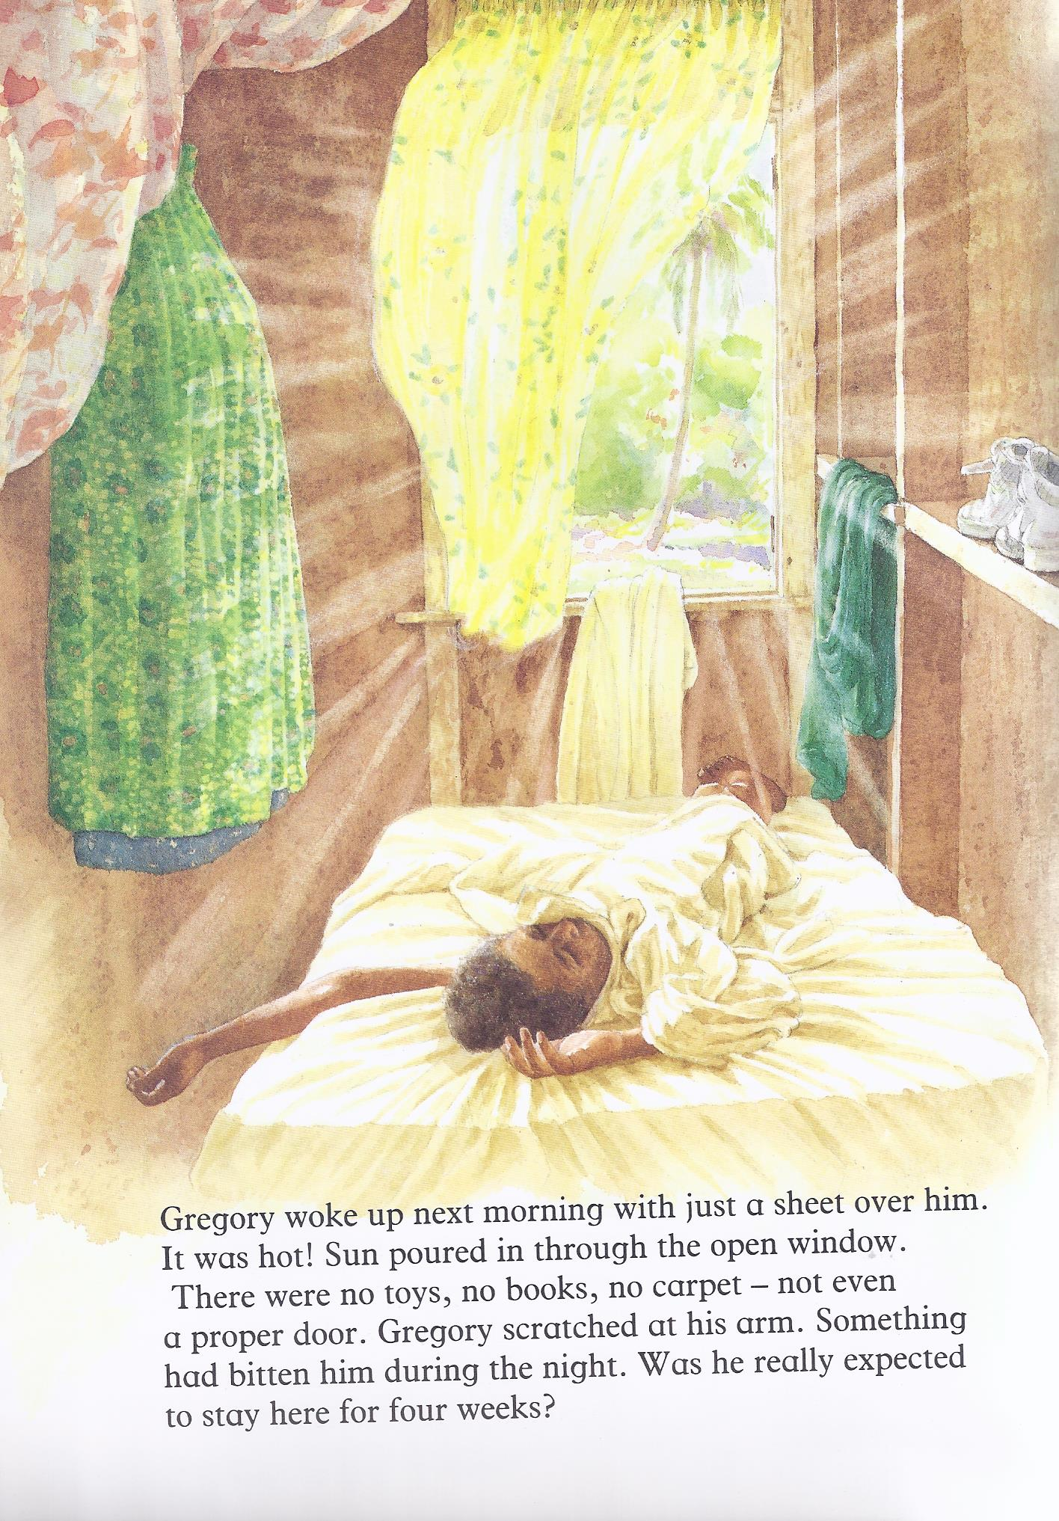
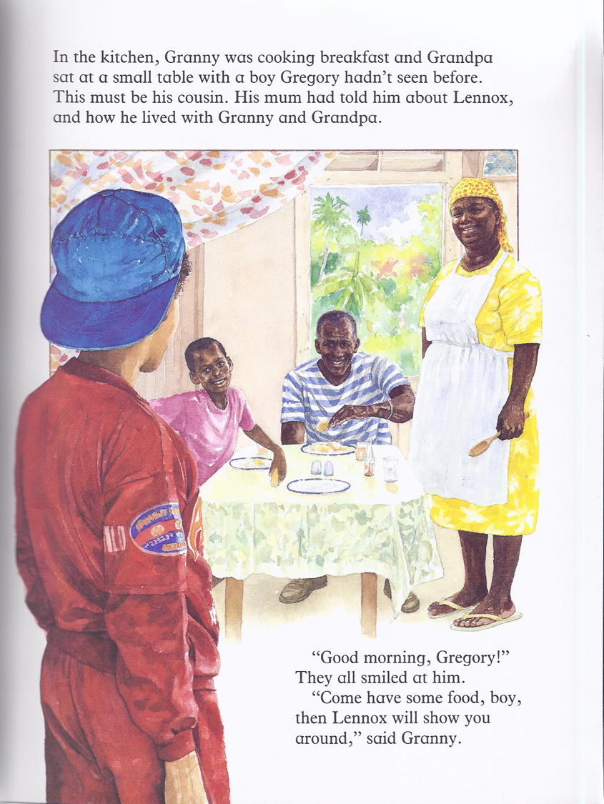

Slide 3
Can you find the answers?
Find it Prove it
Paragraph 1 –
FI – Why has Gregory come to Tobago?
FI – How does he feel about it?
PI – Why does Granny say that Gregory looks just like his photos?
Paragraph 2 –
PI – How does Gregory feel about Granny and Grandpa's house?
Why does Grandpa find that funny?
Paragraph 3 –
FI – What does Gregory feel is wrong with his room?
Paragraph 4 –
Who is Lennox?

