Slide 1

Titanic KQ2
What was so special about
life on board the Titanic and
was it the same for everyone?

Slide 2
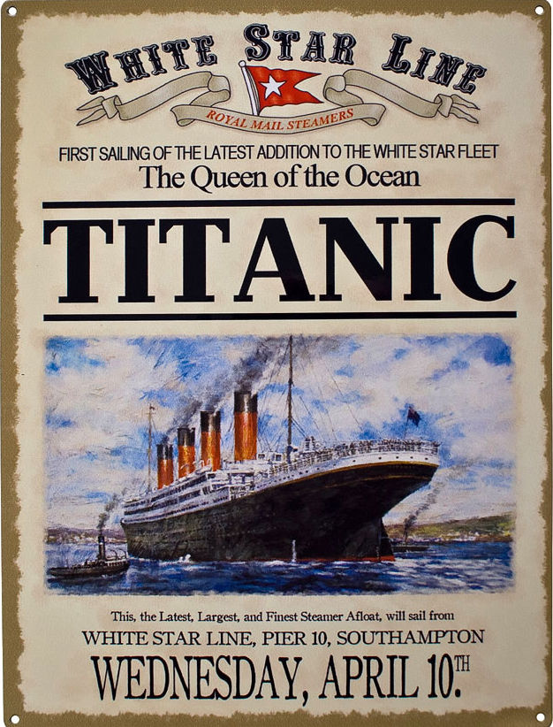

Slide 3
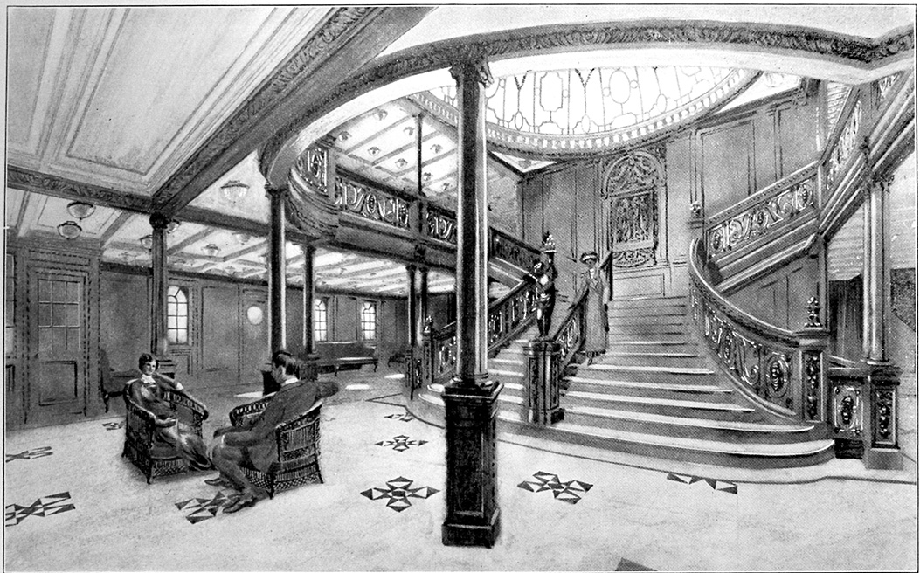
https://upload.wikimedia.org/wikipedia/commons/a/ad/Drawing_of_the_Grand_Staircase_onboard_the_RMS_Titanic_from_the_1912_promotional_booklet.jpg

Slide 4

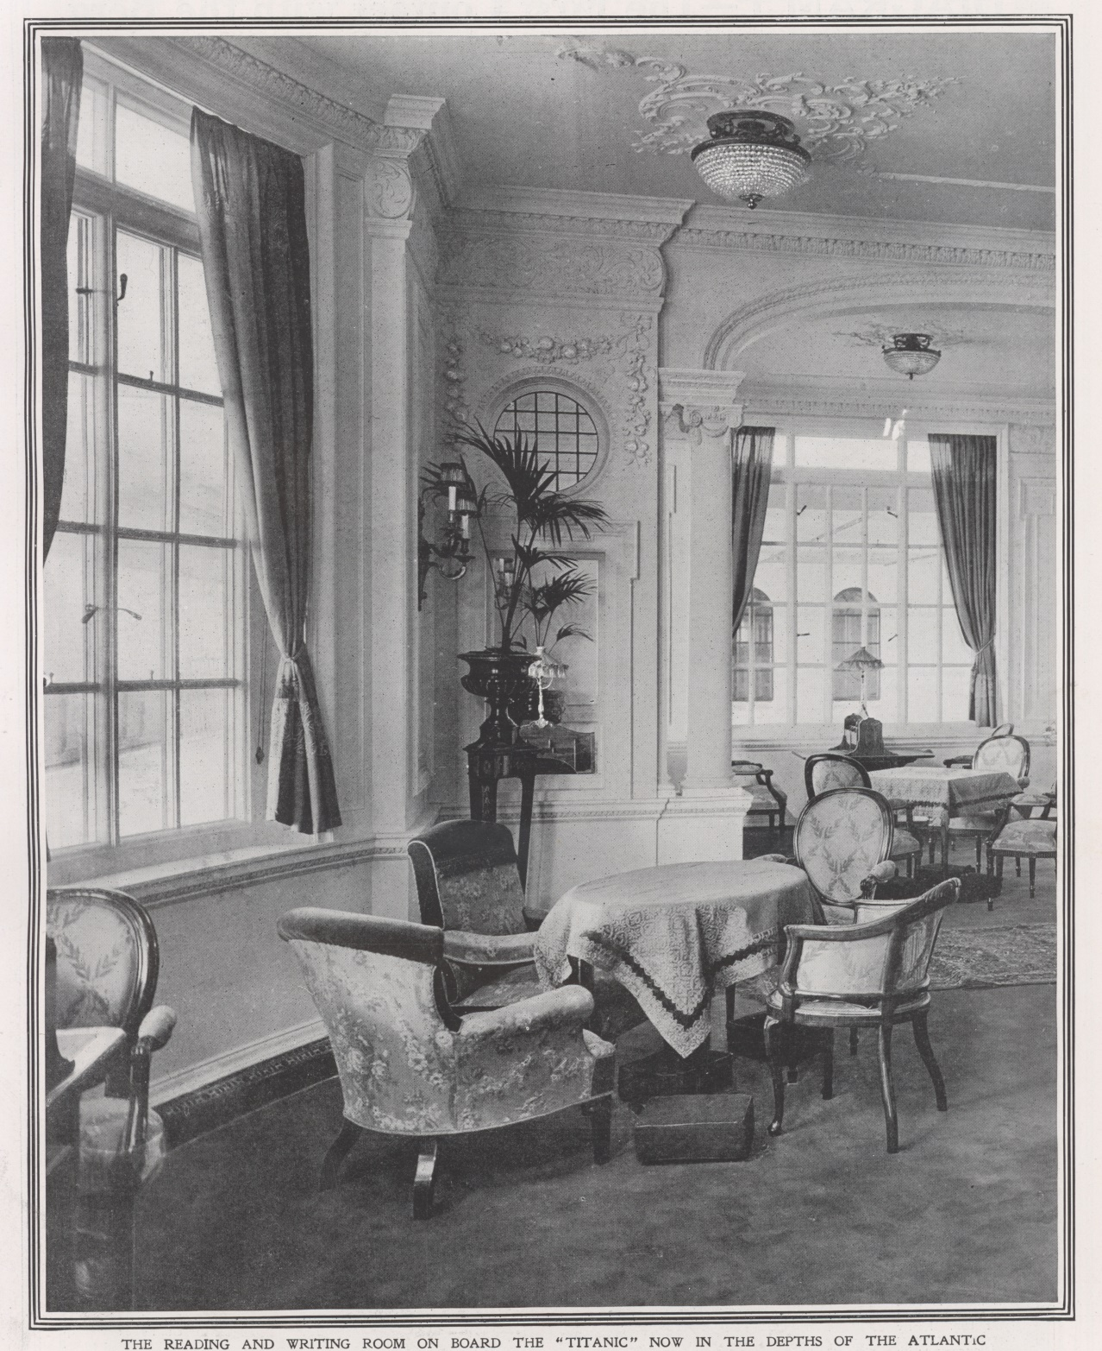
The reading and writing room on board the Titanic
© Look and Learn

Slide 5
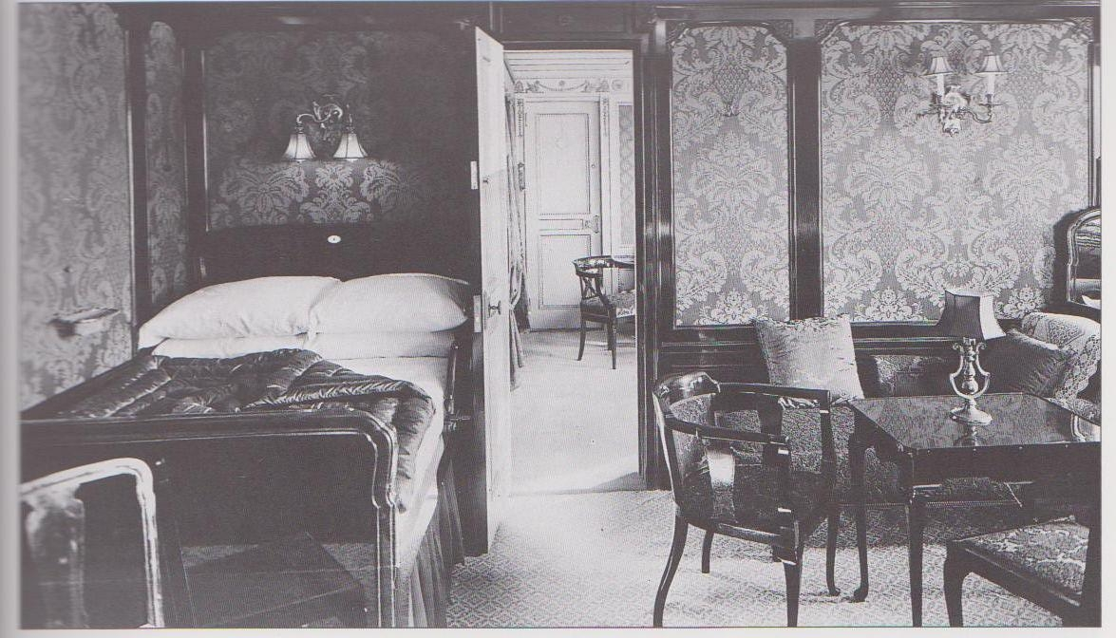
https://dianaoverbey.files.wordpress.com/2012/04/b60-opening-onto-private-drawing-room.jpg

Slide 6
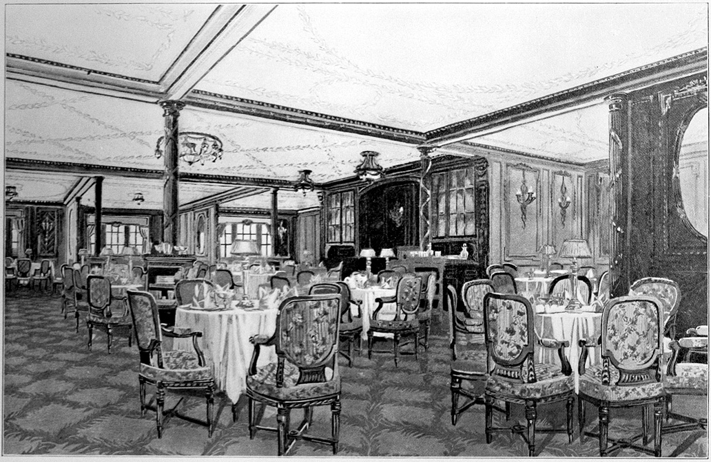

https://upload.wikimedia.org/wikipedia/commons/8/8d/Titanic_A_La_Carte_restaurant.jpg

Slide 7
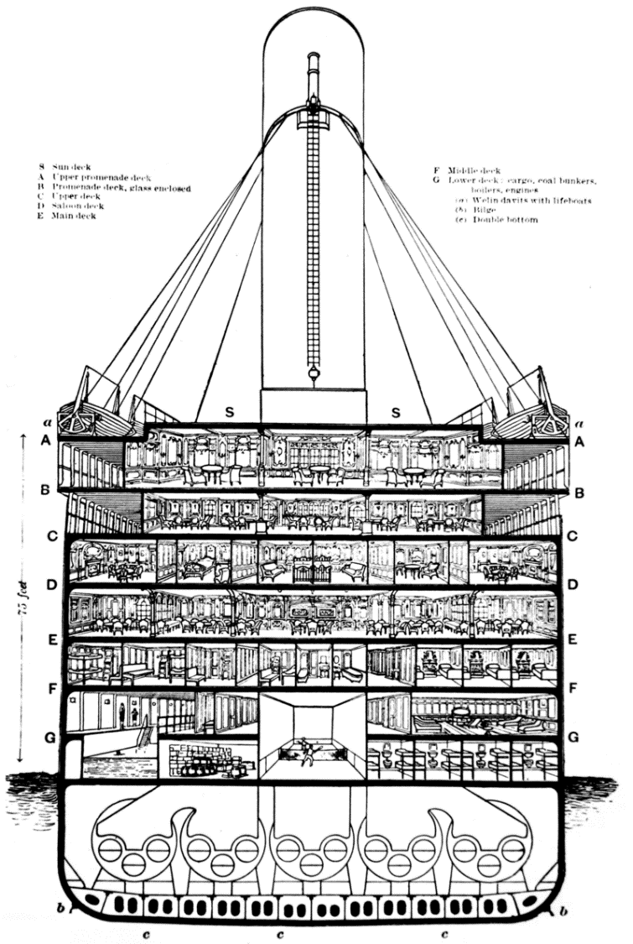
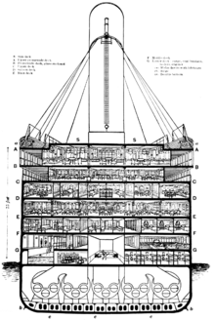
Showing the many decks of the Titanic
https://upload.wikimedia.org/wikipedia/commons/8/84/Titanic_cutaway_diagram.png

Slide 8
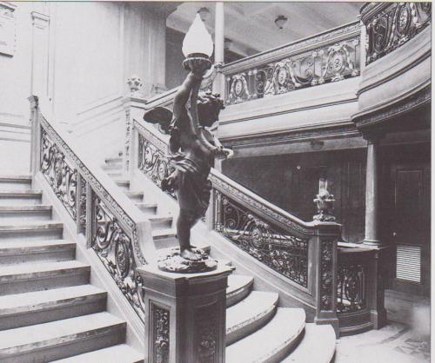
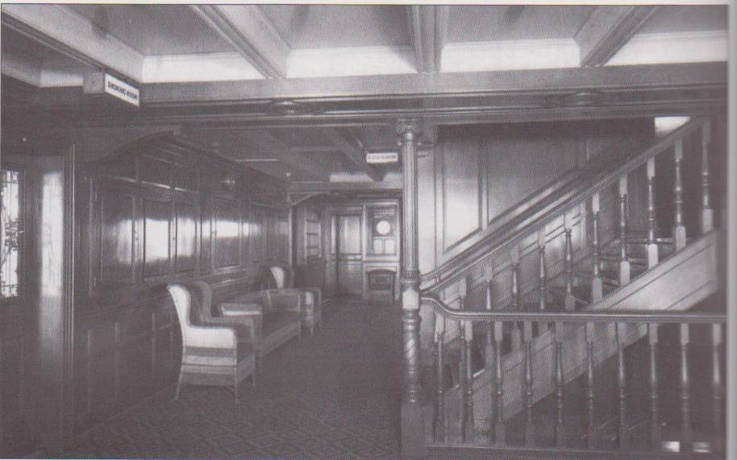
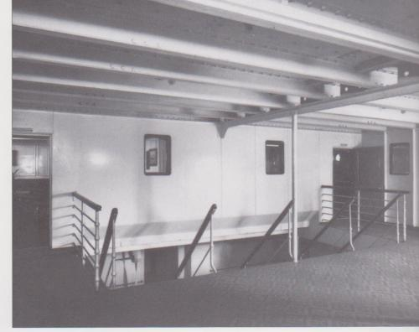
See how different the staircases were

Slide 9
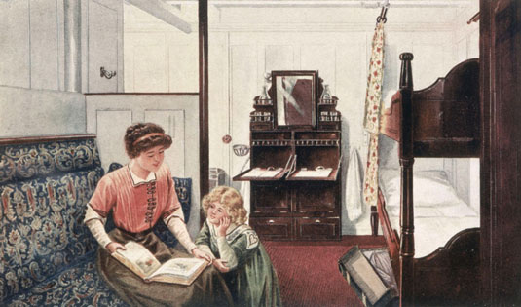
Second class room
https://upload.wikimedia.org/wikipedia/commons/8/8b/Period_Illustration_of_2nd_Class_Stateroom_on_Titanic.jpg

Slide 10
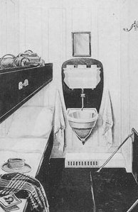

Third class rooms
https://upload.wikimedia.org/wikipedia/commons/f/f5/Titanic-third-class-cabin.jpg

Slide 11
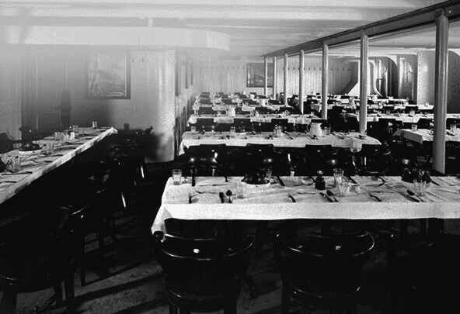
3rd class dining room
https://upload.wikimedia.org/wikipedia/commons/2/20/3rd_Class_Dining_Saloon_on_the_RMS_Olympic.jpg

Slide 12

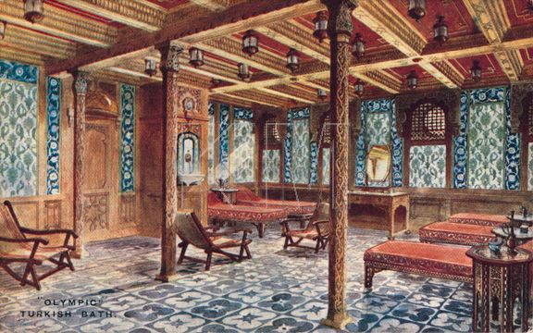
https://upload.wikimedia.org/wikipedia/commons/b/b5/Cool_Room_of_the_Turkish_Baths%2C_RMS_Olympic.jpg

Slide 13
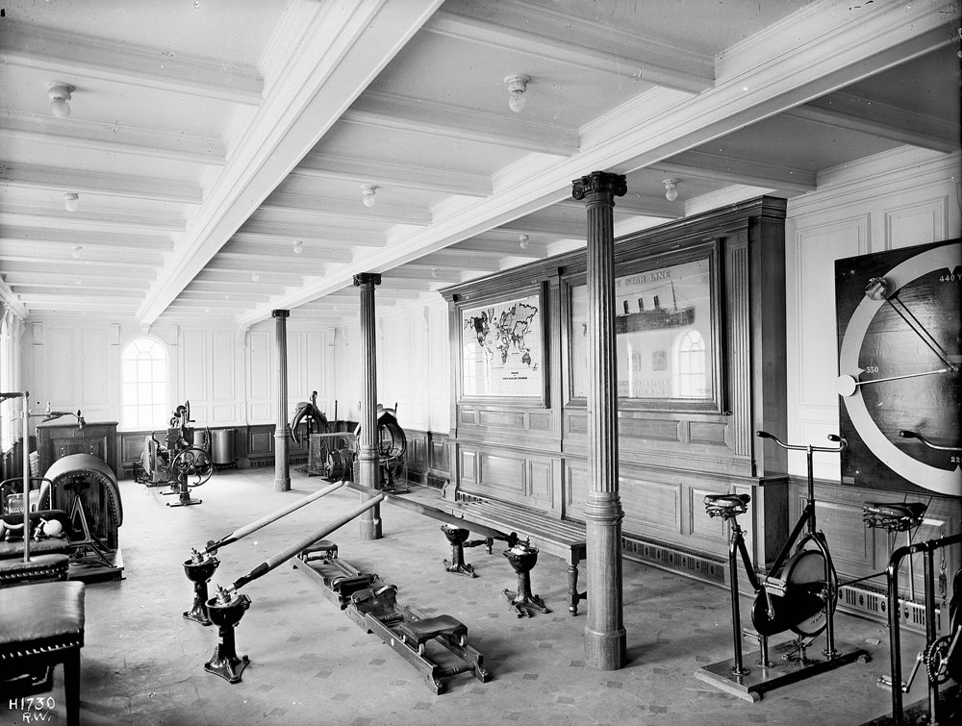

https://upload.wikimedia.org/wikipedia/commons/2/26/Gym.jpg

Slide 14
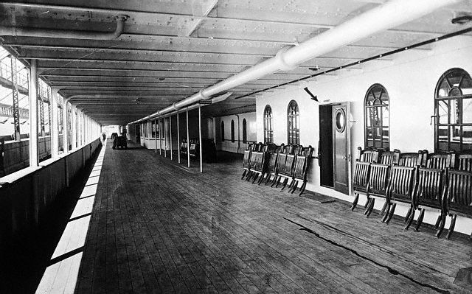

https://upload.wikimedia.org/wikipedia/commons/0/08/RMS_Olympic_promenade_deck.jpg

Slide 15
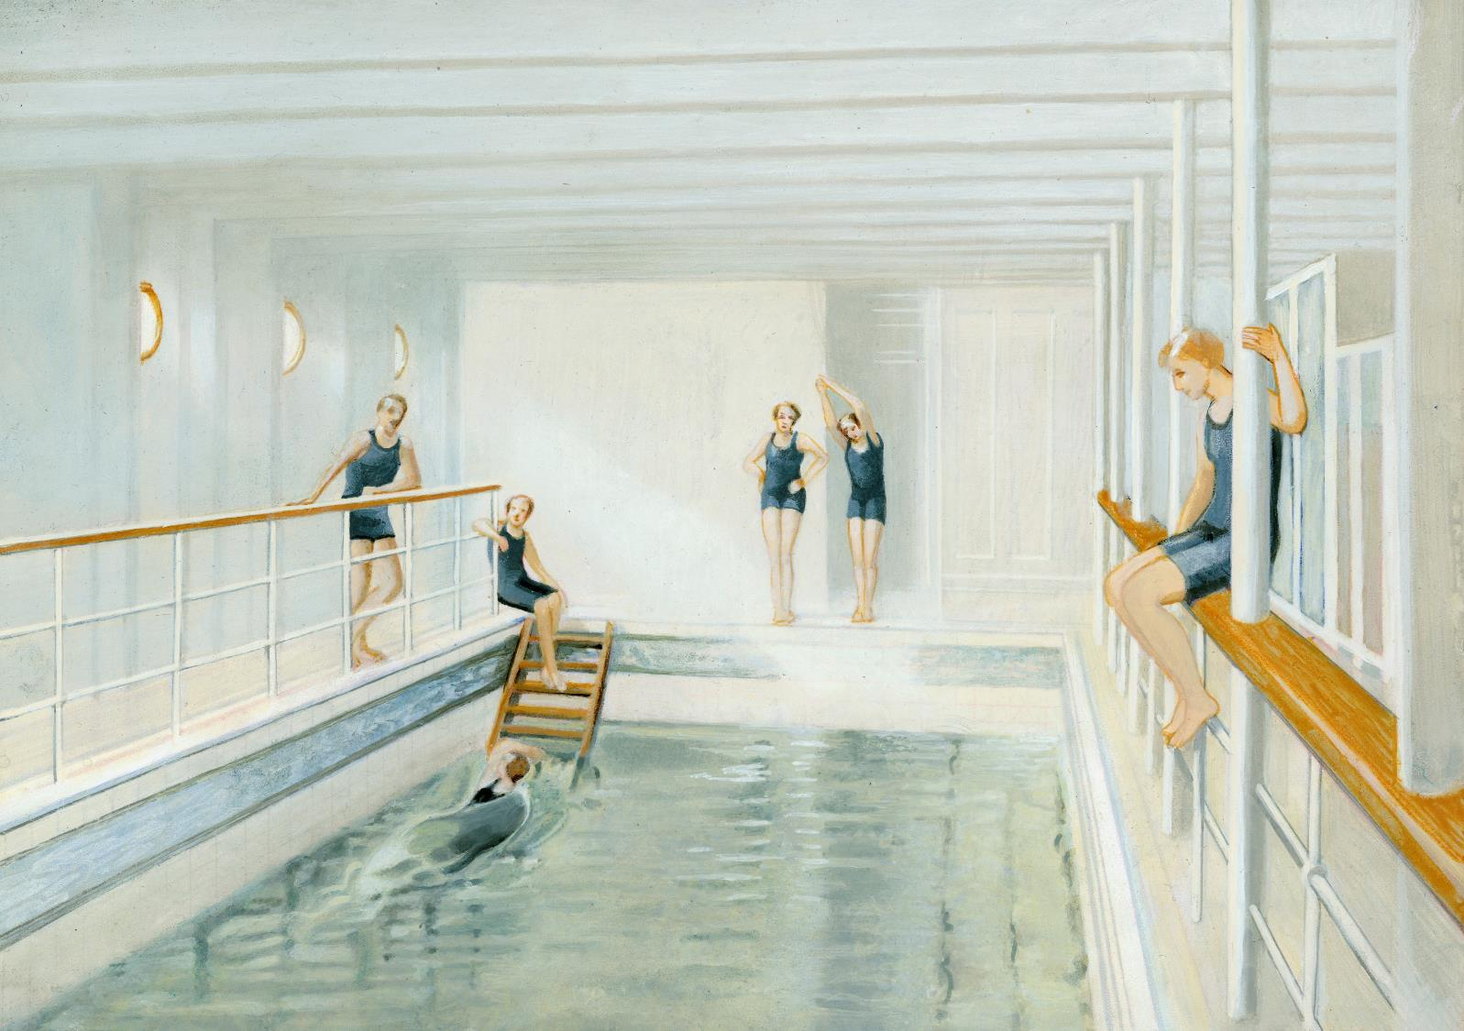

© Look and Learn

Slide 16
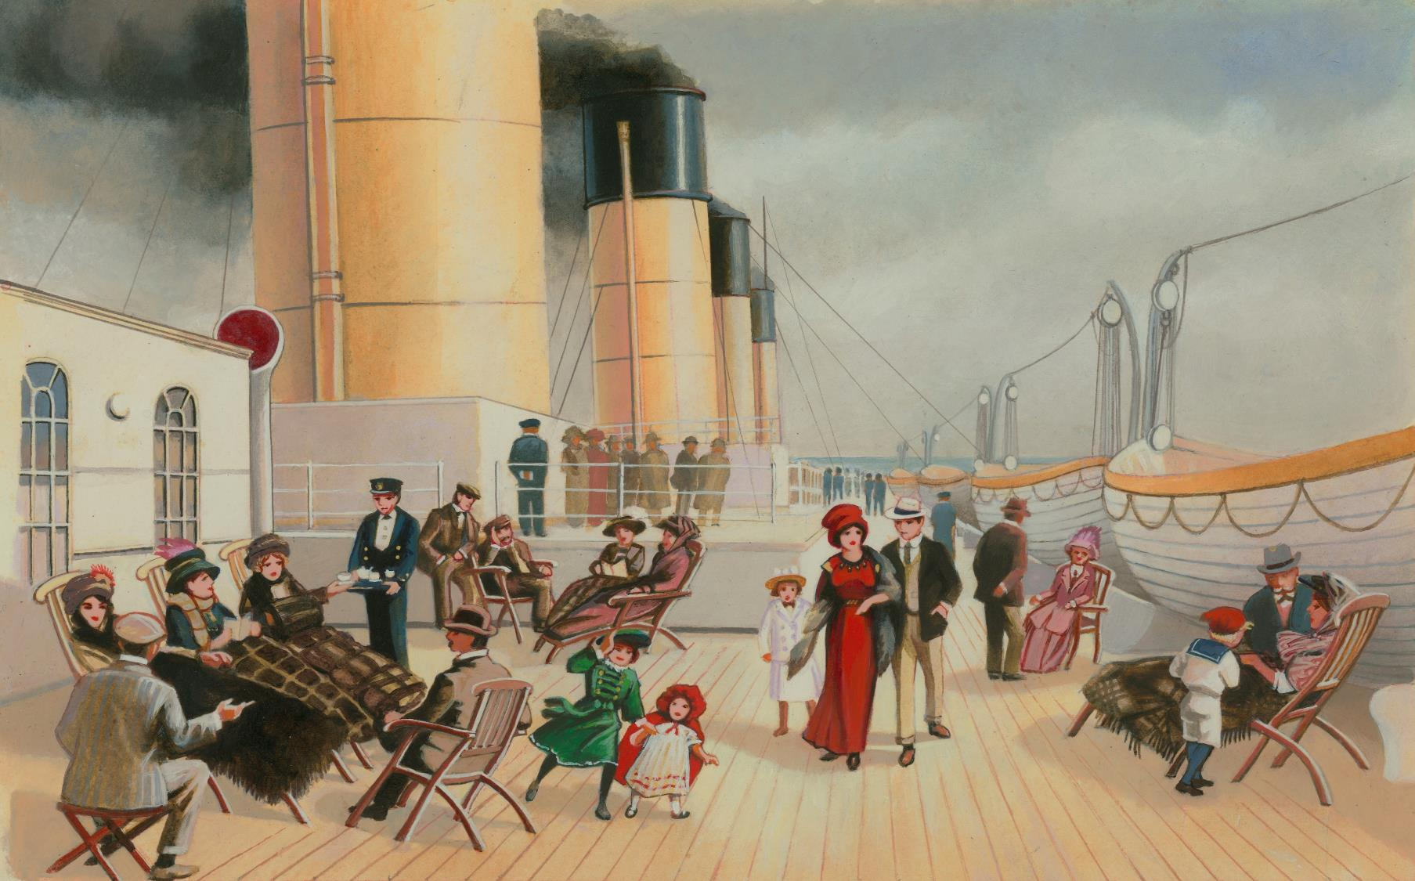

Second class promenade deck

Slide 17
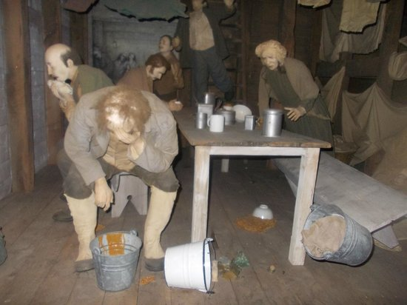

Was it the same for everyone
Third class

Slide 18

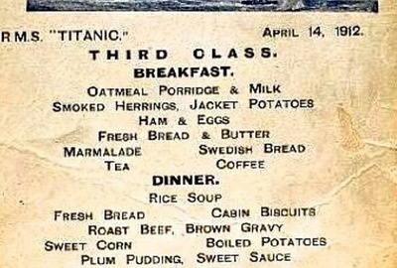
http://cdn.lifebuzz.com/images/131256/lifebuzz-a41db3db711dffeef063246413ad1d29-thumb_400.jpg

