Slide 1
Fox Class Art
Our art work, inspired by the work of Georgia o’keeffe

Slide 2
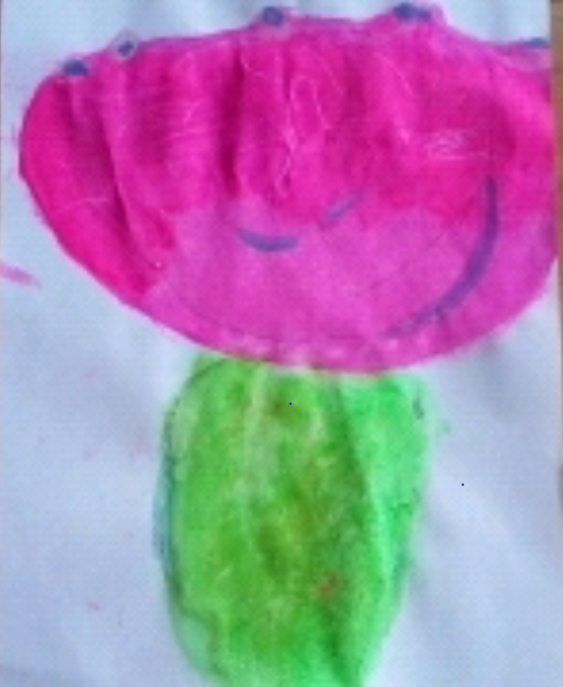
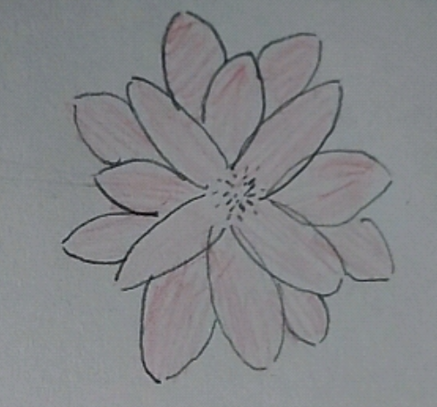
Daisy Rhodes
Beth Anderson

Slide 3
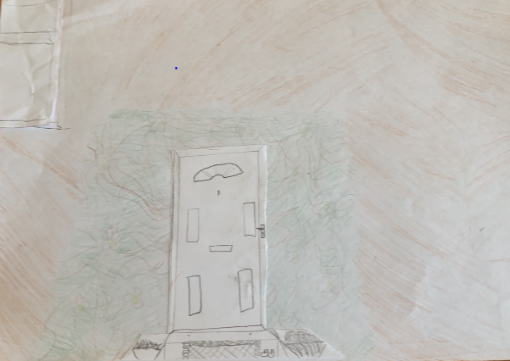
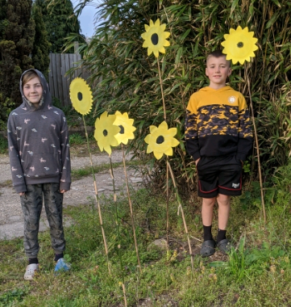
Brooke Voutt
Carly and Jake Funnel

Slide 4
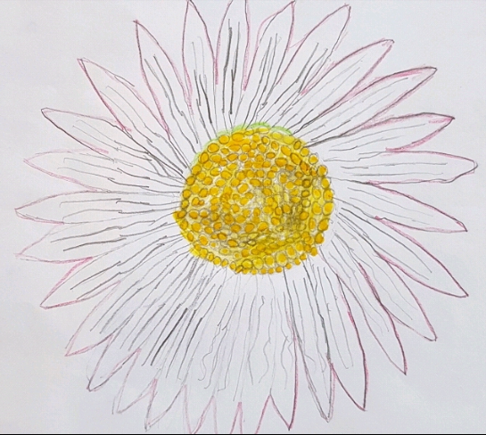
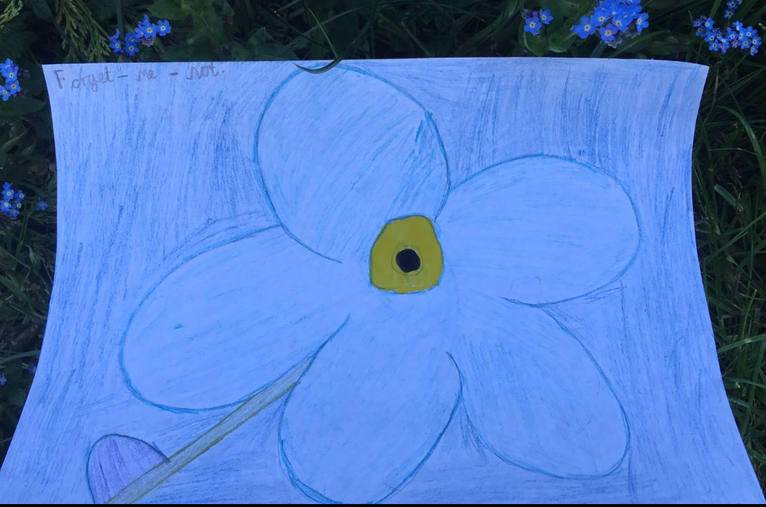
Casey Stoner
Ewan Brown

Slide 5
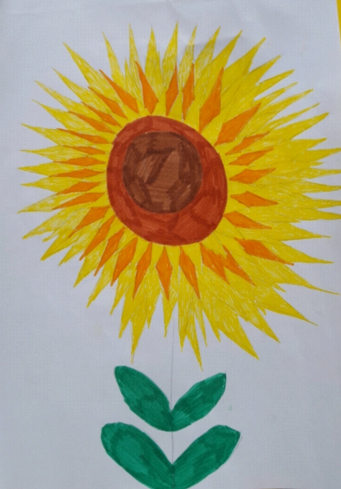
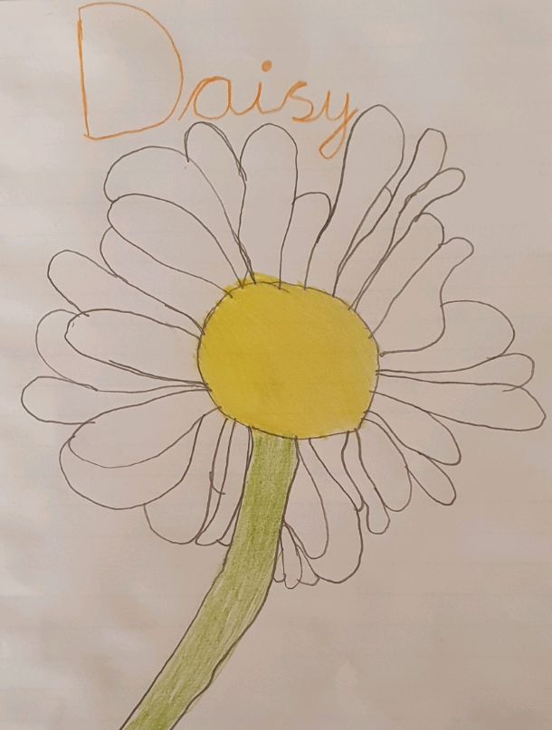
Lily Baty
Oscar Allen

Slide 6
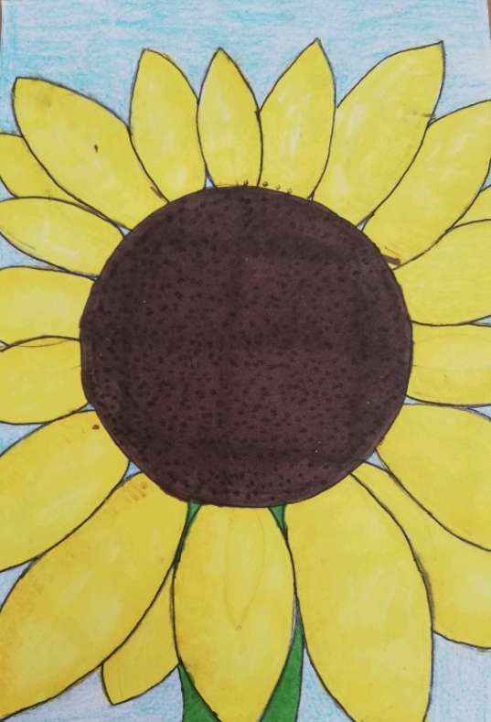
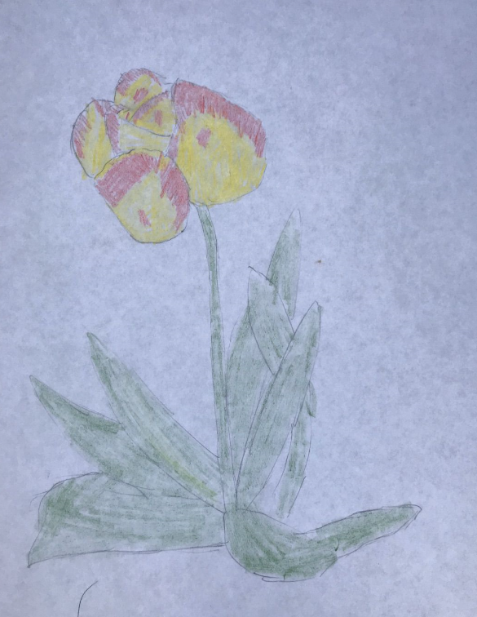
Riley Allan
Robin Woodcock

Slide 7
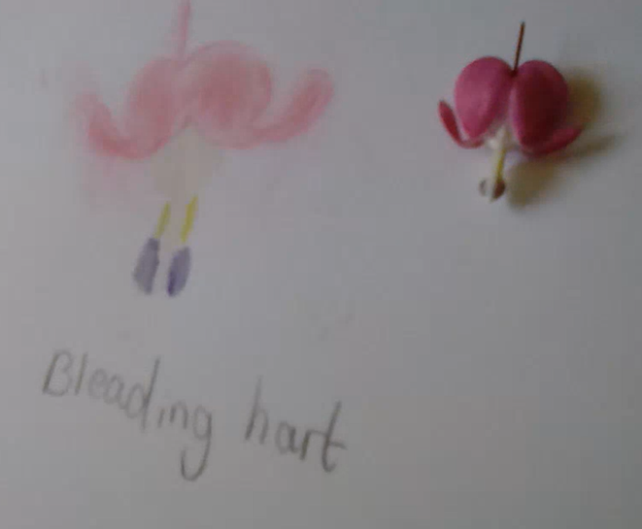
Tibby Ellis
Thank you to everyone who shared a photo of their amazing art work!
Georgia O’Keeffe would be proud!

