Slide 1

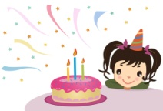
The ‘ir’ Sound
This week we are learning words with the long ‘ir’ sound.
These are:
girl | sir | bird | shirt | skirt
birth | third | first | thirteen | thirst
Lets see if we can make a short story out of these words:
There once was a young g............... who was th.................... years old. She always
celebrated her b............day on the f............ day of the th.......... Month.
Whenever she went to school she would always wear a blue sh........ with a little
white b......... on it (the Dove of Peace) and a blue sk......... so that her teacher
(who she called s......) would not tell her off.
Now see if you can make up a sentence using the word thirst:
......................................................................................................................................................
Cover and copy the words – practice writing them without looking at them:
girl ........................................... sir ................................................
bird .......................................... shirt .............................................
skirt .......................................... birth ..............................................
third .......................................... first ..............................................
thirteen .......................................... thirsty ..........................................
Can you think of any other words with the ir sound?
.............................. ........................... .............................. ...........................

