Slide 1


Year 1/2 – Autumn Block 2 – Addition and Subtraction
Step 12
Year 1: Counting Back
Year 2: Subtract with
2-Digits 1
© Classroom Secrets Limited 2018

Slide 2
Introduction
Complete each sequence of numbers.
8 |  | 7 |  | 6
10 |  | 9 |  | 8
5 |  | 4 |  | 3
Y1
© Classroom Secrets Limited 2018

Slide 3
Introduction
Complete each sequence of numbers.
8 |  | 7 |  | 6 |  | 5 |  | 4 |  | 3
10 |  | 9 |  | 8 |  | 7 |  | 6 |  | 5
5 |  | 4 |  | 3 |  | 2 |  | 1 |  | 0
Y1
© Classroom Secrets Limited 2018

Slide 4
Introduction
Use knowledge of number bonds to solve these calculations quickly:
20 – 5 =
20 – 3 =
20 – 8 =
20 – 10 =
20 – 15 =
20 – 14 =
20 – 11 =
20 – 13 =
20 – 12 =
20 – 16 =
Y2
© Classroom Secrets Limited 2018

Slide 5
Introduction
Use knowledge of number bonds to solve these calculations quickly:
20 – 5 = | 15
20 – 3 = | 17
20 – 8 = | 12
20 – 10 = | 10
20 – 15 = | 5
20 – 14 = | 6
20 – 11 = | 9
20 – 13 = | 7
20 – 12 = | 8
20 – 16 = | 4
Y2
© Classroom Secrets Limited 2018

Slide 6
Varied Fluency 1
Tick the calculation that matches the number line.
0 | 1 | 2 | 3 | 4 | 5 | 6 | 7 | 8 | 9 | 10
A. | 6 | – | 2 | = | 4
B. | 6 | – | 3 | = | 3
C. | 6 | – | 1 | = | 5
Y1
© Classroom Secrets Limited 2018

Slide 7
Varied Fluency 1
Tick the calculation that matches the number line.
0 | 1 | 2 | 3 | 4 | 5 | 6 | 7 | 8 | 9 | 10
A. | 6 | – | 2 | = | 4
B. | 6 | – | 3 | = | 3 | 
C. | 6 | – | 1 | = | 5
Y1
© Classroom Secrets Limited 2018

Slide 8
Varied Fluency 2
True or false?
If I count backwards 4 from 9, the answer is 5.
0 | 1 | 2 | 3 | 4 | 5 | 6 | 7 | 8 | 9 | 10
Y1
© Classroom Secrets Limited 2018

Slide 9
Varied Fluency 2
True or false?
If I count backwards 4 from 9, the answer is 5.
True
0 | 1 | 2 | 3 | 4 | 5 | 6 | 7 | 8 | 9 | 10
Y1
© Classroom Secrets Limited 2018

Slide 10
Varied Fluency 3
Use the number line to complete to calculation.
0 | 1 | 2 | 3 | 4 | 5 | 6 | 7 | 8 | 9 | 10
8 | – |  | = | 5
Y1
© Classroom Secrets Limited 2018

Slide 11
Varied Fluency 3
Use the number line to complete to calculation.
0 | 1 | 2 | 3 | 4 | 5 | 6 | 7 | 8 | 9 | 10
8 | – | 3 | = | 5
Y1
© Classroom Secrets Limited 2018

Slide 12
Varied Fluency 4
Start on the number 10. Count backwards 4.
Which number do you land on?
Write a number sentence to match.
0 | 1 | 2 | 3 | 4 | 5 | 6 | 7 | 8 | 9 | 10
Y1
© Classroom Secrets Limited 2018

Slide 13
Varied Fluency 4
Start on the number 10. Count backwards 4.
Which number do you land on?
Write a number sentence to match.
10 – 4 = 6
0 | 1 | 2 | 3 | 4 | 5 | 6 | 7 | 8 | 9 | 10
Y1
© Classroom Secrets Limited 2018

Slide 14
Varied Fluency 1
Write a calculation to match the chart below and complete the answer.
Tens | Ones
10
10
10
1
1
1
10
10
1
1
1
–
=
Y2
© Classroom Secrets Limited 2018

Slide 15
Varied Fluency 1
Write a calculation to match the chart below and complete the answer.
Tens | Ones
10
10
10
1
1
1
10
10
1
1
1
56
21
35
–
=
Y2
© Classroom Secrets Limited 2018

Slide 16
Varied Fluency 2
True or false?
 | 7 | 3
– | 3 | 1
 | 4 | 1
Y2
© Classroom Secrets Limited 2018

Slide 17
Varied Fluency 2
True or false?
False; 73 – 31 = 42
 | 7 | 3
– | 3 | 1
 | 4 | 2
Y2
© Classroom Secrets Limited 2018

Slide 18
Varied Fluency 3
Circle the correct answer.
Tens | Ones
10
10
10
10
1
10
10
10
subtract 21
30
40
50
Y2
© Classroom Secrets Limited 2018

Slide 19
Varied Fluency 3
Circle the correct answer.
Tens | Ones
10
10
10
10
1
10
10
10
subtract 21
30
40
50
Y2
© Classroom Secrets Limited 2018

Slide 20
Varied Fluency 4
Work out the calculation below.
 | 4 | 7
– | 1 | 5
Y2
© Classroom Secrets Limited 2018

Slide 21
Varied Fluency 4
Work out the calculation below.
 | 4 | 7
– | 1 | 5
 | 3 | 2
Y2
© Classroom Secrets Limited 2018

Slide 22

Problem Solving 1
The butterfly starts on 7. It flies back 3 and lands on 5.
What has the butterfly done wrong?
Explain your answer.
0 | 1 | 2 | 3 | 4 | 5 | 6 | 7 | 8 | 9 | 10
Y1
© Classroom Secrets Limited 2018

Slide 23
Problem Solving 1
The butterfly starts on 7. It flies back 3 and lands on 5.
What has the butterfly done wrong?
Explain your answer.
The butterfly has not flown far enough. It should have landed on 4 because 7 – 3 = 4.
0 | 1 | 2 | 3 | 4 | 5 | 6 | 7 | 8 | 9 | 10
Y1
© Classroom Secrets Limited 2018

Slide 24
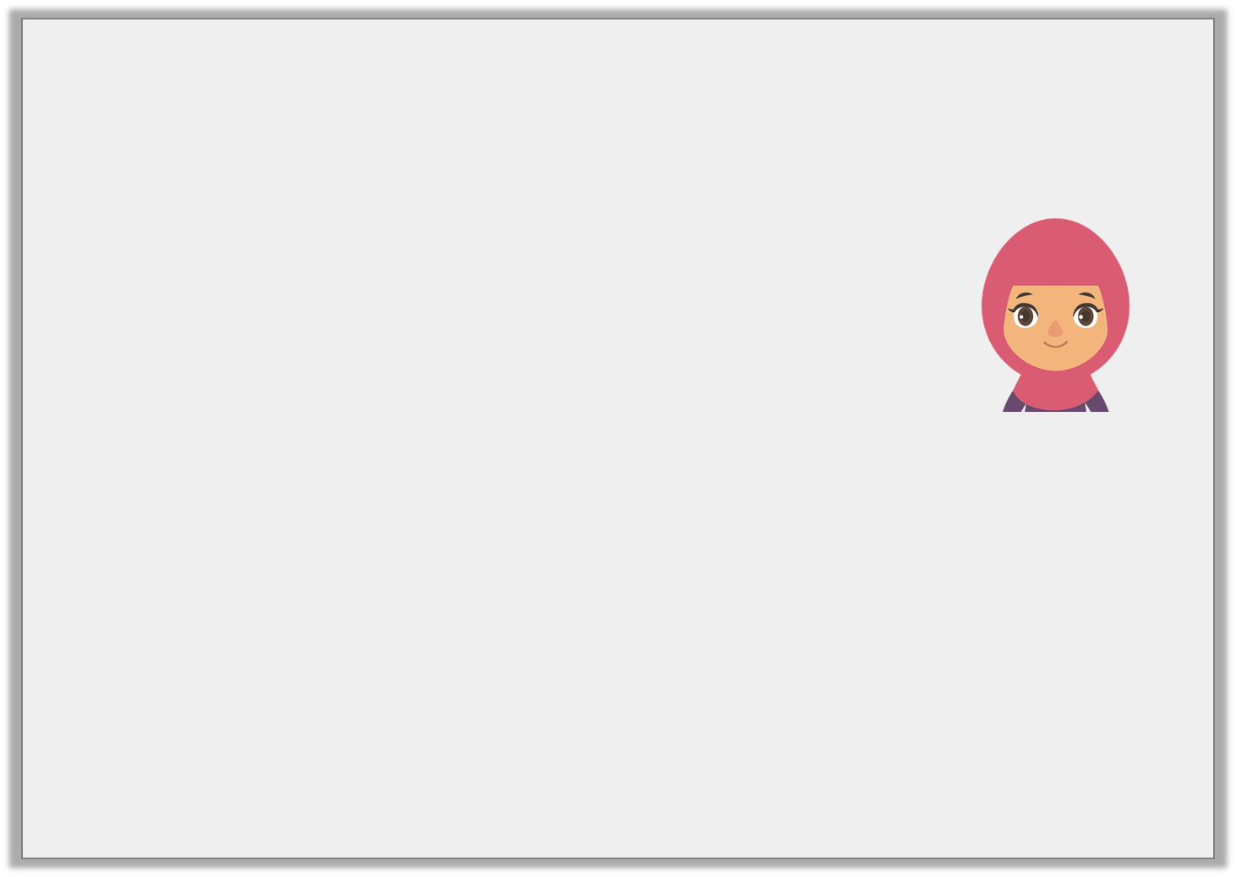
Problem Solving 2
Aliza is counting back on a number line.
Give two possibilities.
I start on 6 and end on a number less than 2. How many have I counted back?
0 | 1 | 2 | 3 | 4 | 5 | 6 | 7 | 8 | 9 | 10
Y1
© Classroom Secrets Limited 2018

Slide 25
Problem Solving 2
Aliza is counting back on a number line.
Give two possibilities.
Various answers; for example: 5
I start on 6 and end on a number less than 2. How many have I counted back?
0 | 1 | 2 | 3 | 4 | 5 | 6 | 7 | 8 | 9 | 10
Y1
© Classroom Secrets Limited 2018

Slide 26

Reasoning 1
Sarah has 8 sweets to share.
She gives 2 sweets to Millie.
She gives 3 sweets to Natasha.
How many sweets does she have left?
Use the number line to help you.
0 | 1 | 2 | 3 | 4 | 5 | 6 | 7 | 8 | 9 | 10
Y1
© Classroom Secrets Limited 2018

Slide 27
Reasoning 1
Sarah has 8 sweets to share.
She gives 2 sweets to Millie.
She gives 3 sweets to Natasha.
How many sweets does she have left?
Use the number line to help you.
Sarah has…
0 | 1 | 2 | 3 | 4 | 5 | 6 | 7 | 8 | 9 | 10
Y1
© Classroom Secrets Limited 2018

Slide 28
Reasoning 1
Sarah has 8 sweets to share.
She gives 2 sweets to Millie.
She gives 3 sweets to Natasha.
How many sweets does she have left?
Use the number line to help you.
Sarah has 3 sweets left;
8 – 2 = 6,
6 – 3 = 3
0 | 1 | 2 | 3 | 4 | 5 | 6 | 7 | 8 | 9 | 10
Y1
© Classroom Secrets Limited 2018

Slide 29
Reasoning 1
Explain the mistake below.
Tens | Ones
10
10
10
10
1
1
1
10
10
10
10
1
1
85 – 51 = 43
Y2
© Classroom Secrets Limited 2018

Slide 30
Reasoning 1
Explain the mistake below.
The calculation is incorrect because…
Tens | Ones
10
10
10
10
1
1
1
10
10
10
10
1
1
85 – 51 = 43
Y2
© Classroom Secrets Limited 2018

Slide 31
Reasoning 1
Explain the mistake below.
The calculation is incorrect because the tens and the ones have been mixed up. The answer should be 34, not 43.
Tens | Ones
10
10
10
10
1
1
1
10
10
10
10
1
1
85 – 51 = 34
Y2
© Classroom Secrets Limited 2018

Slide 32
Problem Solving 1
Toby has subtracted a number from 94. He has put counters into a place value chart to show his answer.
What number did he subtract?
Tens | Ones
10
10
10
10
1
1
1
Y2
© Classroom Secrets Limited 2018

Slide 33
Problem Solving 1
Toby has subtracted a number from 94. He has put counters into a place value chart to show his answer.
What number did he subtract?
51
Tens | Ones
10
10
10
10
1
1
1
Y2
© Classroom Secrets Limited 2018

Slide 34
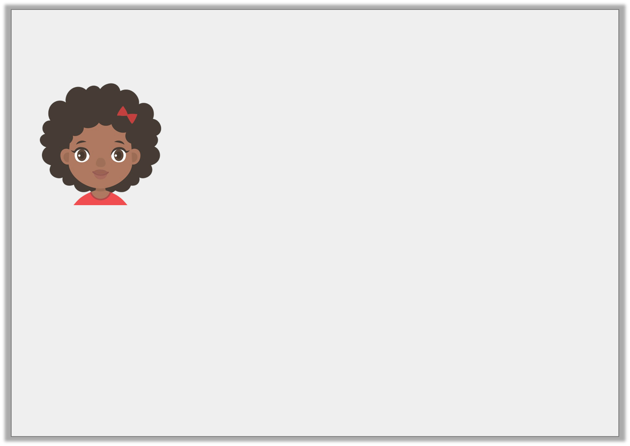
Reasoning 2
Freya says this about the calculation below..
Is Freya correct? Explain your answer.
The answer is 50, because if I subtracted 2 tens from 7 tens I would have 5 tens left.
 | 7 | 9
– | 2 | 2
Y2
© Classroom Secrets Limited 2018

Slide 35
Reasoning 2
Freya says this about the calculation below..
Is Freya correct? Explain your answer.
Freya is incorrect because…
The answer is 50, because if I subtracted 2 tens from 7 tens I would have 5 tens left.
 | 7 | 9
– | 2 | 2
Y2
© Classroom Secrets Limited 2018

Slide 36
Reasoning 2
Freya says this about the calculation below..
Is Freya correct? Explain your answer.
Freya is incorrect because she has only subtracted the tens. She has forgotten to subtract the ones. The answer should be 57, not 50.
The answer is 50, because if I subtracted 2 tens from 7 tens I would have 5 tens left.
 | 7 | 9
– | 2 | 2
Y2
© Classroom Secrets Limited 2018

