Slide 1



R2f. Uses knowledge of vocabulary and context to give meaning to new language.
Commissioned by The PiXL Club Ltd.
October 2017
This resource is strictly for the use of member schools for as long as they remain members of The PiXL Club. It may not be copied, sold nor transferred to a third party or used by the school after membership ceases. Until such time it may be freely used within the member school.
All opinions and contributions are those of the authors. The contents of this resource are not connected with nor endorsed by any other company, organisation or institution.
© Copyright The PiXL Club Limited, 2017

Slide 2
Teachers’ Notes
This therapy is designed to provide children with some strategies to work out the meaning of unfamiliar words which they come across.
The key strategies which are modelled are: using context clues; using antonyms and synonyms; using root words and antonyms/synonyms and finding links to words already known.
Alongside the modelling, there are opportunities for the pupils to practise the strategies themselves.
Once the therapy has been delivered, encourage and remind the children to make these strategies a regular part of their independent or guided reading.

Slide 3
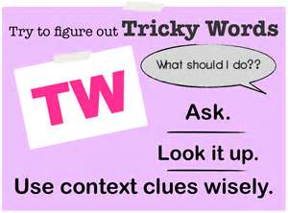
Finding the meaning of words.
Sometimes, when we are reading, we might come across a word or phrase we don’t understand and might not have seen before. We are going to learn about strategies which we can use to try to work out the meaning.
Strategies we will explore:
Using the context of the word.
Using antonyms and synonyms.
Using roots words, prefixes and suffixes.
Links to words already known.

Slide 4
Context clues are clues which come from the surrounding words in a sentence.
Discuss what could go in the space.
Jimmy …….. home.
There are many possibilities because there is not much information in the sentence. However, if we provide more context, we could be more precise.
Now, discuss what could go in the space.
Jimmy …….. home because he was so excited about the puppies.
With more context, we can be more precise about our word choice. The information about puppies directs us to a word like ‘sprinted’ because it is how Jimmy may get home if he is excited.

Slide 5
Using the context of a word to work out the meaning.
The letter was confidential, so he couldn’t tell anyone.
If he couldn’t tell anyone, it suggests it was a secret or something he had to keep to himself.
Using the information in the sentence, can we work out what the underlined word means?
To test my guess, I could put my words in place of the underlined word. Does it still make sense?
The letter was secret, so he couldn’t tell anyone.
Confidential: intended to be kept secret

Slide 6
Your turn: use the context to work out the meaning of the underlined word. Remember to test it in the sentence to see if it makes sense.
She knew she was innocent, but she still felt as if she had done something wrong.
not guilty of an offence
Luckily, Kim was very tolerant, so the different opinions in her group didn’t upset her.
willing to accept the opinions of others
It was a solemn occasion so they couldn’t laugh.
formal or serious
His fear of spiders made him very wary of them.
showing caution about possible dangers

Slide 7
Your turn: finding the meaning of words.
Look at the sentences below. Use the context to decide which of the choices is the correct meaning of the underlined word.
If only he knew what he would do when he grew up. Perhaps he should visit a prophet?
a) witch b) a teacher c) someone who tells the future
c
She burst into tears and put her head in her hands when she read the malicious text.
a) nasty b) interesting c) exciting
a

Slide 8
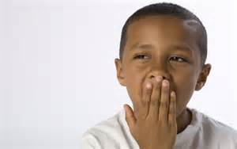
Using synonyms to work out the meaning.
Synonyms are words which have a similar meaning. For example, some synonyms for lovely are: adorable, exquisite, attractive and appealing. If we can think of synonyms to replace the unfamiliar word, it can help with the meaning. Take care to choose an appropriate synonym. For example, ’the meal was lovely’ makes sense. However, ‘the meal was attractive’ doesn’t work as well.
Example:
I was conscious that I was boring him, as he was yawning.
Can you think of a synonym for ‘conscious’? From the context, the person knows that he/she is boring the boy. A synonym could be ‘aware’. If I put the synonym into the sentence, does it make sense?
I was aware that I was boring him, as he was yawning.

Slide 9
Can you think of some synonyms for the underlined word (or use a thesaurus if necessary)?
He knew had eaten sufficient food as he was full up.
When they were climbing the mountain, Josh was a hindrance and slowed them down.
As an amateur athlete, she had to go out to work to earn a living.
In his leisure time, he liked to escape to the peace of the river and go fishing.

Slide 10
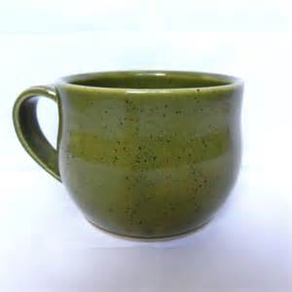
Using antonyms to work out the meaning.
Antonyms are words which have the opposite meaning. For example, the antonym of happy is sad. We can check our choices by replacing the tricky word with the antonym.
Example:
I knew the cup wasn’t fragile when I felt the sturdy handle and thick sides.
As we are told the reason she knows the cup isn’t fragile is because it is sturdy, this must mean fragile means the opposite of sturdy. So it must mean something like ‘delicate’.
I knew the cup wasn’t delicate when I felt the sturdy handle and thick sides. (This makes sense.)

Slide 11
Can you use antonyms to work out what the underlined word might mean?
Jane knew the woman wasn’t reliable when she was late for the third time running.
Leroy clearly wasn’t curious to solve the puzzle; he peeped at the answers.
The information wasn’t relevant to answering the question, so they ignored it.
When they visited the town, it wasn’t familiar to them so they got lost.

Slide 12
Using root words, prefixes and suffixes
Sometimes we can work out what a word might mean by recognising root words and understanding prefixes and suffixes.
unobservant
I recognise the root ‘observe’. I know this means to look at something.
The prefix ‘un-’ makes the meaning opposite.
The suffix ‘ant’ makes the verb into an adjective.
So, unobservant means that someone is not observant.
un-
observe
-ant
prefix
root
suffix

Slide 13
Your turn: try to work out the meaning of each word by identifying the root words and/or prefixes and suffixes
inelegant
not elegant or graceful
infrequently
not very often
transmittable
can be transmitted (sent)
inconsiderate
not considerate/don’t think about others

Slide 14
Links to words already known.
Sometimes, unfamiliar words may link to words we already know. If we know that the word ‘nation’ means country, then words within the same family are easier to understand.
nation
international
nationality
national
nationalism

Slide 15
Your turn: try to create word families by adding prefixes and suffixes. How does this help you to understand the tricky words?
legal
vision
perfect

Slide 16
So, when you come across unfamiliar words in your reading, try some of these strategies to work out the meaning. You can try:
Using the context clues – look for clues in the text to help with the meaning.
Replacing the word with a synonym or an antonym – does it make sense?
Identifying root words, prefixes and suffixes.
Check if there are words you already know which link to the unfamiliar word.

