Slide 1
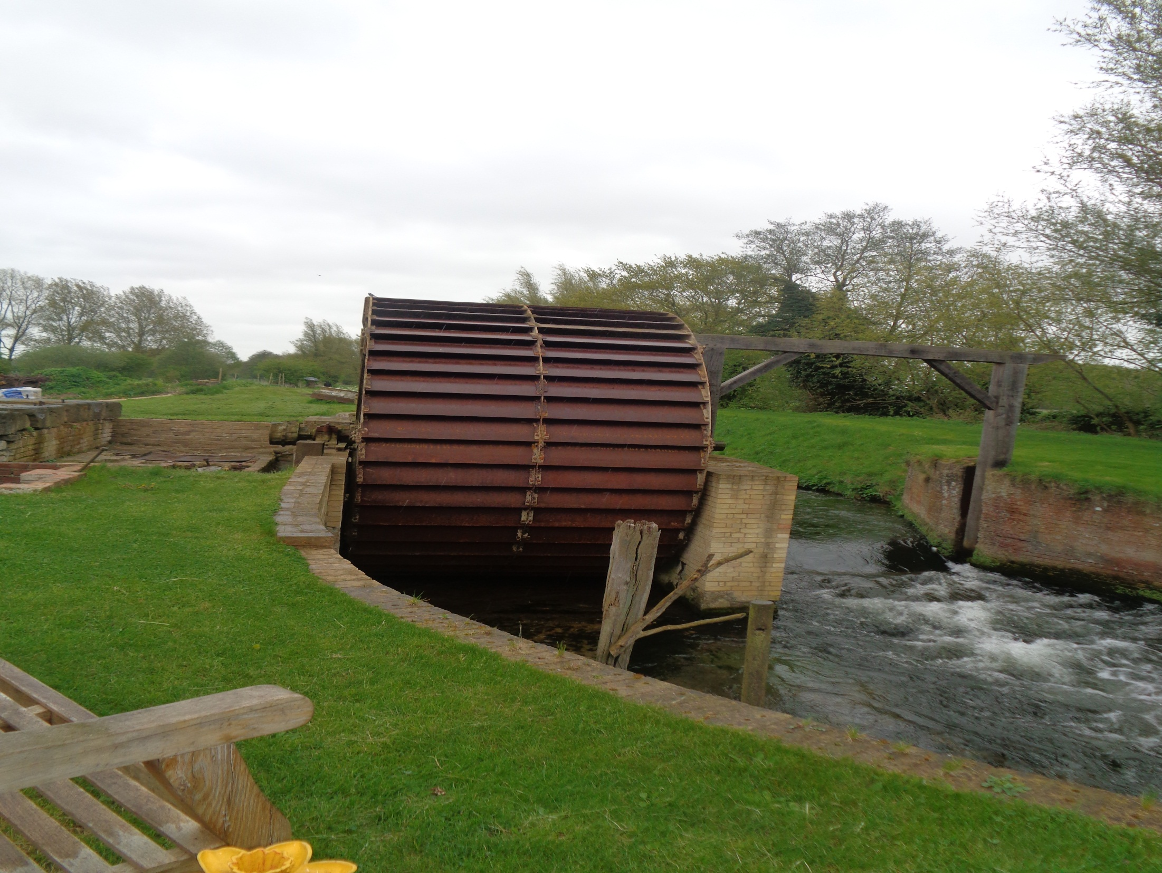
Bone Mill visit
Wednesday 2nd May 2018

Slide 2
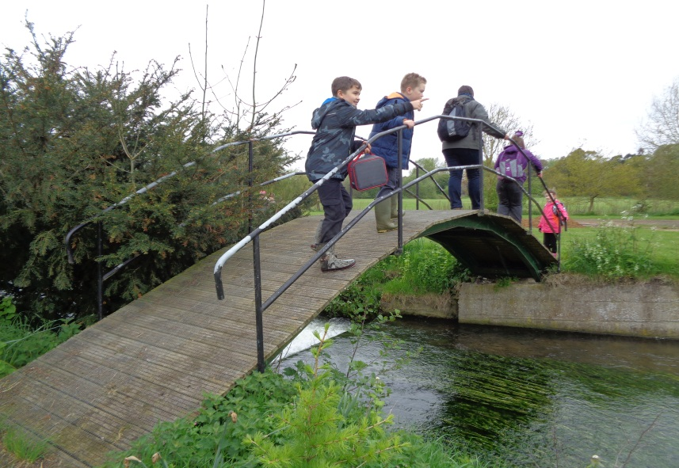
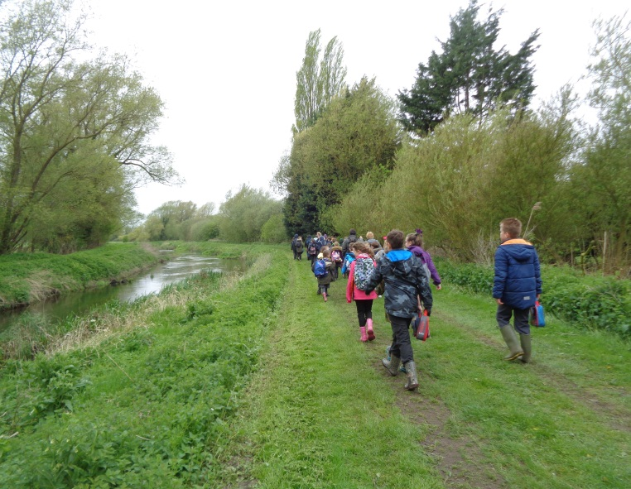
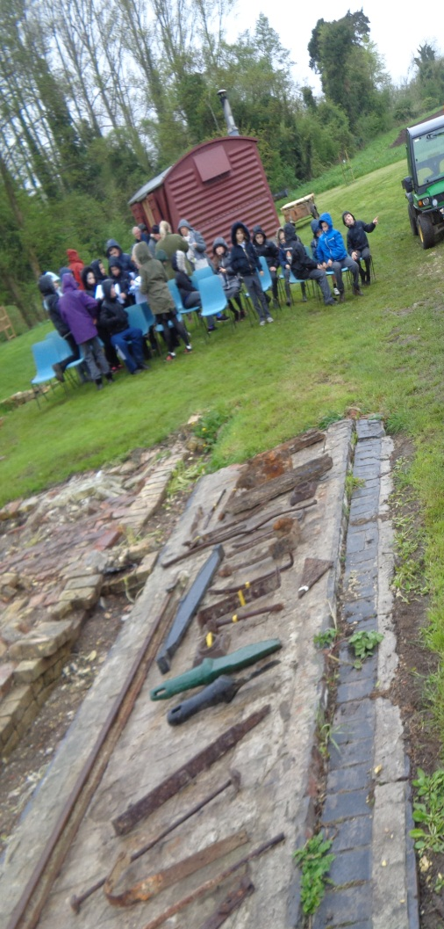
Years 3, 4 and 5 braved the weather to experience a fantastic day at the Bone Mill. We set off from school with a steady pace and soon arrived at our destination.
As soon as we arrived we were greeted with refreshments and a warm welcome from the volunteers.

Slide 3
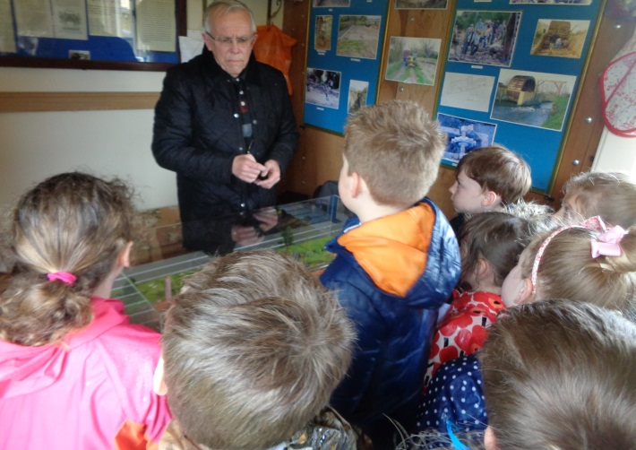
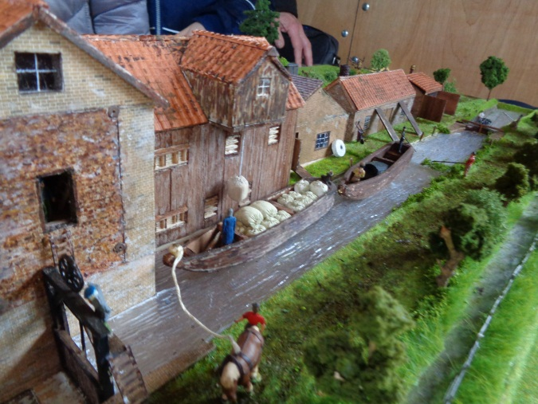
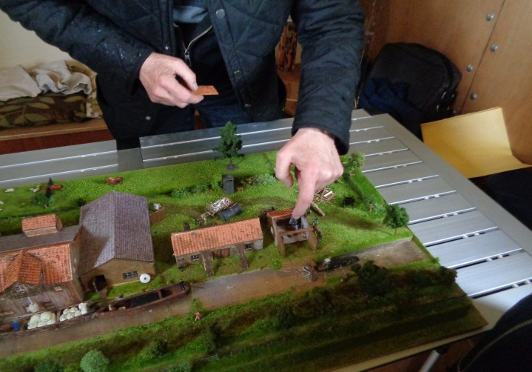
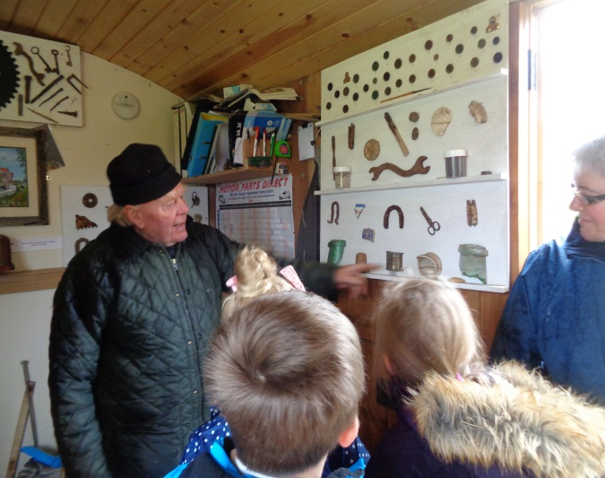
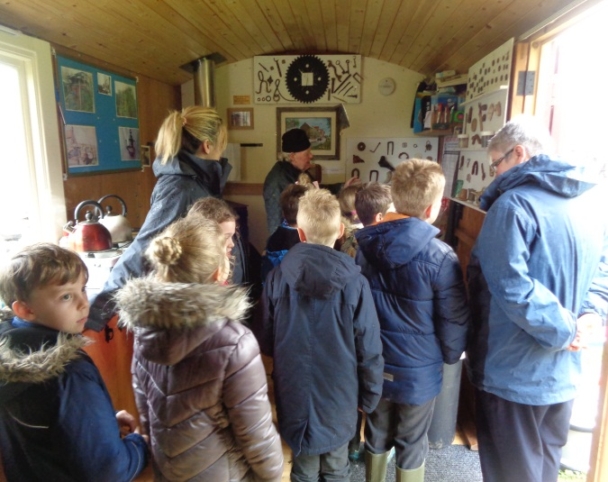
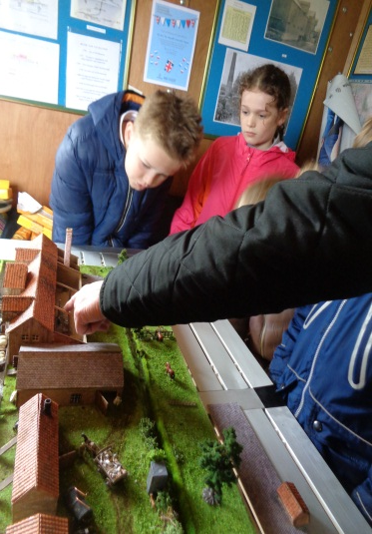
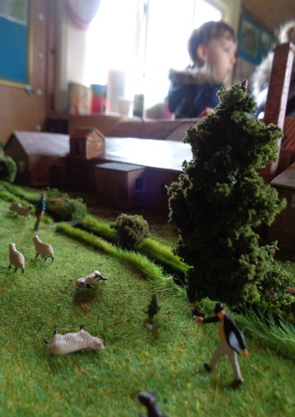
During the day the children took part in a variety of activities.
We looked at David Turner’s wonderful model of the Bone Mill and Frank talked to the children about the finds displayed in the hut.

Slide 4
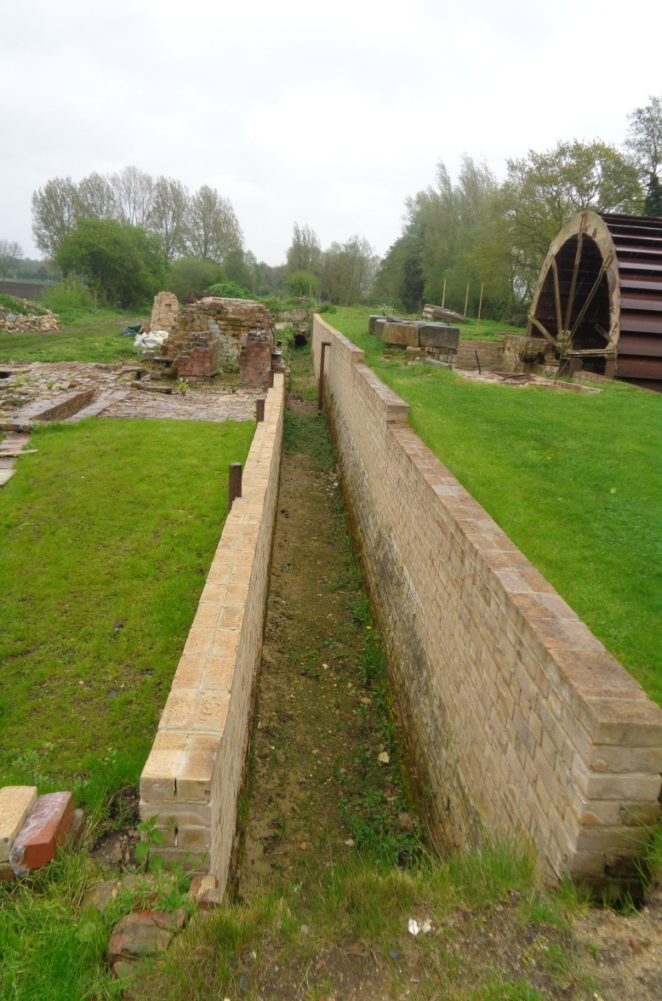
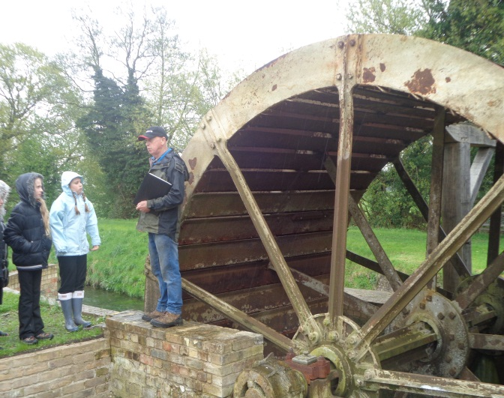
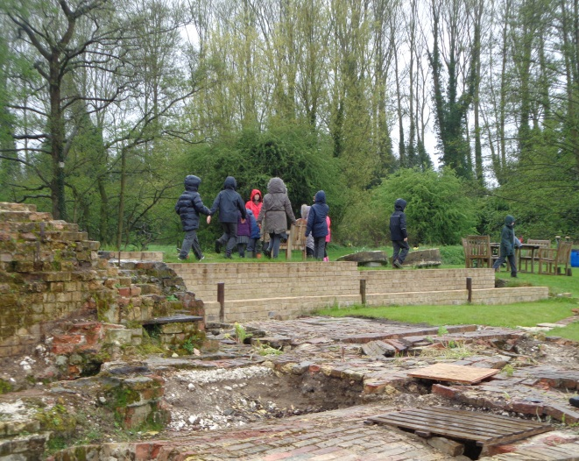
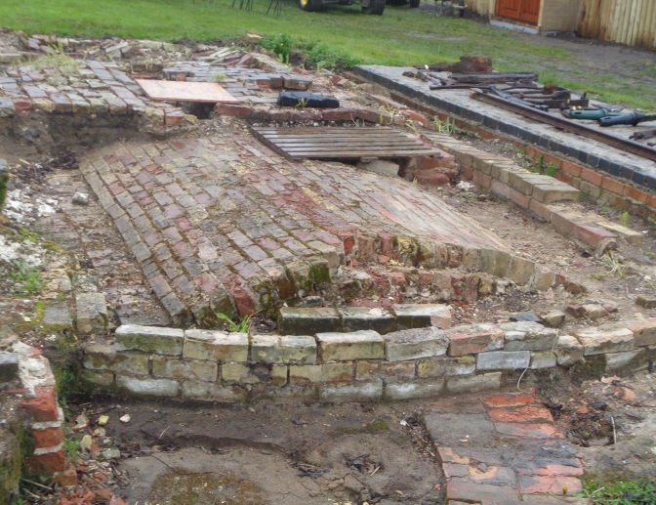
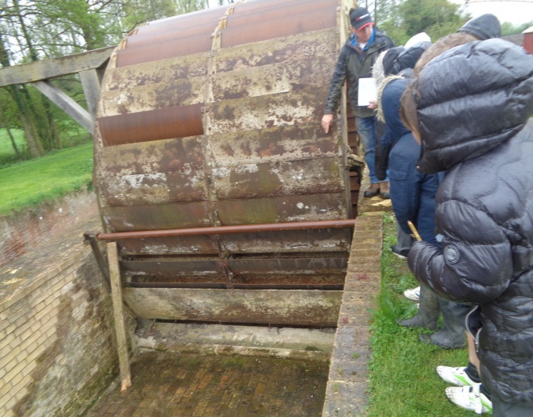
During the day the children took part in a variety of activities.
We spent some time being shown the excavated parts of the Bone Mill during a tour of the site. It was fascinating to see all the hard work the volunteers put into the upkeep.

Slide 5
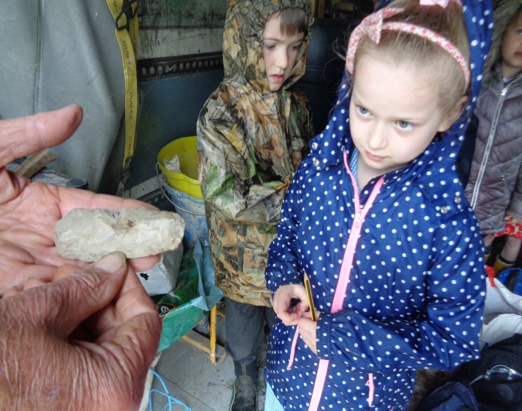
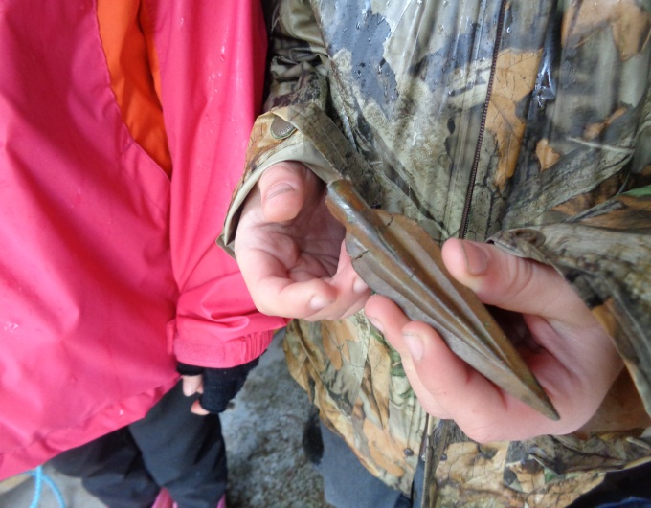
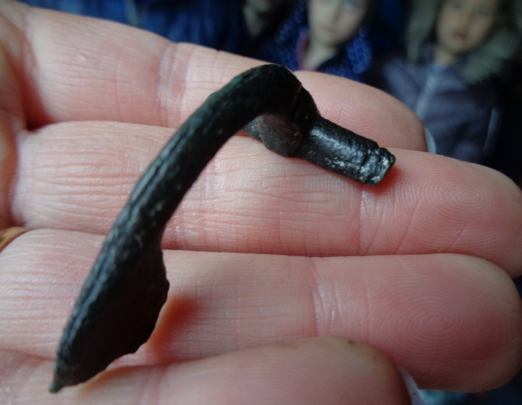
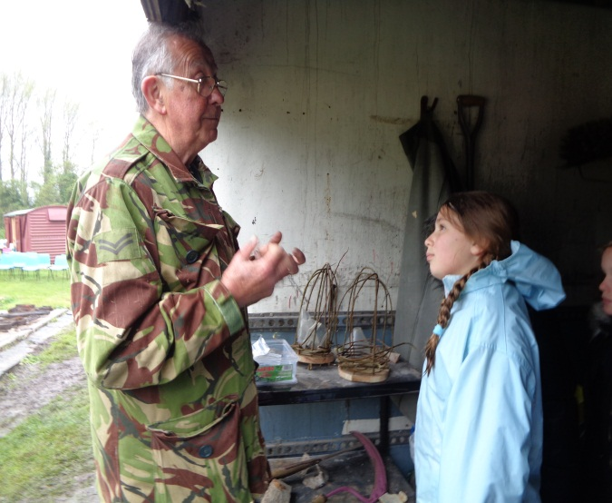
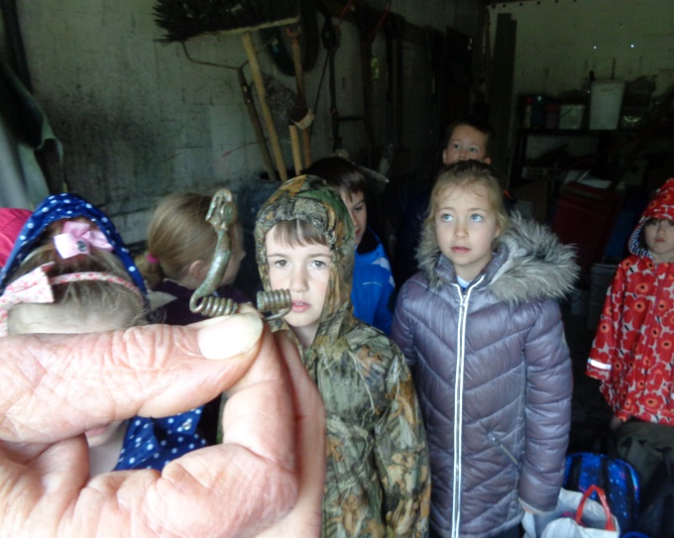
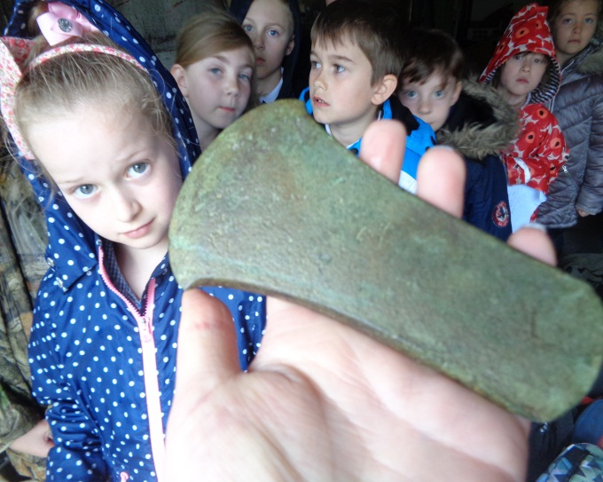
During the day the children took part in a variety of activities.
Unfortunately the weather was not suitable for us to go metal detecting, however, Barry did show us some of the amazing artefacts he had found on the site.

Slide 6
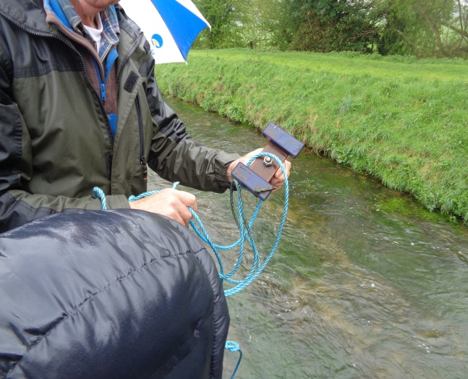
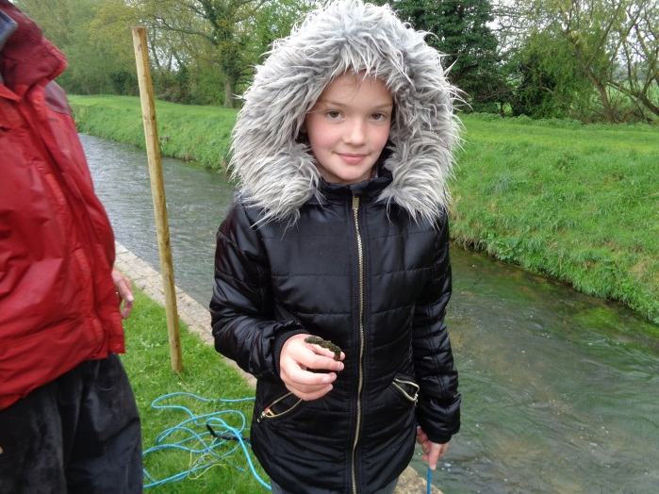
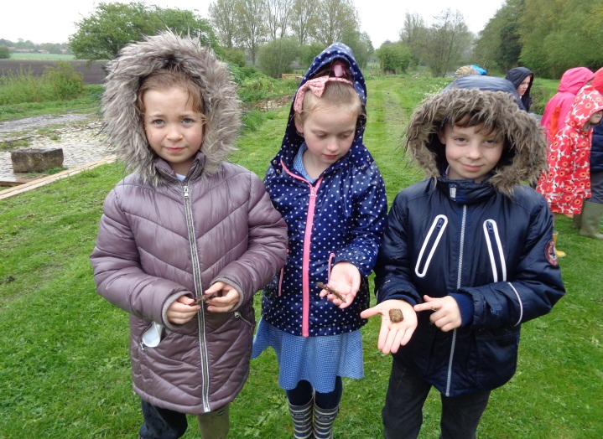
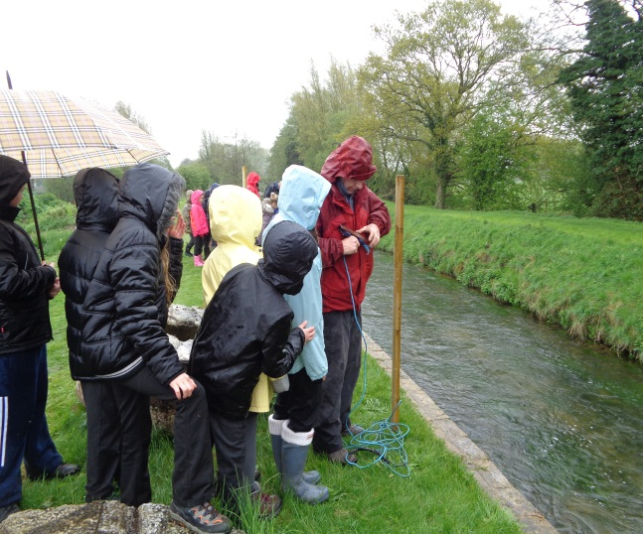
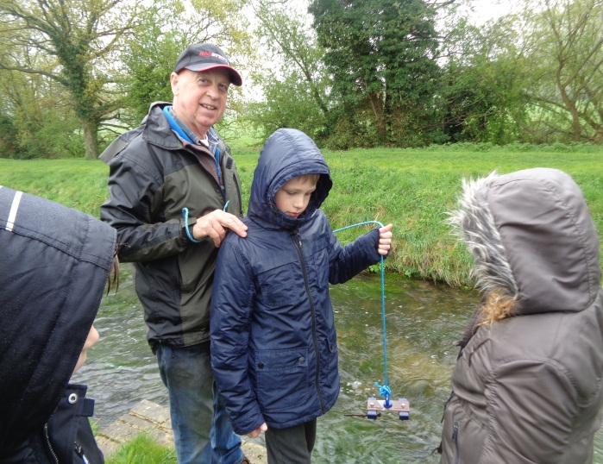
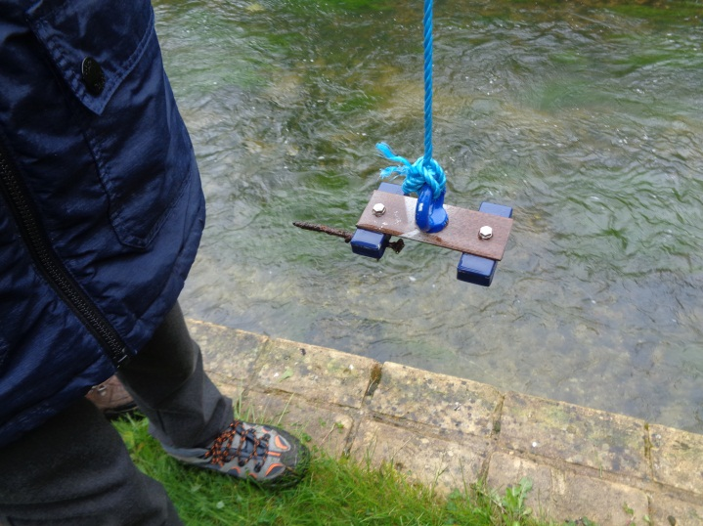
During the day the children took part in a variety of activities.
Magnet fishing proved to be a highlight for many of us, especially when we managed to ‘catch’ some of the lost nails from the original Bone Mill wheel!

Slide 7
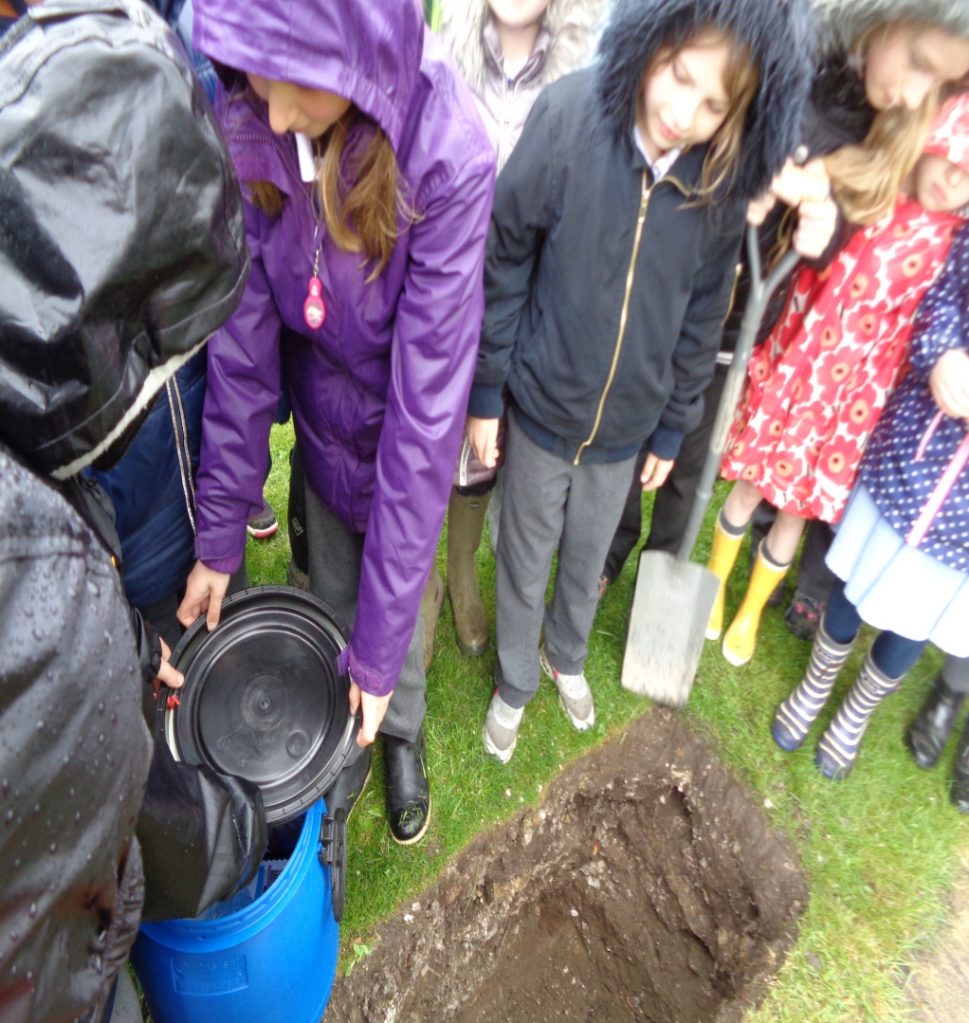
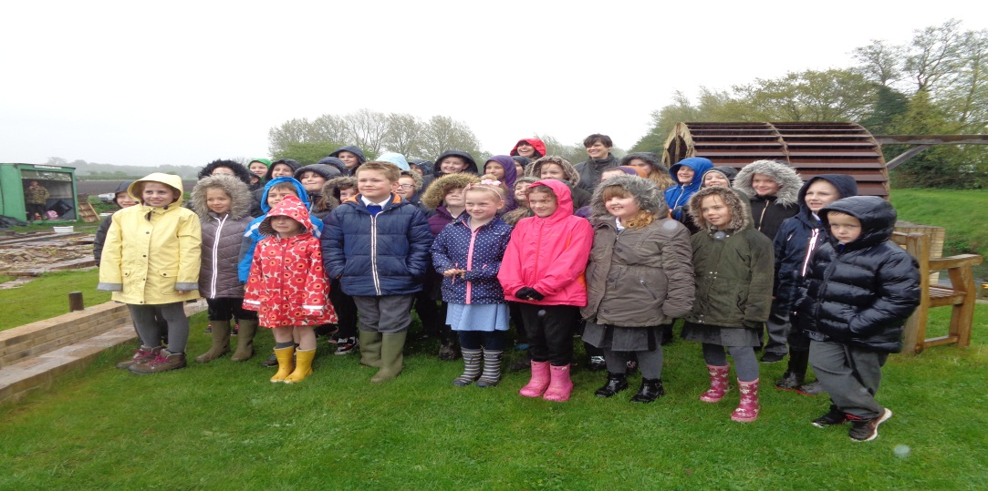
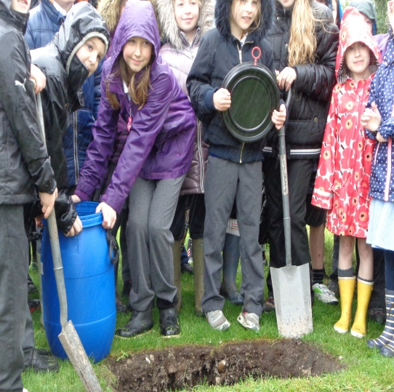
During the day the children took part in a variety of activities.
Thank you!
We were also privileged to have been invited to take part in the burying of a time capsule.

